Slide 1

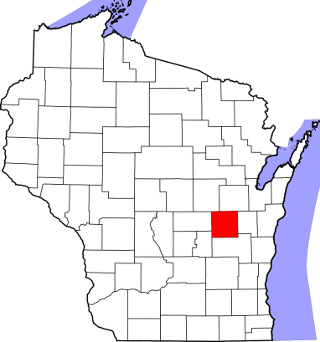

The “Age Wave”
How prepared is your community?
?
Notes:
A key question: “How prepared are our communities for what has been referred to in the popular media as the “age wave” ? …referring, of course, to the increasing number of older persons…due largely to the aging of the “baby boom” generation.
The image in this slide - of wave “engulfing” our state - could be viewed in a negative light; meaning that the increasing number of older persons is not a welcome trend. We do not mean to convey this message! There are many positive community impacts that may result from an increasing number of older persons. Older persons represent what is often an untapped resource for many communities, particularly in terms of their potential for swelling the ranks of much needed volunteer efforts in schools, hospitals, and community service agencies.
The “wave” image in this slide is used primarily to convey the immensity of the demographic change about to occur, and a sense of urgency in preparing for it.

Slide 2

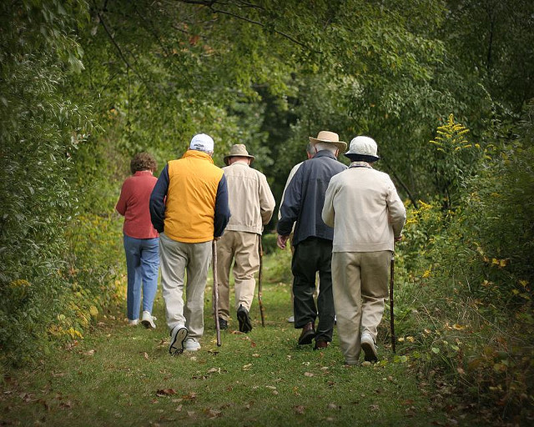
Aging in Place
Americans want to age in place.
Communities will have to adapt.
Notes:
Contrary to popular belief and stereotype, only a minority of older adults actually move to warmer climates upon retirement. Most remain in their own homes and communities as they age. In fact, the majority of people retire where they spend the final years of their career.
Between 2011 and 2012, for example, only about 3 percent of people age 65 and older moved; compared to 14 percent of people under 65. And most of those age 65 and older who did move stayed in the same state (83 percent) and the same county (61 percent). During this period of time, only 16 percent of people who moved after age 65 relocated out of state or abroad.
With this in mind, every community - rural or urban - will have to adapt to an increasingly older population.
SOURCES:
UW Extension Applied Population Lab: Net Migration Patterns for US Counties: http://www.netmigration.wisc.edu/
Internal Migration of the Older Population: 1995-2000 (issued August 2003), by Wan He and Jason Schachter, US Census Bureau.
National Association of Area Agencies on Aging and Partners for Livable Communities (2006). The Maturing of America - Getting Communities on Track for an Aging Population. http://www.n4a.org/pdf/MOAFinalReport.pdf

Slide 3
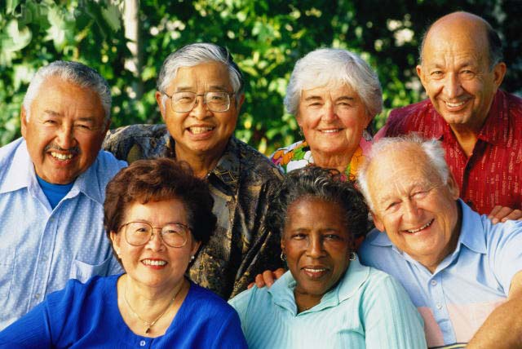
How prepared are our communities for the impacts of a rapidly aging population?
Nation’s Aging Population Booms
10,000 Americans are turning 65 every day…a trend that will continue for the next 20 years!
Notes:
With the much heralded aging of the baby boomers, it is no surprise that the number of persons age 65 and older will significantly increase over the next 30 years. A number of news articles in the last year or so have highlighted the nation’s “aging boom”. With the aging of the Baby Boom generation, 10,000 Americans are turning 65 every day….a trend that will continue for the next 20 years. This slide shows one example: A USA Today headline entitled, “Nation’s aging population booms”.
QUESTION: How prepared are our communities for the impacts of a rapidly aging population?
Note: “Each day,10,000 baby boomers retire and begin receiving Medicare and Social Security benefits.”
–Sen. Rob Portman (R-Ohio), writing in The Wall Street Journal, July 22, 2014.
There were 76 million people born between the years 1946 and 1964, the traditional window for the baby boom generation. That means that they will retire over a 19-year period. Simple math shows that 76 divided by 19 is 4 million, or almost 11,000 people a day. While a certain percentage will die before they reach retirement age, analysts say that immigrants will actually boost the number of potential baby-boomer retirees to nearly 80 million —and not everyone retires exactly at 65 or 66. Some baby boomers likely retired at 62. So let’s say it’s 80 million over 20 years—which still yields 4 million a year. Thus, as a simple round figure, 10,000 a day is pretty close. In fact, that a number used by the Social Security Administration in a 2012 report, which Portman spokeswoman Caitlin Conant said was a source used by the senator. She also cited a Pew Research Center report that used this figure.
Indeed, in a 2013 report, the Social Security Administration said that the wave of baby boom retirements was a significant problem for the agency itself: “By 2015, almost 33 percent of our workforce, including 48 percent of our supervisors, will be eligible to retire. In FY [fiscal year] 2011, we lost over 4,000 employees due to retirement and other reasons. We expect this trend to continue. During this same timeframe, the baby boomer retirement wave continues to have a significant effect on our workloads.”

Slide 4
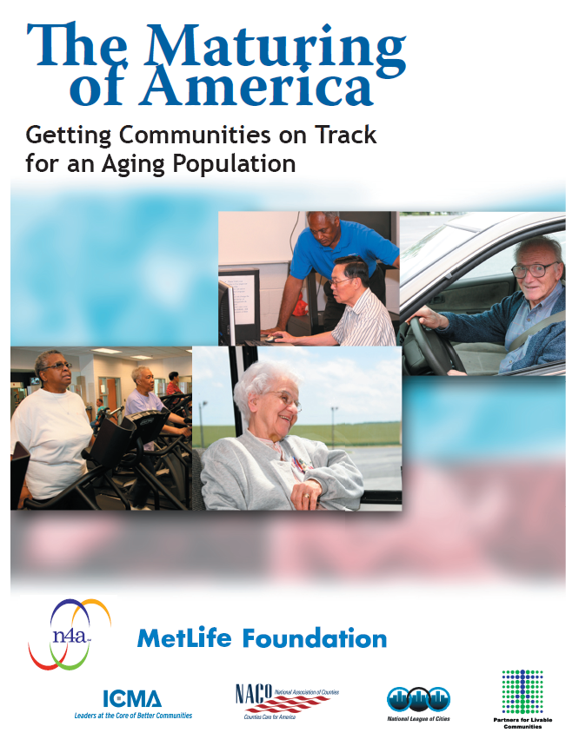
2005 National Survey of
10,000 Communities
National Association of Area Agencies on Aging (n4a) and the MetLife Foundation
What percentage of communities in the
United States have
started to plan for the impacts of population aging?
Notes:
To find an answer to this question, in 2005, the National Association of Area Agencies on Aging – together with several partners (e.g. the MetLife Foundation) – conducted a national survey of 10,000 communities wherein the focus was on assessing the extent to which American communities had begun to plan for population aging.
Ask participants: Of those communities that responded to the Survey, what percent do you think indicated that they had started to plan for the impacts of population aging?
HANDOUT: Included in the handout packet is a copy of the front page of this report, and the first page of the executive summary.

Slide 5
Finding:
Fewer than 46% of communities have begun to assess their “aging-readiness” and prepare for the impacts of an aging population.
Notes:
A key finding in a report published in 2006 (Maturing of America: Getting Communities on Track for an Aging Population) was that fewer than half (46%) had even begun to prepare for this important demographic trend. The report stated that “Although many communities have some programs to address the needs of older adults, few have undertaken a comprehensive assessment to make their communities ‘aging-friendly’ or livable for people of all ages.”
NOTE: Report may be found online at: http://www.n4a.org/pdf/MOAFinalReport.pdf
“Although many communities have some programs to address the needs of older adults, very few have undertaken a comprehensive assessment to make their communities ‘aging-friendly’ or livable for people of all ages.”

Slide 6
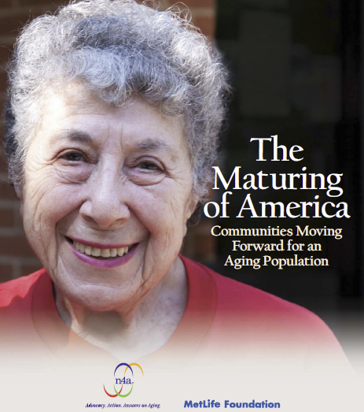
2010 Follow-Up Survey
Reported that…
“only limited progress
in advancing the goal of preparing for an aging population.
Many communities are struggling just to maintain the status quo.”
Notes:
A follow-up survey was conducted in 2010, and revealed that only limited progress had been made in becoming aging-ready. As a result of the severe economic challenges associated with the recession, most communities have been able only to “hold the line”— maintaining policies, programs and services already established. They have not been able to move forward to the degree needed to address the nation’s current “age wave.”
Source: National Association of Area Agencies on Aging (2011). The Maturing of America: Communities Moving Forward for an Aging Population, Washington, D.C. Website: http://www.n4a.org/files/MOA_FINAL_Rpt.pdf

Slide 7
Questions to Guide Discussion:
What are some indicators of population aging?
What are some of the impacts of population aging on our communities?
What are the key attributes or characteristics of “aging-friendly” communities?
What steps can a community take to become more aging-friendly? What survey instruments can be used for an initial assessment?
What resources are available for communities?
Notes:
Here is a list of five questions that will guide our discussion today. We will begin with a focus on population aging.
(NOTE: This is a sample slide only. The questions to be addressed will vary with the setting, time constraints, and target audience).

Slide 8


Measures of Aging
Individuals
Entire Populations
What are some ways of measuring the aging of individuals?
What are some ways of measuring the aging of entire populations?
Notes:
What are some ways used to measure the aging of individuals? Chronological age (birthdays). Functional/physical age (ability to perform activities of daily living; physical health; etc.). Psychological age (problem-solving ability).
Just as the aging of individuals can be measured so, too, can the aging of entire populations (i.e. groups of people living in a given geographical area). QUESTION: What are some ways that aging is measured for entire populations?

Slide 9
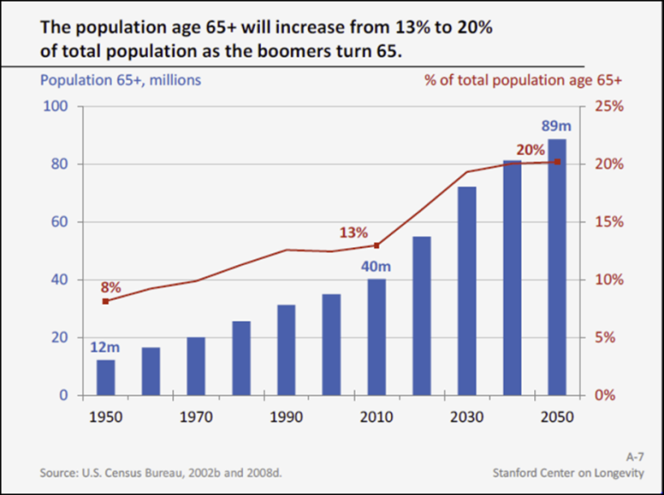
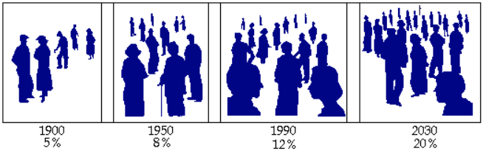
Measures/Indicators of Population Aging
Life expectancy
Number of persons age 65+
Percent of persons age 65+
Median age
Notes:
Possible responses
Average life expectancy
Number of persons age 65 and older
Percent or proportion of persons age 65 and older
The median age of a population (i.e. the age at which half a population are older and half are younger).

Slide 10
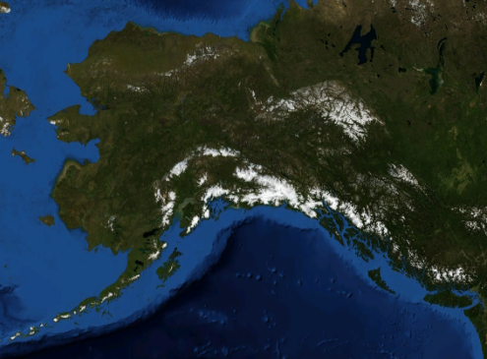
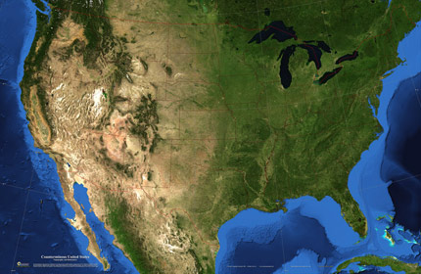
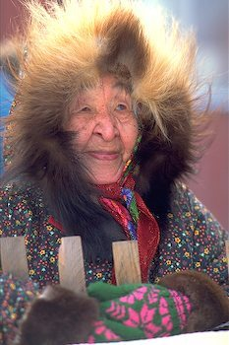
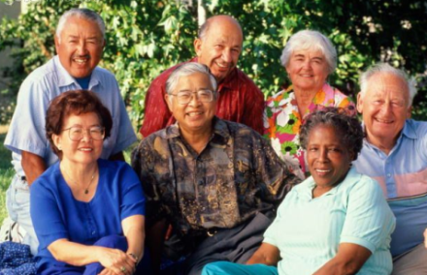

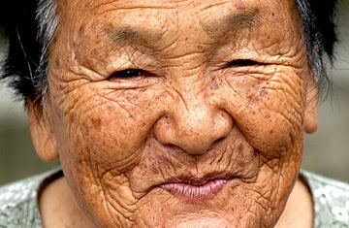
Population Aging in the United States
Notes:
One of the slides showed earlier was headline news indicating that the population in the United States is aging. Although it is certainly not one of the oldest countries in the world, the United States is aging.

Slide 11
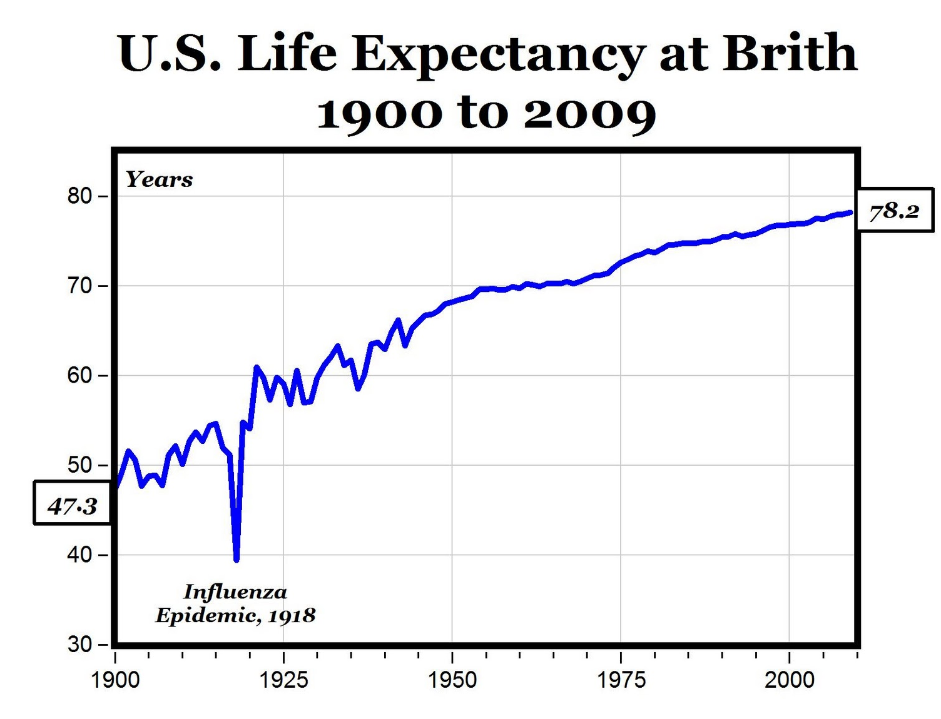
Life expectancy at birth has increased by more than 30 years!
Notes:
One of the great success stories of public health is the significant increase in life expectancy. This line graph shows the increases in life expectancy at birth from 1900 to 2009. For women, 30 years have been added to the average length of life (from 51 to 80); for men, the gain has been 28 years (from 48 to 75).
SOURCE NOTES:
Centers for Disease Control report (March 2011): http://www.cdc.gov/media/releases/2011/p0316_deathrate.html

Slide 12
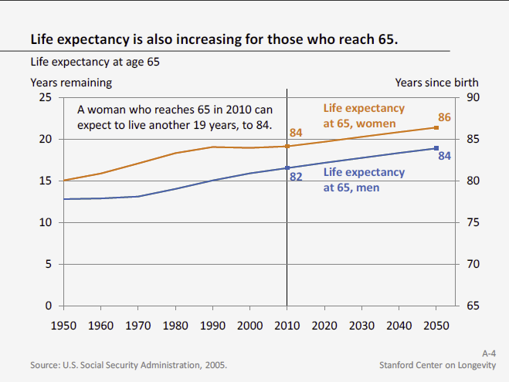
Notes:
Although not as great as the increase in life expectancy at birth, the additional number of years a person lives once they have their 65th birthday has also increased.
The data portrayed in this graph show that in 1950 a man who reached 65 could expect to live 13 more years, to age 78. Today a 65-year-old man can expect to live to 82, or 17 more years….4 years longer.
In the year 2050, it is projected that a man reaching the age of 65 will live – on average – another 19 years…to age 84; a woman will live another 21 years…to age 86.
Note: Higher life expectancy for women creates what some call the “feminization” of aging. Because women live longer, more than half of the 65+ population is female. By 2050, women will represent 55% of the 65+ population and 61% of the 85+ population (U.S. Census Bureau, 2008). Gender differences in aging affect issues across the board, including labor force participation, living arrangements, financial security and care giving.
SOURCE: U.S. Social Security Administration, 2005 (Stanford Center on Longevity)

Slide 13
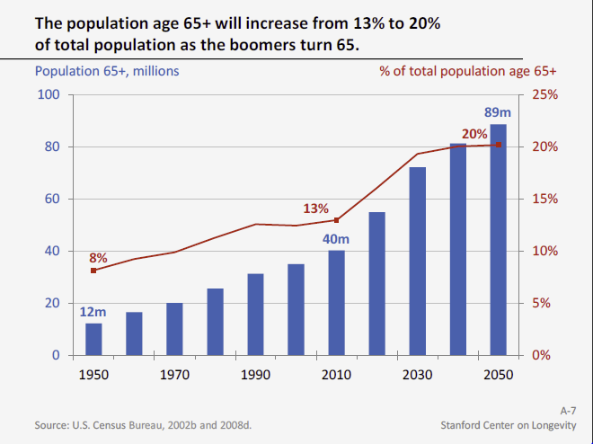
Increase in Number and Percentage
Notes:
The increase in life expectancy has resulted in an increase in the number of persons age 65 and older. In fact, the population age 65+ has been growing steadily since 1950, when there were only 12 million old people. Today there are 40 million people age 65+, but as the boomers turn 65 over the next few decades, this population will more than double, reaching 89 million by 2050.
Several factors contribute to the doubling of the older population:
• The arrival of the baby boom bulge into old age, from 2011 to 2029, will swell the ranks of the 65+ population.
• Increasing life expectancy means that a higher share of people reach the older age brackets.
• Because life expectancy at age 65 continues to increase, those who make it to age 65 live longer, and thus, the population growth is sustained for a longer time.
• The population age 65+ could grow even faster than the Census Bureau forecasts if higher life expectancy gains are achieved through behavioral changes and scientific advances. Based on projections that mortality improvements will accelerate rather than slow, the MacArthur Foundation Research Network on an Aging Society forecasts that the population age 65+ could reach 99 million to 108 million by 2050,
or 12% to 22% higher than the 89 million projected by the Census Bureau (Olshansky et al., 2009).
Source: Stanford Center on Longevity (2010). New Realities of an Older America: Challenges, Changes and Questions. Website: http://longevity.stanford.edu
Not only is the number of older people increasing, but the share or percentage of older people in the population is increasing.
• In 1950, fewer than 1 in 10 people were 65 or older. Today about 13% of the population is 65 or older; by 2050, 1 person in 5 will be 65 or older.
• This increase in the share of the population 65+ occurs because the older population is growing faster than the total population; over the next 40 years, the older population will grow by 120%, compared with 36% for children and 28% for working-age adults.
• After two decades of almost no increase in the proportion of old people, the next 20 years will see a rapid increase from 13% to 20% as the boomers reach 65.
SOURCE: Stanford Center on Longevity (2010). New Realities of an Older America: Challenges, Changes and Questions. Website: http://longevity.stanford.edu

Slide 14
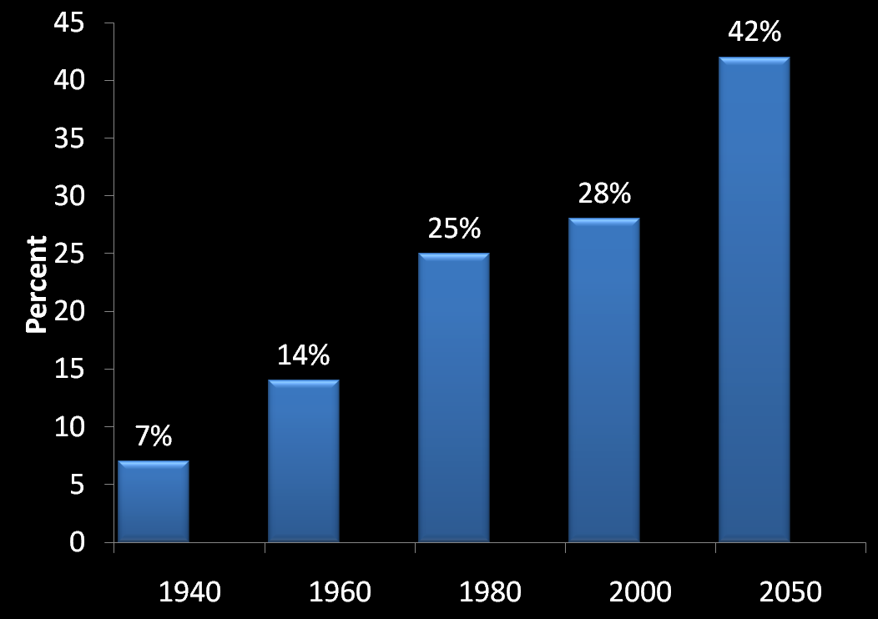
Percentage of Americans Age 65 Expected to Survive to Age 90
Notes:
Not only is the population as a whole getting older, but the old as a group are aging. This graph illustrates that an increasing percentage of those age 65 and older are expected to live to age 90.
NOTE ON HYPERLINK/SOURCE: Clicking on the graph image opens a hyperlink to the source of the information (Fact Sheet on Aging America – Experience Corps) used for the graph: http://www.experiencecorps.org/images/pdf/Fact%20Sheet.pdf

Slide 15
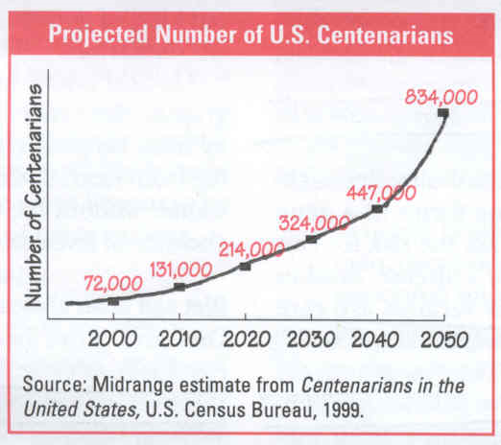


Growth of U.S. Centenarians
Notes:
The previous slide focused on the percentage of Americans age 65 who are expected to survive to age 90. This slide highlights the trend that an increasing number are reaching the 100-year mark. Numbers of US Centenarians are expected to rise exponentially between now and 2050.
The latest Census projection, made in 2003 calls for a US centenarian population of 1.1 million in 2050. That's up from a projection made a few years earlier of 834,000…which is depicted in the graph in this slide.
SOURCE:
There is also a new 2010 report on centenarians in the United States (NUMBER OF CENTENARIANS IN THE UNITED STATES
01/01/1990, 01/01/2000, AND 01/01/2010 BASED ON IMPROVED MEDICARE DATA, by Bert Kestenbaum and B.Reneé Ferguson
Social Security Administration.) Here is the link: http://paa2005.princeton.edu/download.aspx?submissionId=50718

Slide 16

Aging of the
Baby Boomers…
Baby boomers started
turning 65 in January 2011.
Approximately 10,000 of them turn 65 every day — and this will continue for the next 20 years!
2030: 65+ projected to be 72 million people (20% of population.)
2050: 65+ projected to be 80 to 90 million people and those age 85+ close to 21 million
Notes:
SUGGESTION FOR AUDIENCE PARTICIPATION: Ask participants to indicate (either by standing up or raising their hands) how many were born between 1946 and 1964….members of the Baby Boom generation.
Approximately 10,000 people turn 65 every day, a trend that started in January 2011 when the first wave of Baby Boomers turned 65. This will continue for 20 years! (HYPERLINK NOTE: clicking on the underlined link will take you to the source document for this information: “Preparing for the Silver Tsunami”, by the Alliance for Aging Research: http://72.32.160.218/content/article/detail/826 ).
Also see quoate by Sen. Rob Portman: “Each day,10,000 baby boomers retire and begin receiving Medicare and Social Security benefits.” –Sen. Rob Portman (R-Ohio), writing in The Wall Street Journal, July 22, 2014.
Commentary: There were 76 million people born between the years 1946 and 1964, the traditional window for the baby boom generation. That means that they will retire over a 19-year period. Simple math shows that 76 divided by 19 is 4 million, or almost 11,000 people a day. While a certain percentage will die before they reach retirement age, analysts say that immigrants will actually boost the number of potential baby-boomer retirees to nearly 80 million —and not everyone retires exactly at 65 or 66. Some baby boomers likely retired at 62. So let’s say it’s 80 million over 20 years—which still yields 4 million a year. Thus, as a simple round figure, 10,000 a day is pretty close. In fact, that a number used by the Social Security Administration in a 2012 report, which Portman spokeswoman Caitlin Conant said was a source used by the senator. She also cited a Pew Research Center report that used this figure.Indeed, in a 2013 report, the Social Security Administration said that the wave of baby boom retirements was a significant problem for the agency itself: “By 2015, almost 33 percent of our workforce, including 48 percent of our supervisors, will be eligible to retire. In FY [fiscal year] 2011, we lost over 4,000 employees due to retirement and other reasons. We expect this trend to continue. During this same timeframe, the baby boomer retirement wave continues to have a significant effect on our workloads.”
By 2030, almost one out of every five Americans—some 72 million people—will be 65 years or older. By 2050, the 65+ population is projected to be between 80 and 90 million, with those 85 and older close to 21 million.
SOURCE NOTE:
Source: Alliance for Aging Research, 2021 K Street, NW Suite 305, Washington, DC 20006;
tel 202/293-2856 fax 202/785-8574 ; Website link: http://72.32.160.218/content/article/detail/826

Slide 17

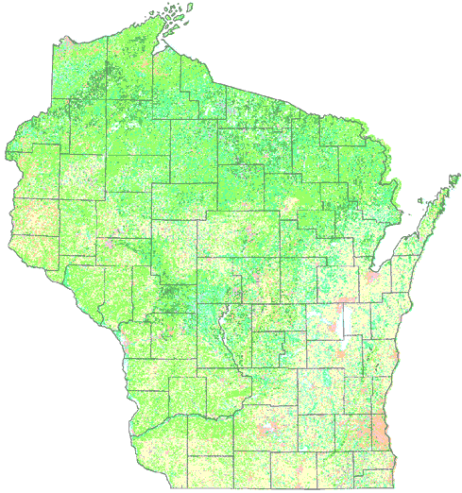

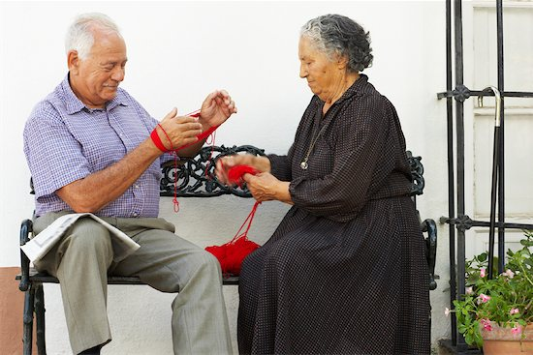
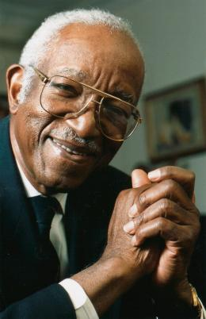
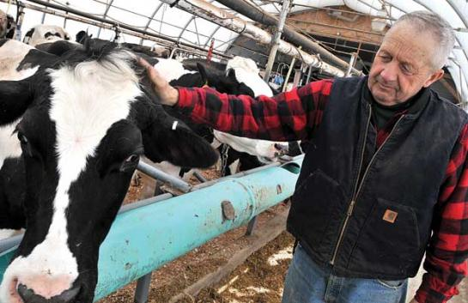
Population Aging in Wisconsin
Notes:
What is happening globally and nationally is also occurring in Wisconsin. A DoA report published in July 2012 highlights population aging in our state. We’ll highlight a few items mentioned in this report.
Source: Eagan-Robertson, D. (2013, December). Wisconsin’s Future Population, Projections for the State, Its Counties and Municipalities, 2010-2040. http://www.doa.state.wi.us/documents/DIR/Demographic%20Services%20Center/Projections/FinalProjs2040_Publication.pdf

Slide 18
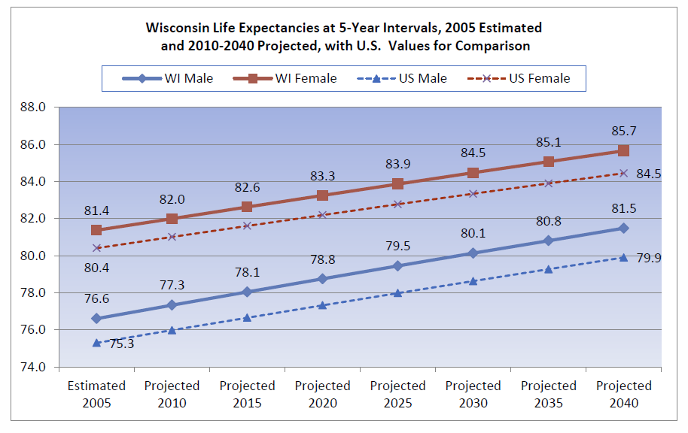
Increasing Life Expectancy
Notes:
As has been the case nationally, residents of Wisconsin are living longer. As can be seen in this line graph, fife expectancies at birth are currently 81 for women and 77 for men. By 2040, these figures will be 86 and 82 respectively. Note: Solid lines are for Wisconsin…dashed lines are for the United States as a whole.
Source: Wisconsin's Future Population: Projections for the State, Its Counties and Municipalities, 2010-2040. Compiled by David Egan-Robertson, UW-Madison Applied Population Laboratory. Prepared for the Wisconsin Department of Administration, Demographic Services Center, December 2013.
http://www.doa.state.wi.us/Divisions/Intergovernmental-Relations/Demographic-Services-Center/Wisconsin-Population-Projections/;

Slide 19
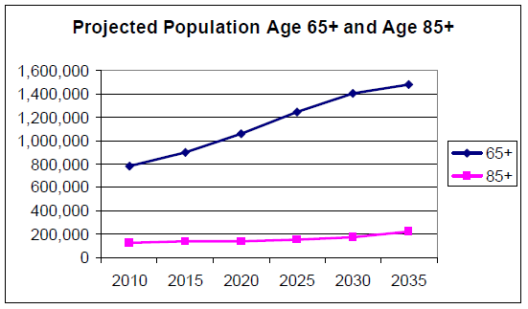
Wisconsin Projections
778,000 to almost 1.5 million
Notes:
The elderly population—age 65 and over—will increase rapidly in every five-year interval, from 777,000 in 2010 to almost 1.5 million in 2035…nearly doubling!
Source: Wisconsin Plan for Older Persons 2010-2012 (http://dhs.wi.gov/aging/Publications/Final%20State%20Plan%2007-24-09.pdf )

Slide 20
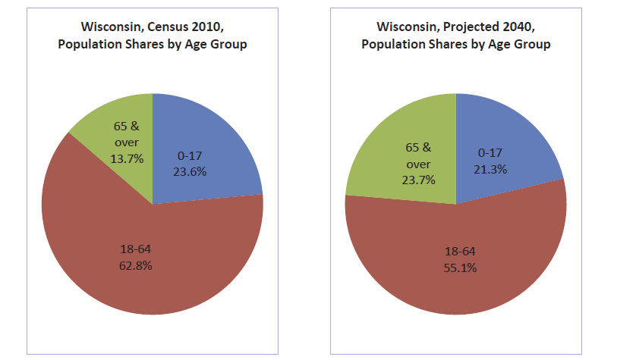


Increasing Proportion of Persons Age 65+ in Wisconsin
2010 (13.7%) to 2040 (23.7%)
Notes:
Consolidating the age groups into three broad categories—under 18, 18 through 64, 65 and older—allows a comparison of the proportion of the population that each group formed at 2010 and is projected to form at 2040. The share of the population ages 0-17 will remain fairly similar, declining only a few percentage points and, numerically, growing only slightly from 1.339 million to 1.367 million. The share of 18-64 year olds is projected to drop more than seven percentage points and, numerically, barely growing from 3.570 million to 3.585 million. Finally, the share of the population age 65 and over will gain more than ten percentage points and, numerically, increase from 770,000 to 1.544 million. What may be suprising to some people is that the number of elderly Wisconsin residents is forecast to exceed the number of children at some point during the latter half of the 2020s.
Source: Wisconsin's Future Population: Projections for the State, Its Counties and Municipalities, 2010-2040. Compiled by David Egan-Robertson, UW-Madison Applied Population Laboratory. Prepared for the Wisconsin Department of Administration, Demographic Services Center, December 2013.
http://www.doa.state.wi.us/Divisions/Intergovernmental-Relations/Demographic-Services-Center/Wisconsin-Population-Projections/;

Slide 21


Percent of Population Age 65+
State Rankings (2010 Census)
Ranked 1st 17.3%
Ranked 22nd 13.7%
Notes:
Wisconsin ranks 22nd in terms of the percentage of the population age 65 and older…with 13.7% ....which is about the same as for the United States (13%).
Not surprisingly, Florida ranks #1 with just over 17% of its population consisting of persons age 65+. Remember this figure (17.3%)…we will refer back to it in a few minutes.

Slide 22
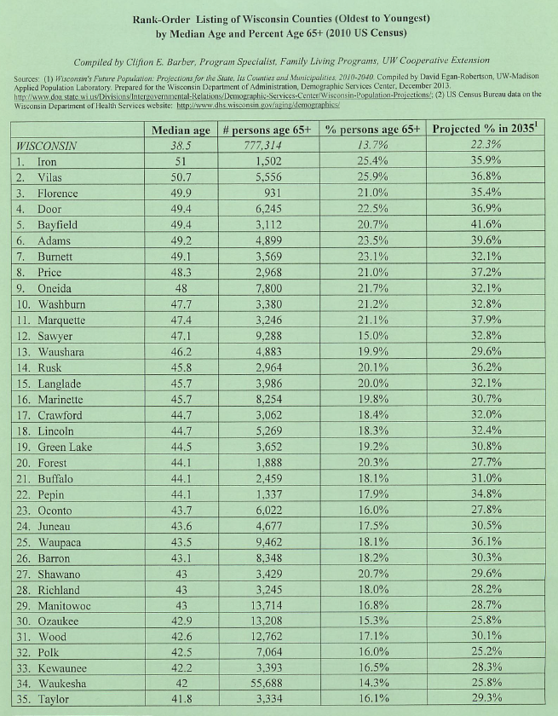
Population Aging in Wisconsin’s Counties Median Age by County (2010 Census)
See Packet Handout
Ten “Oldest” Counties in Wisconsin:
Iron (51.0)
Vilas (50.7)
Florence (49.9)
Door (49.4)
Bayfield (49.4)
Adams (49.2)
Burnett (49.1)
Price (48.3)
Oneida (48.0)
Washburn (47.7)
Median age for WI: 38.5
Notes:
Median age is the age that divides a population into two numerically equal groups; that is, half the people are younger than this age and half are older. It is a single index that summarizes the age distribution of a population.
HANDOUT: Rank-Order Listing of Wisconsin Counties (Oldest to Youngest) by Median Age and Percent Age 65+ (2010 US Census)
Iron (51.0)
Vilas (50.7)
Florence (49.9)
Door (49.4)
Bayfield (49.4)
Adams (49.2)
Burnett (49.1)
Price (48.3)
Oneida (48.0)
Washburn (47.7)
Sources used to compile data in handout:
Wisconsin's Future Population: Projections for the State, Its Counties and Municipalities, 2010-2040. Compiled by David Egan-Robertson, UW-Madison Applied Population Laboratory. Prepared for the Wisconsin Department of Administration, Demographic Services Center, December 2013. http://www.doa.state.wi.us/Divisions/Intergovernmental-Relations/Demographic-Services-Center/Wisconsin-Population-Projections/;
US Census Bureau data on the Wisconsin Department of Health Services website: http://www.dhs.wisconsin.gov/aging/demographics/

Slide 23
Projections for 2035
10 “oldest” Counties: | Median age in 2010 | # persons age 65+ in 2010 | % persons age 65+ in 2010 | Projected % in 2035
Iron | 51 | 1,502 | 25.4% | 35.9%
Vilas | 50.7 | 5,556 | 25.9% | 36.8%
Florence | 49.9 | 931 | 21.0% | 35.4%
Door | 49.4 | 6,245 | 22.5% | 36.9%
Bayfield | 49.4 | 3,112 | 20.7% | 41.6%
Adams | 49.2 | 4,899 | 23.5% | 39.6%
Burnett | 49.1 | 3,569 | 23.1% | 32.1%
Price | 48.3 | 2,968 | 21.0% | 37.2%
Oneida | 48 | 7,800 | 21.7% | 32.1%
Washburn | 47.7 | 3,380 | 21.2% | 32.8%
Winnebago | 37.9 | 22,336 | 13.4% | 23.0%
Notes:
Note: This slide is “tailored” for the area where the presentation is being made.
Source: Wisconsin's Future Population: Projections for the State, Its Counties and Municipalities, 2010-2040. Compiled by David Egan-Robertson, UW-Madison Applied Population Laboratory. Prepared for the Wisconsin Department of Administration, Demographic Services Center, December 2013.
http://www.doa.state.wi.us/Divisions/Intergovernmental-Relations/Demographic-Services-Center/Wisconsin-Population-Projections/;

Slide 24

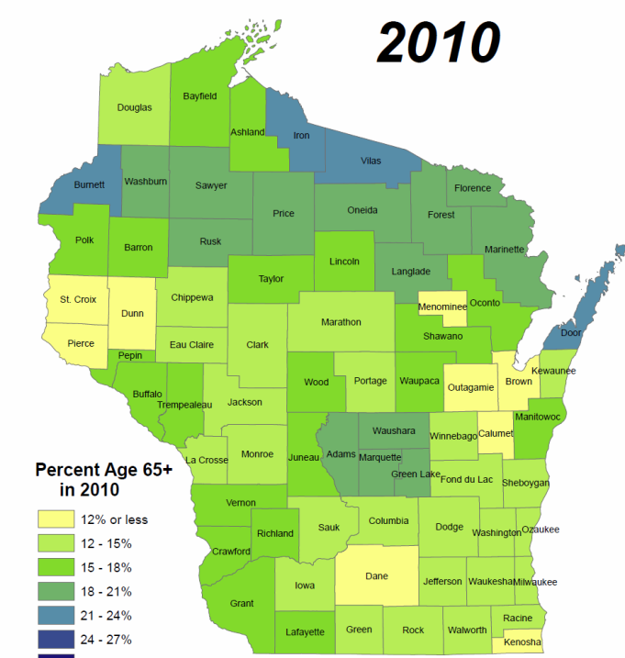
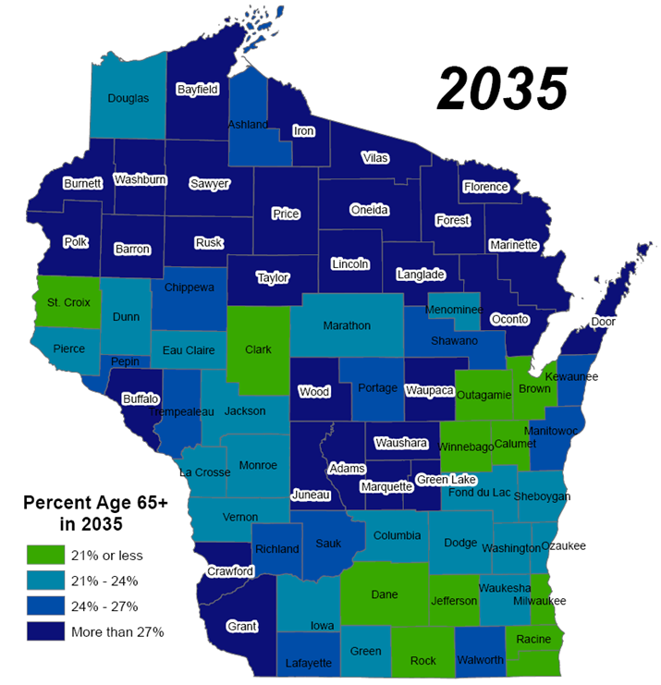
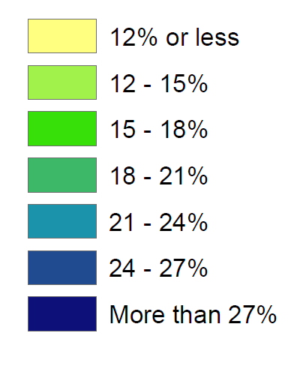

Percentage of Persons Age 65+ by County:
Changes Between 2010 and 2035
Wisconsin’s Age Wave
Notes:
Based on U.S. Census data and projections, the county-maps of Wisconsin illustrate the change in percentage of persons age 65 and older between 2010 (the map on the left) and 2035 (the map on the right).
Yellow indicates counties with age 65+ population of 12% or less.
Increasing shades of green indicates counties with elderly populations of between 12 and 21%. And increasing shades of blue, counties with aged populations over 21%.
The darkest blue – and note how many counties there are – have age 65+ populations that are more than 27%.
HANDOUT: These color-coded maps are printed on a single page in the packet of handouts. One side is for 2010; the other for 2035.
SOURCE NOTE:
Wisconsin Plan for Older Persons 2010-2012: http://dhs.wi.gov/aging/Publications/Final%20State%20Plan%2007-24-09.pdf

Slide 25
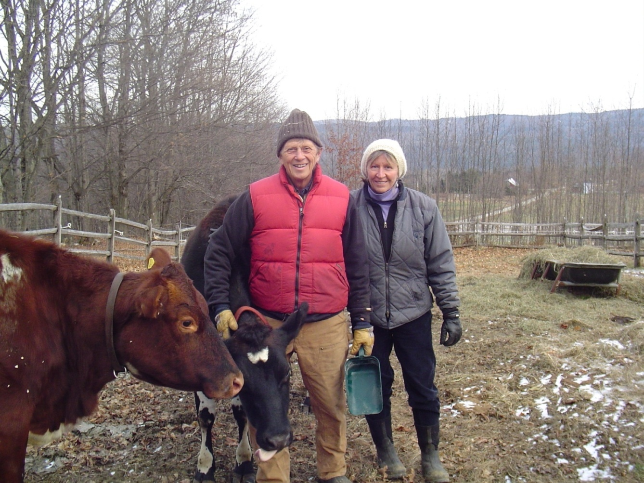
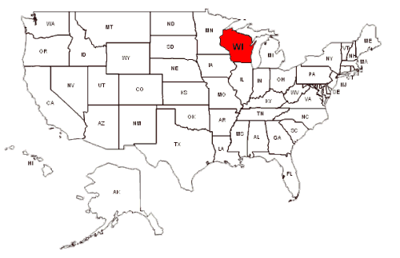
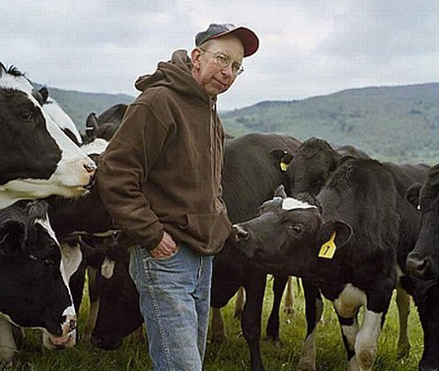
What Impacts Will Population Aging Have on Wisconsin Communities?
Notes:
Within the next 20-25 years, the percentage of persons in Wisconsin who are age 65+ will rise from 13.7% to more than 20%...and their number will increase from 800,000 to almost 1.5million. As we’ve already mentioned, in term of percentage, some counties (particularly in the north) will have elderly populations that are more than twice what Florida is at the present time.
What do you think will be some of the impacts of population aging in Wisconsin?

Slide 26
Areas of Community Life
Impacted by Population Aging
Housing
Transportation, accessibility, and parking
Sidewalks & Pedestrian Crossings
Community and Health Care Resources
Family caregiving
Nutrition and Wellness
Arts, Culture, and Lifelong Learning
Employment and Workforce development
Public safety and emergency planning
Respect and Social Inclusion
Community Connectedness: Civic Engagement and Volunteer Opportunities
Taxation, Finance, Protection Against Fraud
Community Leadership and Intergenerational Collaboration
Notes:
Listed on this slide are 13 areas of community life that might be impacted by population aging. Your task now in small groups is to brainstorm what some of these impacts might be.
NOTE: May want to take a poll regarding which areas participants feel would be most impacted by a significant increase in number or percentage of persons age 65 and older.

Slide 27
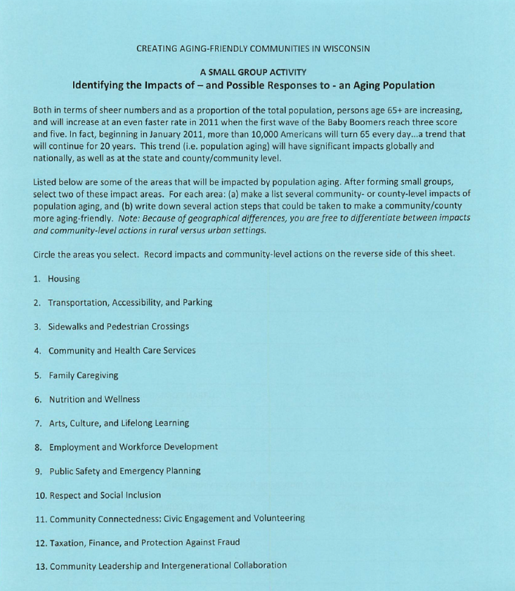
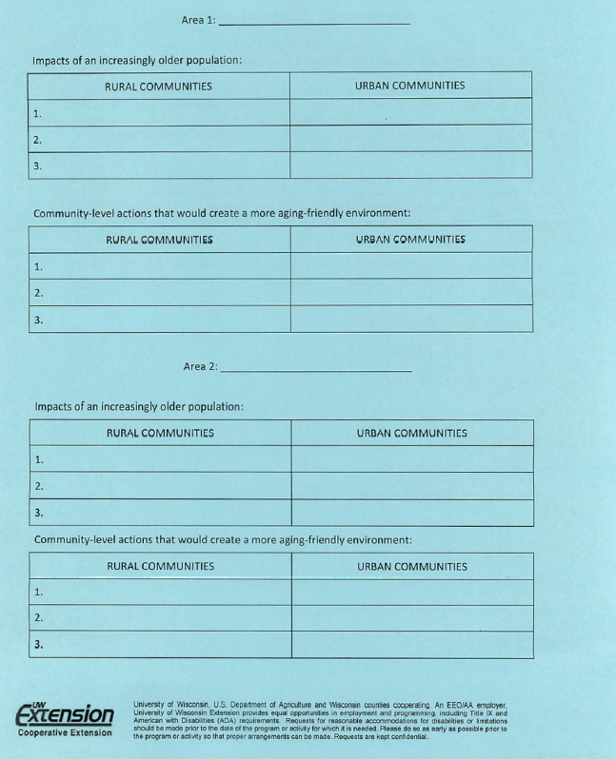
Packet Handout:
Activity – Identifying Impacts
Notes:
Have workshop participants break into small groups. Assign each group to brainstorm the impacts and possible community responses to one of the following areas listed on the front page of the packet handout entitled “Identifying the Impacts of – and Possible Responses to – An Aging Population”): families/family caregiving, housing, transportation. Have one person in each group record responses on the reverse side of this sheet. Mention that responses can be broken down by rural versus urban impacts/responses.
Then have each group select a second area (other than the one they were assigned), and have them repeat this process (i.e. identifying impacts and possible community responses).

Slide 28
Group Reports:
Housing
Transportation, accessibility, and parking
Sidewalks & Pedestrian Crossings
Community and Health Care Resources
Family caregiving
Nutrition and Wellness
Arts, Culture, and Lifelong Learning
Employment and Workforce development
Public safety and emergency planning
Respect and Social Inclusion
Community Connectedness: Civic Engagement and Volunteer Opportunities
Taxation, Finance, Protection Against Fraud
Community Leadership and Intergenerational Collaboration
Notes:
Have one person from each group report the impacts and community responses they identified. This should be done for the families/housing/transportation areas first, and then for the remaining areas.

Slide 29
Creating Aging-Friendly Communities
What are the key attributes or characteristics of aging-friendly communities”
How can you tell whether a community offers a supportive environment for persons of all ages, including those who are elderly?
How can a community measure or assess the extent to which it is aging-friendly?
Notes:
To this point, we have illustrated the aging of populations, and discussed some its impacts on families and communities.
We turn, now, to the third and concluding portion of the presentation: The challenge of creating aging-friendly communities.
Our intention here is not to provide solutions; but to begin a dialogue about what makes a community aging-friendly, and to encourage careful assessment of where communities are in terms of being supportive of the needs of persons of all ages; including those who are – and will be – old.
We pose two questions:
1. What are the key attributes or characteristics of aging-friendly communities? Meaning, what criteria can you use to tell if a community is a supportive place to live for persons of all ages, including those who are elderly?
2. How can you tell the extent to which your community is “aging-friendly”?

Slide 30
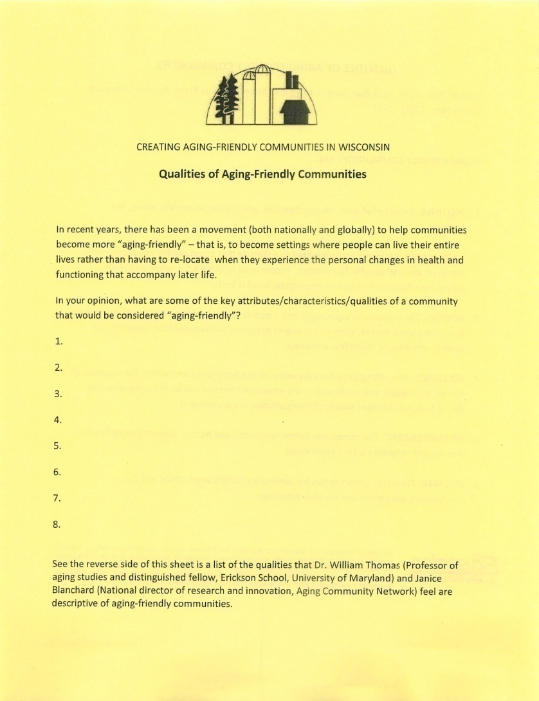
Qualities of Aging-Friendly Communities
Notes:
Either individually or in small groups, have workshop participants identify qualities (aka traits, attributes or characteristics) of communities that are “aging-friendly”. Responses should be recorded on the front page of the handout entitled “Qualities of Aging-Friendly Communities”.
Reserve about 10 minutes for reports/discussion. May want to record responses on a white-board/easel, etc.

Slide 31
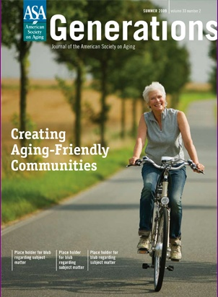
Qualities or Attributes of an Aging-Friendly Community
Inclusive
Sustainable
Healthy
Accessible
Interdependent
Engaged
Source: Thomas, W. H., & Blanchard, J. M. (2009). Moving beyond Place: Aging in community. Generations, 33(2), 12-17.
Notes:
The Summer 2009 issue of Generations, a journal published by the American Society on Aging, was devoted entirely to the topic of creasing aging-friendly communities. One of the articles in this issue (Thomas and Blanchard’s piece entitled, “Moving beyond place: Aging in community”) describes six attributes of aging friendly communities. These attributes are listed and defined on the reverse side of the handout entitled “Qualities of Aging-Friendly Communities”
Aging friendly communities are usually characterized by six traits or properties. They are…
Inclusive
Sustainable
Healthy
Accessible
Interdependent, and
Engaged
SUGGESTION FOR AUDIENCE PARTICIPATION:
After reading the definitions of these six traits, think about the community where you live.
Can use “clickers” for participants to “vote” on whether their respective communities exhibit each of these characteristics.
Could also have people stand.
HYPERLINK NOTE:
Clicking on the journal image is a hyperlink to the Summer 2009 issue; only the editorial preface by Dr. Andrew Scharlach, however, can be read. But you will be able to see the other articles in the issue. Here is the URL: http://www.generationsjournal.org/generations/gen33-2/toc.cfm

Slide 32
Steps to Becoming More “Aging-Friendly” and “Aging-Ready”
Assemble a team of public and private leaders/stake holders in the community; provide education to increase awareness of population aging.
Assess the community’s aging-readiness.
Take focused-action.
Promote Success.
Set-a long-term course.
Obtain resources.
Notes:
This slide lists 6 steps that a community can take to become more aging-friendly. The first is to assemble a team of public and private leaders and stakeholders, and to do as we are doing in this presentation – to increase awareness of population aging.
The second step is to assess the extent to which a community or county is “aging friendly”. To this end, there are several assessment tools that might be useful.
32

Slide 33
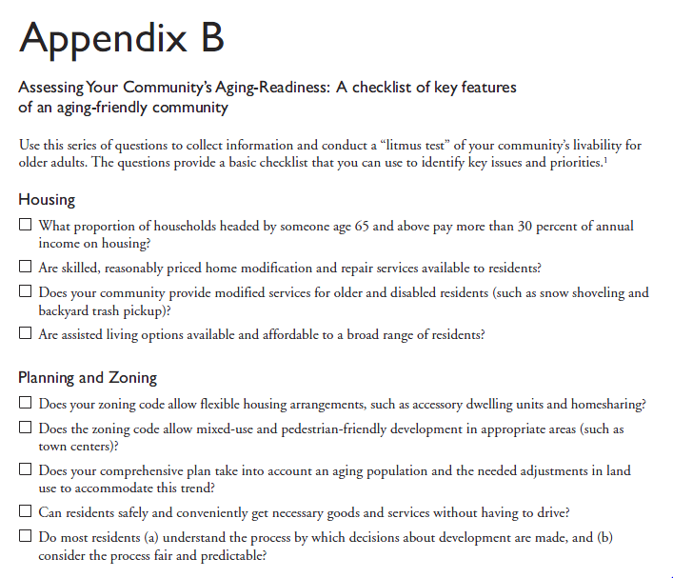
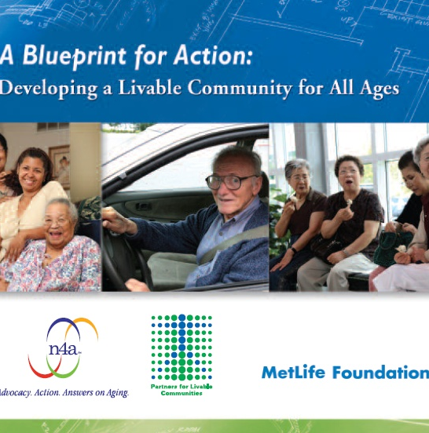
Assessment Tool #1:
Appendix B of “Blueprint for Action”
Notes:
The first assessment instrument is a checklist published in a 2007 booklet entitled: A Blueprint for Action: Developing a Viable Community for All Ages (published by the National Association of Area Agencies on Aging and the MetLife Foundation).
Source: http://www.aginginplaceinitiative.org/storage/aipi/documents/Blueprint_for_Action_web.pdf

Slide 34

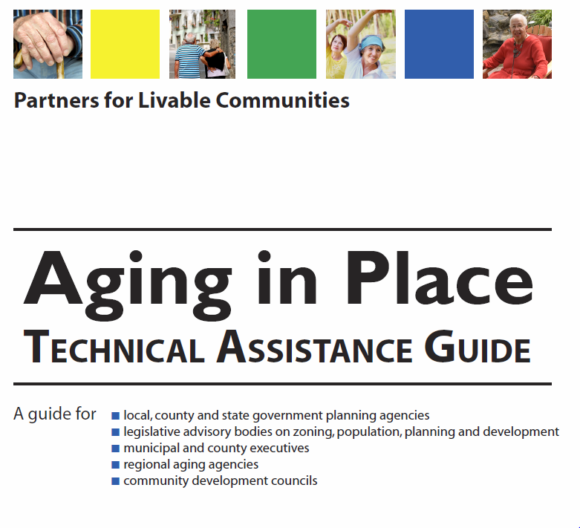
Assessment Tool #2:
Community “Report Card”
Notes:
The second is a Community “Report Card” appearing in a 2009 technical assistance guide, Aging in Place (published by Partners for Livable Communities).
Source: http://www.nwc.cog.co.us/docs/rrr/seniors2009/Aging%20in%20Place%20TA%20assessment%20guide-PartnrsLivblComm.pdf

Slide 35
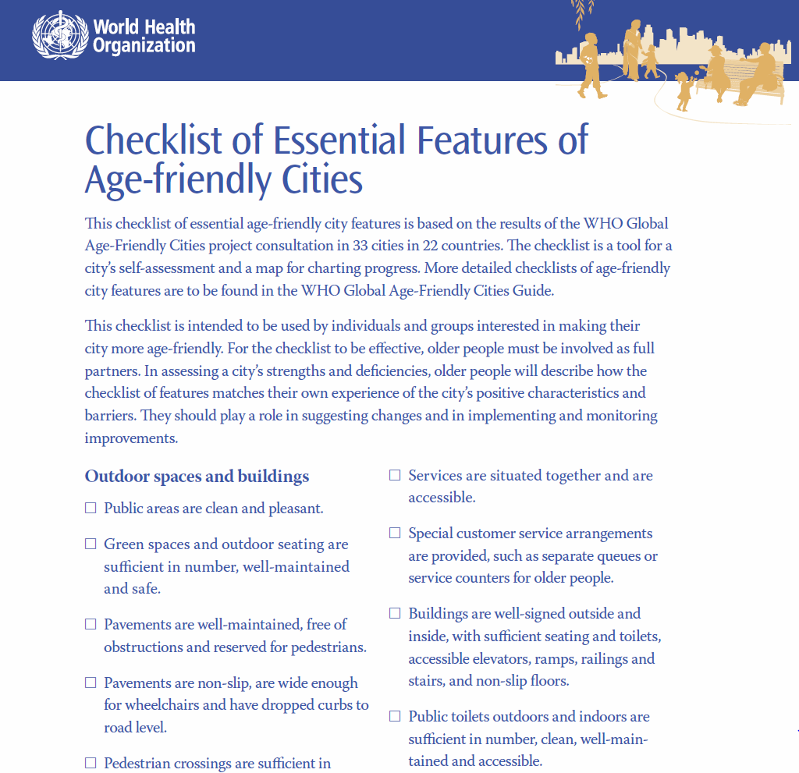

Assessment Tool #3: Checklist of essential features of age-friendly cities
Notes:
A third assessment tool is a checklist published in 2007 by the World Health Organization, in a monograph entitled, “Global Aging-Friendly Cities: A Guide”.
Source: http://www.who.int/ageing/publications/Global_age_friendly_cities_Guide_English.pdf

Slide 36
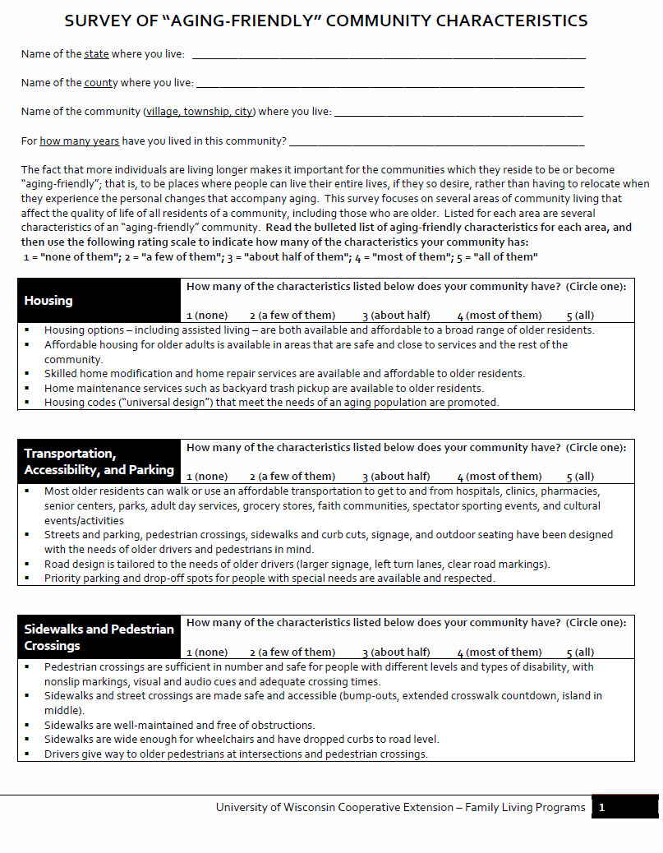
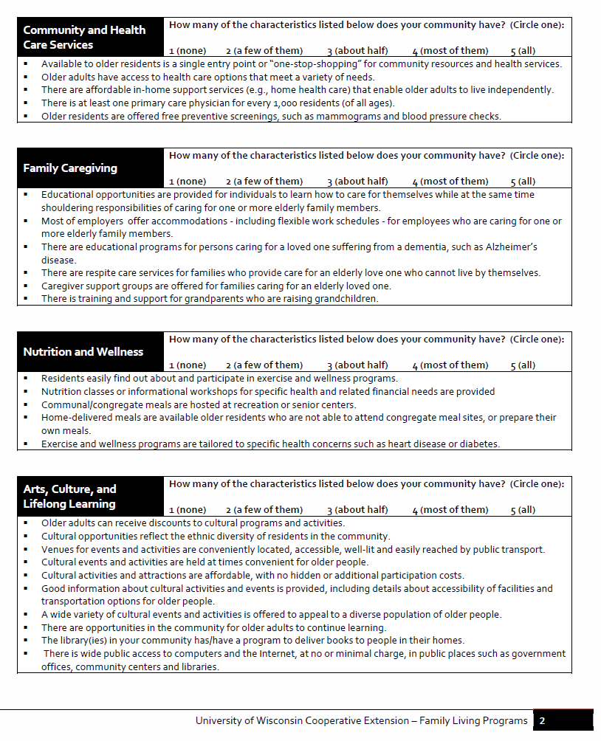
Assessment Tool #4: Cooperative Extension Survey
Notes:
We used the first three assessment tools to create a fourth: A 4-page Survey developed by Family Living Programs and designed to collect information regarding the extent to which your community has aging-friendly characteristics. A hard copy of this Survey is included in the packet of handout materials. This slide shows the first two pages of the survey.

Slide 37
Survey Focuses on 13 Areas
Housing
Transportation, accessibility, and parking
Sidewalks and Pedestrian Crossings
Community and Health Care Resources
Family caregiving
Nutrition and Wellness
Arts, Culture, and Lifelong Learning
Employment and Workforce development
Public safety and emergency planning
Respect and Social Inclusion
Community Connectedness: Civic Engagement and Volunteer Opportunities
Taxation, Finance, Protection Against Fraud
Community Leadership and Intergenerational Collaboration
Notes:
The focus of the Survey is to collect information on the extent to which a person perceives that the community in which they reside has “aging-friendly characteristics” in each of 13 areas:
Housing
Transportation, accessibility, and parking
Sidewalks and Pedestrian Crossings
Community and Health Care Resources
Family caregiving
Nutrition and Wellness
Arts, Culture, and Lifelong Learning
Employment and Workforce development
Public safety and emergency planning
Respect and Social Inclusion
Community Connectedness: Civic Engagement and Volunteer Opportunities
Taxation, Finance, Protection Against Fraud
Community Leadership and Intergenerational Collaboration

Slide 38
Survey Response Options
After reading a list of aging-friendly attributes for each area, the respondent indicates how many on in her/his community:
1 = None of them
2 = A few of them
3 = About half of them
4 = Most of them
5 = All of them
Notes:
The focus of the Survey is to collect information on the extent to which a person perceives that the community in which they reside has “aging-friendly characteristics” in each of 13 areas. After reading a list of aging-friendly attributes for each area, the respondent indicates how many on in her/his community:
1 = None of them
2 = A few of them
3 = About half of them
4 = Most of them
5 = All of them

Slide 39
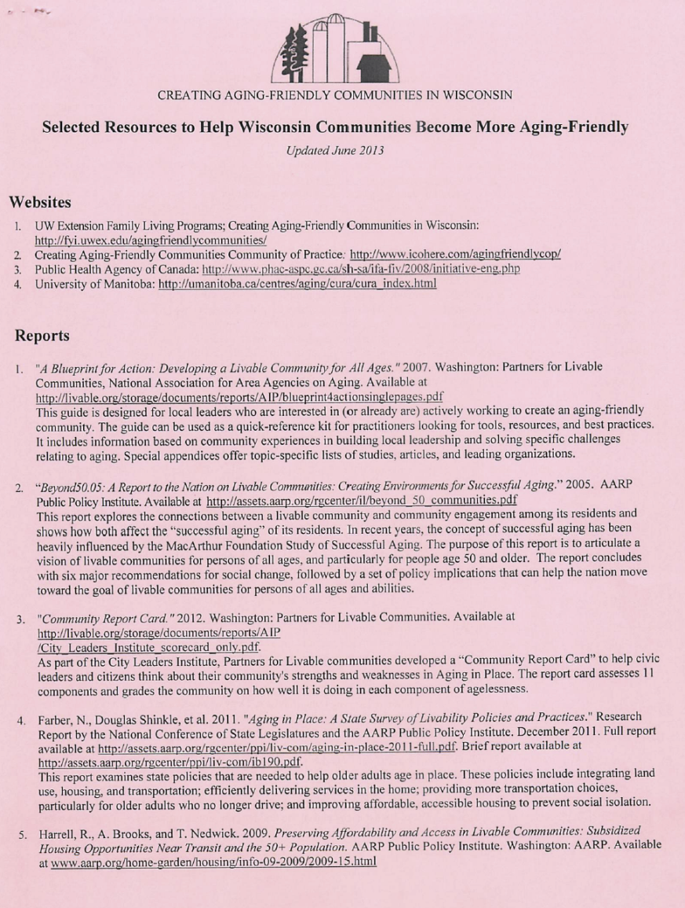
Resources
(updated in 2013)
Websites
Reports
Books
Journal articles
Agencies and organizations
Notes:
In the packet of handout materials is a list of resources that communities/counties might find useful as they begin to plan for population aging. Included in the list of resources are websites, reports, books, articles, agencies, and organizations.

Slide 40
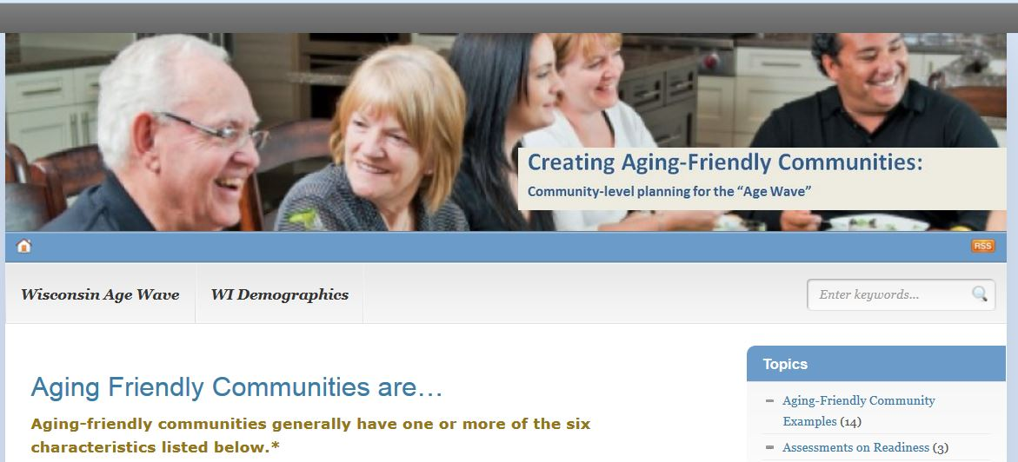
UW Extension FYI Blog: http://fyi.uwex.edu/agingfriendlycommunities/
Notes:
UW Extension Family Living Programs has developed a website aimed at helping to create aging-friendly communities in Wisconsin. One of the sheets in your packet provide the web address this blog. You can also access it by simply typing the following phrase into a web browser: “Creating Aging-Friendly Communities in Wisconsin”.
The blog contains information that may be helpful to communities and counties. It also affords the opportunity for communities to share what they are doing – to highlight “best practice” examples of aging-friendly environments.
This slide shows one of the posts on the blog highlighting efforts in LaCrosse County to become more “aging-friendly”.
HYPERLINK NOTE:
If you are connected to the internet, clicking on this screen shot provides access to the blog: http://fyi.uwex.edu/agingfriendlycommunities/

Slide 41
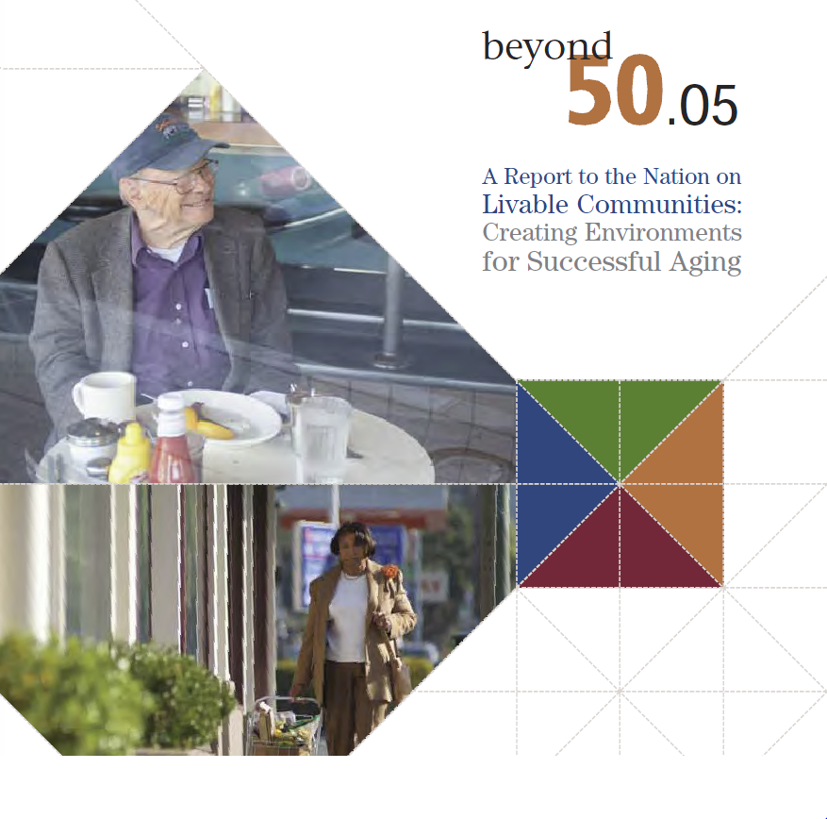
A Call for Action:
Those communities that design for livability empower their residents to remain independent and engaged, and offer a better quality of life.
Notes:
In 2005, AARP published a booklet entitled “Beyond 50.05”, the focus of which was to encourage the development of livable communities. The booklet issues a “call for action” and makes specific recommendations. The booklet concludes with the following: Unless America makes a commitment to livable, “aging-friendly” communities, baby boomers and other persons of a range of ages and with a variety of abilities will find it difficult to age successfully and remain engaged with their communities...
On the other hand, those communities that design for livability empower their residents to remain independent and engaged, and offer a better quality of life.

Slide 42
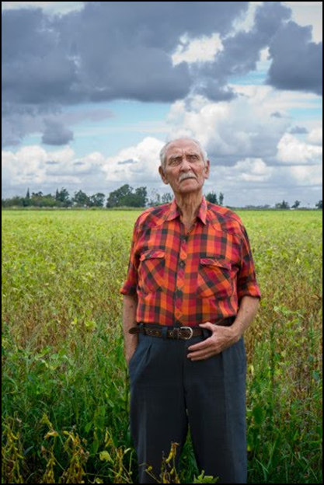
?Questions We All Need to Ask?
Is your community a good place to grow up and grow old?
Will your community meet your needs when you are 65, 75, 85, 95…or even 105?
If not, what can you do now to begin to make your community a friendly and supportive environment for persons of all ages?
Notes:
With this call for action in mind, we pose three questions:
1. Is your community a good place to grow up and grow old?
2. Will your community meet your needs when you are 65, 75, 85, 95…or even 105?
3. If not, what can you do now to begin to make your community a friendly and supportive environment for persons of all ages?

Slide 43

Be a catalyst for action!
Are you willing to take the risk?
Notes:
Responses to these questions will require your involvement in your respective communities and counties.
Are you willing to take the risk? Will you be a catalyst for action?

Slide 44
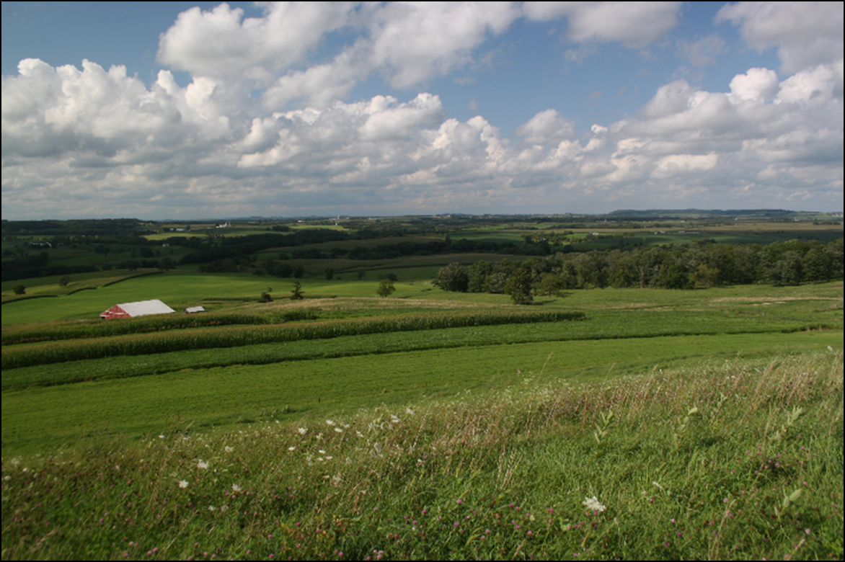
Let’s Work to Ensure that Wisconsin Communities are “Aging-Friendly”….for ALL ages
Notes:
Questions

