Slide 1
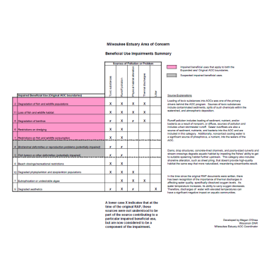
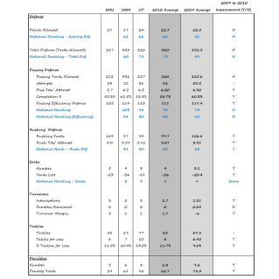
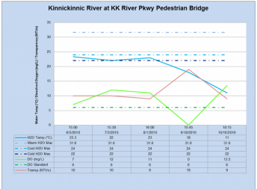
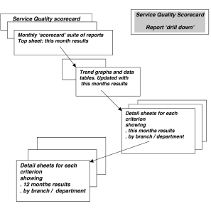
Creating a Production Train
Visual Presentation
Easy to Understand
Detail
Complexity
Visual Presentation
Easy to Understand
Detail
Complexity
Visual Representation
Easy to Understand
Detail
Complexity
Visual Presentation
Easy to Understand
Detail
Complexity
Visual Presentation
Easy to Understand
Detail
Complexity
Translation
Translation
Translation
Translation
Program Parameters
Lead Project Agency
Based on overall community goals – fishable, swimmable, drinkable, aesthetic
Establish science-based measures and targets
Data Points
Entered by AOC Data Managers
Gathered from Partner/ Project Agency
Based on science-based testing and monitoring protocols
Data Aggregation
Levels – site, reach or assessment area, improvement project, watershed, overall AOC
Roll up or drill down between levels
AOC-Level Reporting
* Overview of Data * Determine BUI elimination and AOC delisting progress
Report Card
* For Public
* Simple, familiar model
Gail Epping Overholt, UWEX Natural Resource Education Program , November 2011

