Slide 1
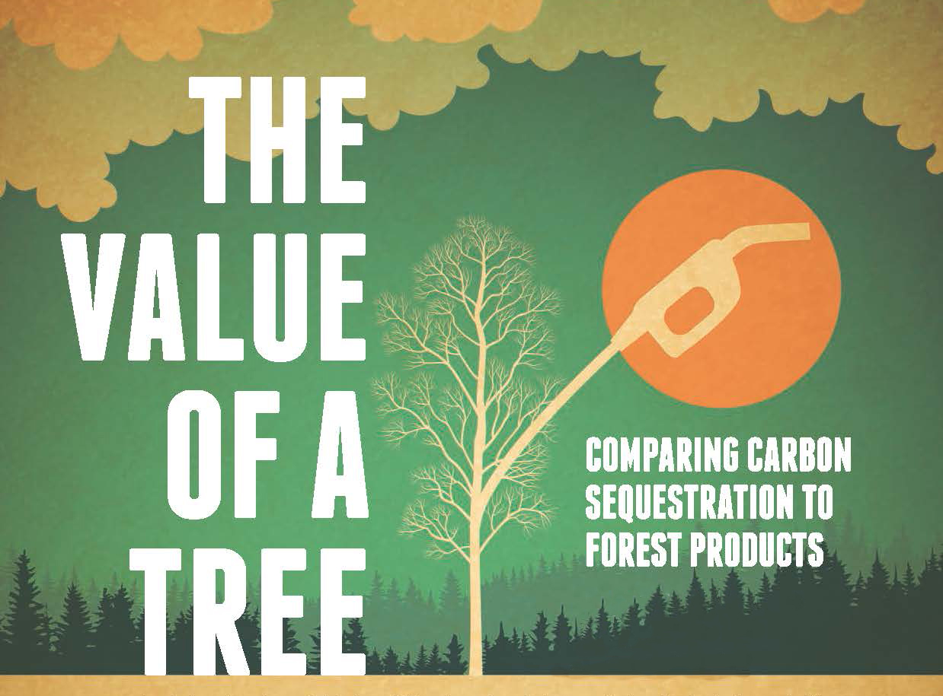

Slide 2
Outline
What are trees good for? Work with a buddy!
How do plants make food?
What are fossil fuels and where do they come from?
Activity: The Carbon Cycle Game
What is the greenhouse gas effect?
Today’s Vocabulary: Biomass & Biofuel
Activity: How many trees would it take to fly from Lambeau Field to Soldier Field?

Slide 3
Activity: Concept Map
Work with a buddy to draw or list things that trees are good for.
These could be things we make out of trees or services that trees provide us or other animals.
Take 10 minutes to get all your ideas on paper (made out of a tree!!)

Slide 4
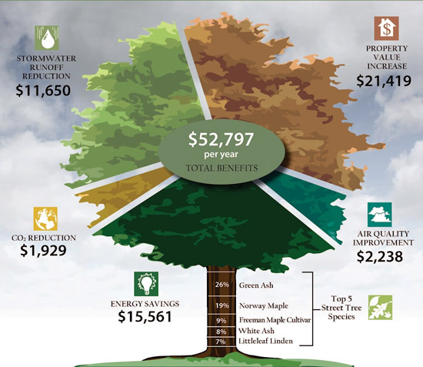
Notes:
This is one way that urban planners in Seattle see the value of a tree in dollars per year.

Slide 5
Concept Map
Forest Products
  Lumber
  Veneer
  Cabinets
  Pencils
  Paper
  Rubber
Biomass
Biofuel
Ecosystem Services
  Flood mitigation
  Wildlife habitat
  Reduced energy costs
  Photosynthesis – provides O²
  Air quality improvement
Carbon dioxide sequestration
Carbon sink
Notes:
Explain the Prepared Concept Map. Define the bolded terms – use the following slides as visual aids to help explain.

Slide 6
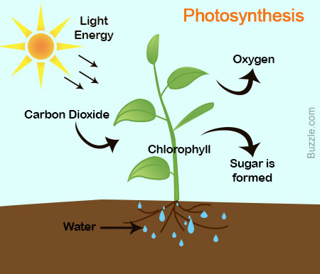
Photo=light; synthesis=put together
Notes:
Explain the very basic process of photosynthesis. Light + CO2 + water = O2 + Sugar (*is a carbon molecule). Ask what sorts of plant sugars (carbon compounds) they can think of. Answers include any vegetable. Ask where the carbon compounds go if they are covered in soil….(see next slide)

Slide 7
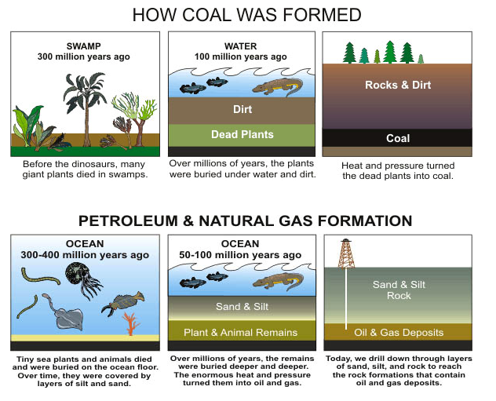
Fossil Fuels: How are they formed?
Notes:
Explain the differences in the formation of the different fossil fuels. Emphasize that really old photosynthesis is what turns into coal, oil, and gas.
“now that you know the overview of the Carbon Cycle and some of the main processes, lets act it out!!!

Slide 8
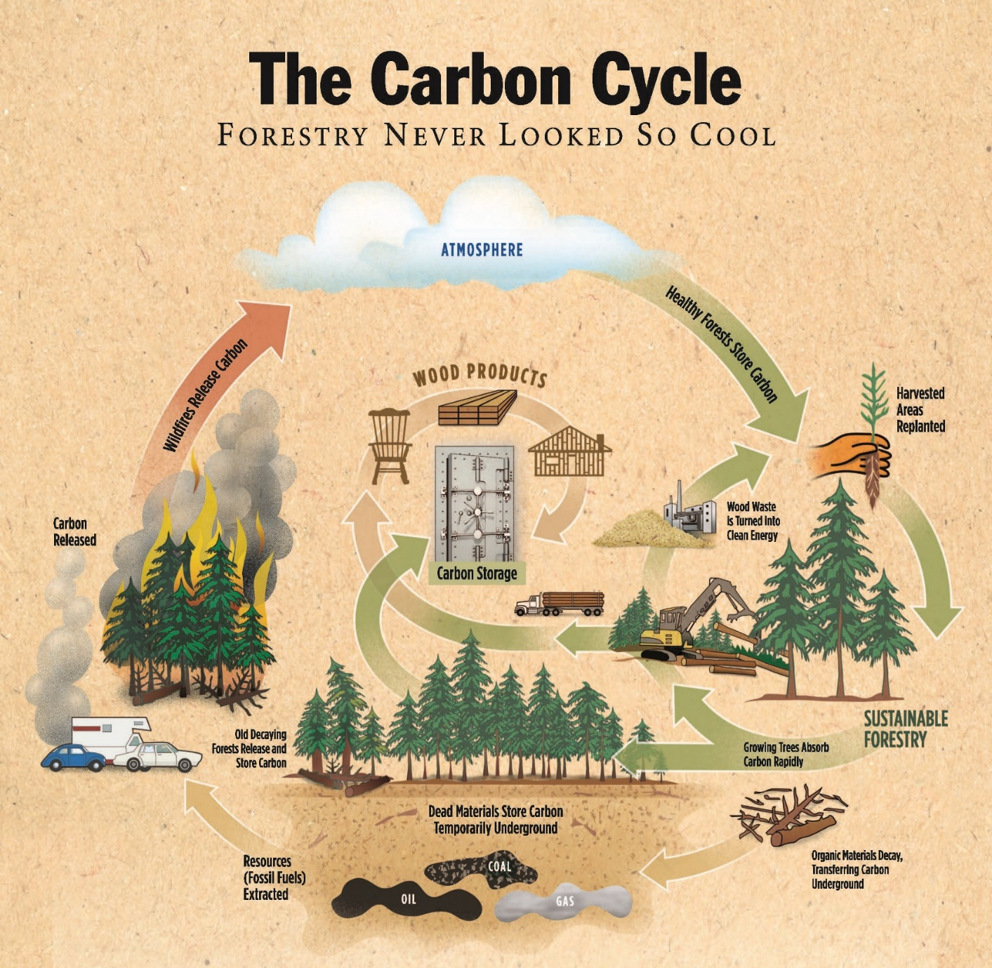
Notes:
Explain the major parts: Atmosphere > Photosynthesis > Carbon Storage > Burning > Atmosphere
This is a model. Remember the important thing about a model is it simplifies things so we can understand the process. There are small differences that affect the carbon cycle in different times of the year and places in the world
Highlight:
Cycles within cycles
Plants trap gaseous carbon via photosynthesis and convert into solid plant matter
Any fire converts solid carbon to gaseous carbon dioxide
Forests are one of the largest carbon sinks on the planet second to oceans.
The difference between non-renewable energy and renewable energy sources even though fossil fuels once originated as biomass

Slide 9
Activity – Act out the Carbon Cycle
Where can carbon be found on Earth?
Let’s review how carbon can move:
  Physical processes
  Chemical processes – burning
  Biological processes – photosynthesis & respiration
  Dissolving in and release from water
  Decomposition

Slide 10
Activity – Act out the Carbon Cycle
Equal number of students at each station
Each station has a dice
  Each student rolls the die individually and records what/where they (as a carbon atom) will move
  Follow the instructions on the station sign to know where to go next
Follow the directions and record rolling the dice 10 times
We’ll see where carbon ends up in the cycle

Slide 11
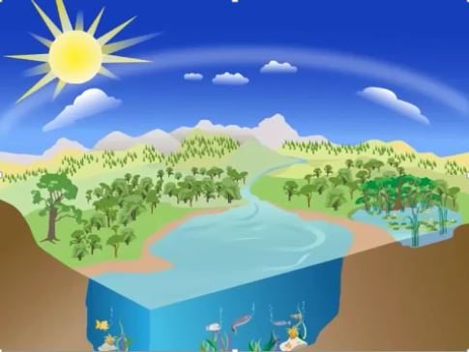
The Greenhouse Effect
The Greenhouse Effect
Reflected Sunlight
Energy Released
Reflected Sunlight
Sunlight
Energy trapped by Greenhouse Gases warm the Earth
Infrared Radiation
Energy absorbed by land and water
Notes:
Greenhouse gases like carbon dioxide trap heat in the atmosphere and warm the earth. It all starts with sunlight, which is a form of energy. Land and water absorb most of the sunlight that reaches the earth, the rest is reflected back to space. The Earths surface warms up, then gives off energy in a different form, called infrared radiation. This energy travels back toward outer space, greenhouse gases trap some of this energy in the atmosphere before it can escape, warming the Earth. We need some greenhouse gases, without them, our planet would be to cold for plants and animals to live.

Slide 12
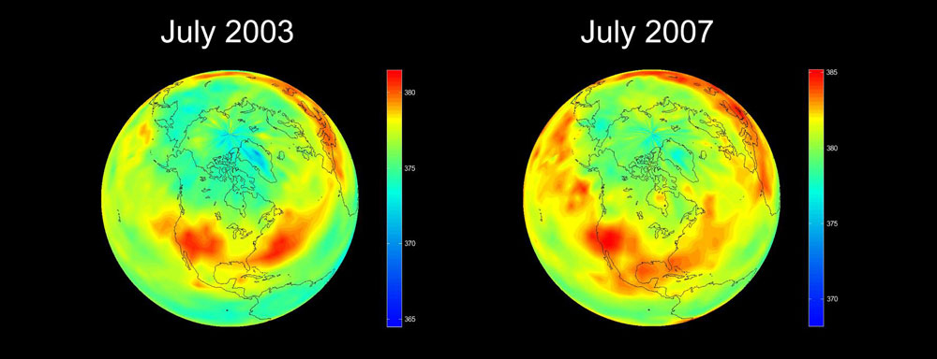
Carbon Dioxide Concentrations over North America
Notes:
Ask the students to share what the notice about these two pics. Be sure to note the color scale had to be changed a little (about 5 ppm) to be able to show the subtle differences in distribution of CO₂. You can also ask them where they think the CO₂ is coming from and where people live.

Slide 13
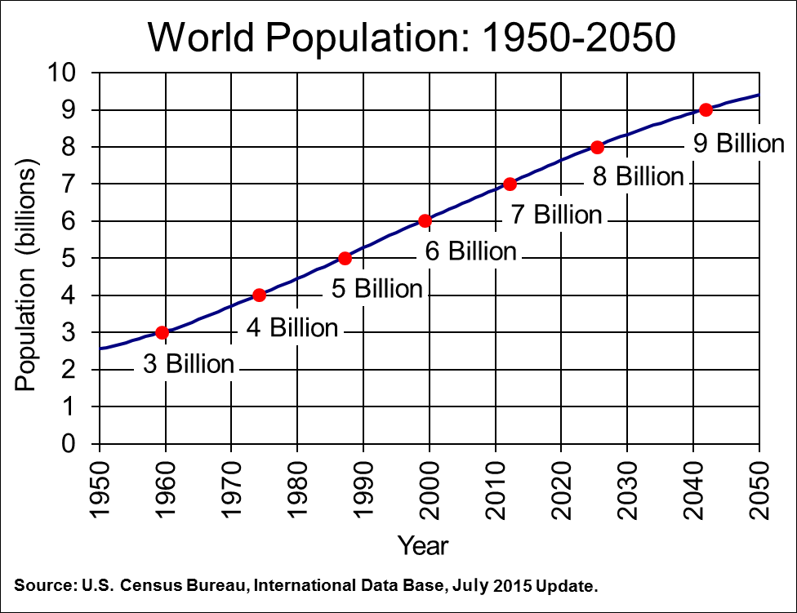
Notes:
https://www.census.gov/population/international/data/idb/worldpopgraph.php

Slide 14
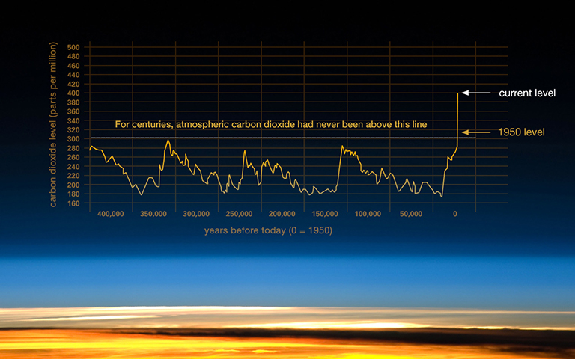
Historic Atmospheric CO₂ Concentrations
Notes:
How do we know past atmospheric concentrations of C02? Well, have you ever seen an icecube with a little bit of air trapped inside? That’s exactly how scientists know what past atmospheres were like – by drilling deep holes in the glaciers that are found near the Earth’s north and south pole!
Image cred: http://climate.nasa.gov/climate_resources/24/

Slide 15
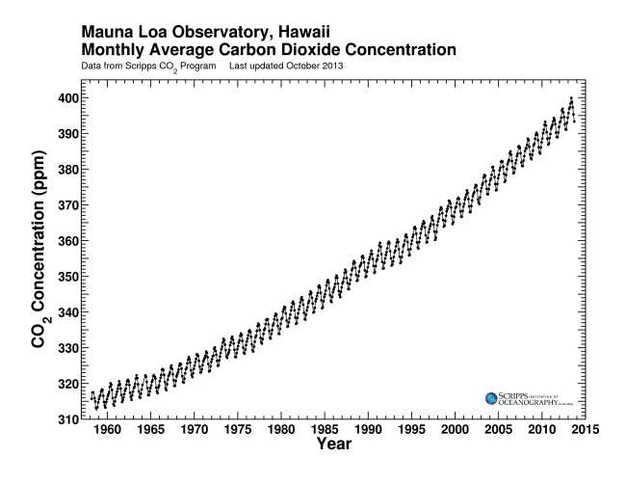
Keeling Curve: 1958-Now
Notes:
Here we can see the rise of carbon dioxide concentrations in the atmosphere, but what else do you notice? Point outside and ask the students if the trees are taking in carbon dioxide, or resting. Every year, the temperate forests of the northern hemisphere uptake a massive amount of carbon dioxide when the trees have their leaves. In the winter, the trees slow down their rate of carbon sequestration or stop all together, allowing carbon dioxide to build up in the atmosphere.
Image cred: http://scrippsco2.ucsd.edu/history_legacy/keeling_curve_lessons

Slide 16
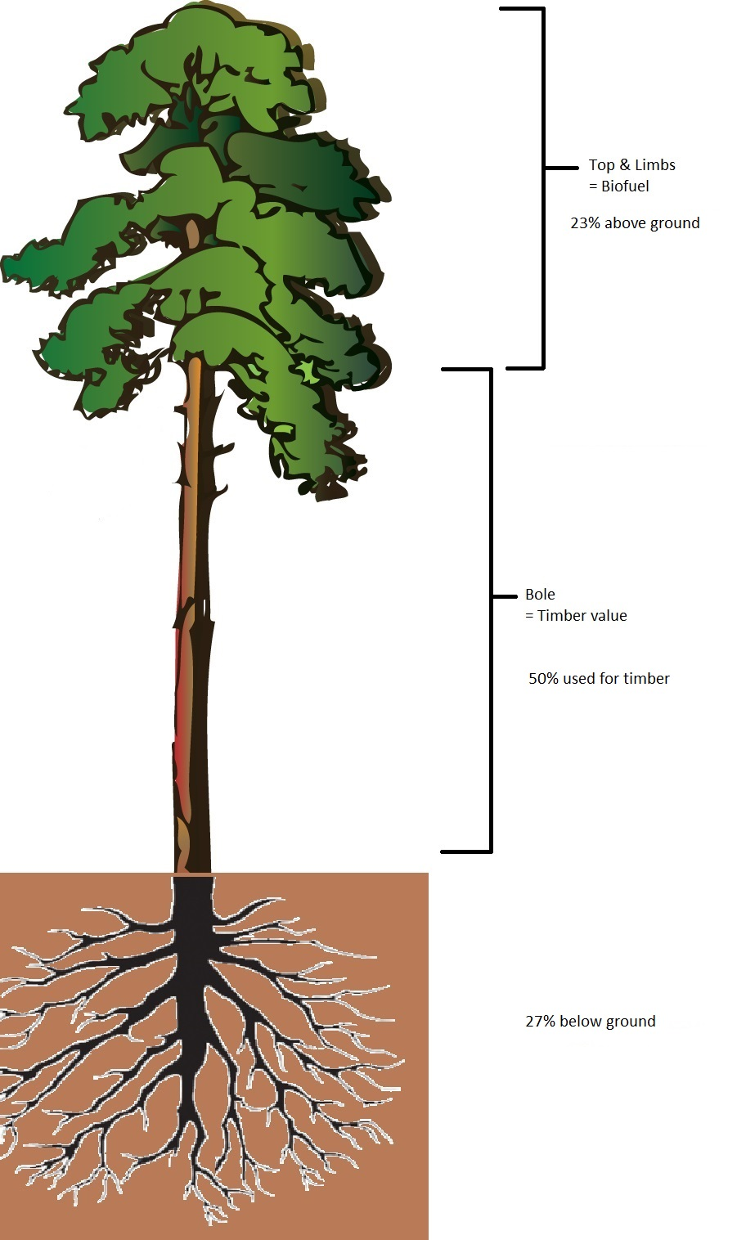
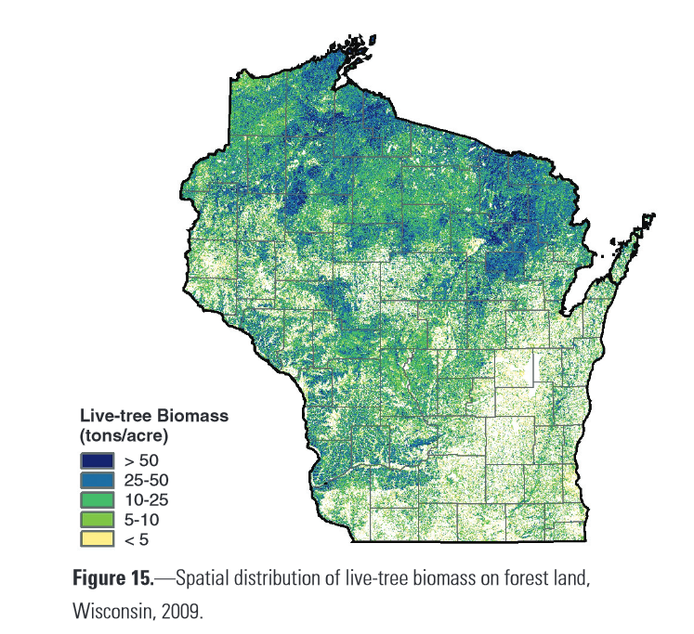
Forestry in WI
U.S. Forest Service. (2012). Wisconsin’s Forests 2009. (Resource Bulletin NRS-67). Washington, DC: U.S. Government Printing Office.
Notes:
Now lets talk about the forests that allow the whole planet to breathe.
Check out the density of forests in Wisconsin. Where are the forests most dense?
Now look at the individual tree. Explain the relative percentage of biomass in roots, bole, and top/limbs. Explain that the roots are unattainable, the bole is used to make the forest products in their concept maps, and the top/limbs are usually piled up and burned because they are too small to do anything with…..until now!

Slide 17
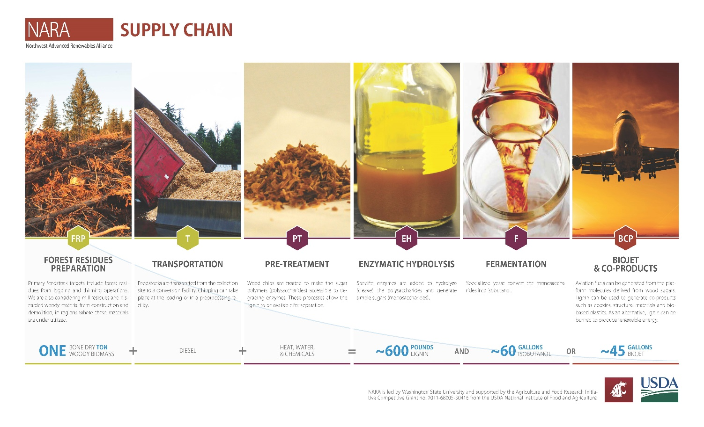
Notes:
First we’ve got to get the stuff from the logging operations and transport them to the processing plant.

Slide 18
Notes:
Next, scientists mash the tree parts into small pieces and add chemicals.

Slide 19
Notes:
Finally, after all that complex chemistry, biofuel is created that can power commercial jet airplanes!!

Slide 20
Notes:
Foresters, chemists, and economists (all scientists) have developed this really smart way of using what was once a waste product to convert it into jet fuel! They use the biomass (quick quiz – ask the students to define) and chemical processes with the addition of fermentation to produce biofuel that is suitable for jets!
Emphasize the lower part of this figure. The blue line represents the volume required for each step. Note how one ton of woody biomass ends up producing just 45 gallons of biojet fuel.

Slide 21
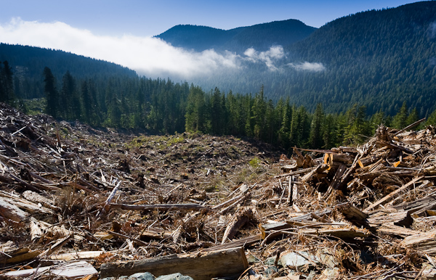
1 Ton of Woody Biomass

Slide 22
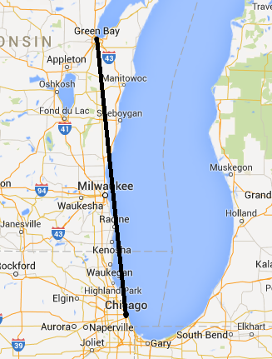
How many trees would it take…
One 747 jumbo jet
175 miles
From Lambeau Field to Soldier Field
Using only the extra stuff from logging!

Slide 23
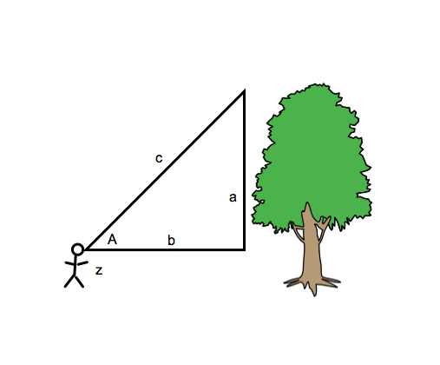
Determine the height of a tree
Find a place to stand where you can see the top of your tree. Measure the distance from the base of the tree to where you stand with the meter tape.
(b): _________________ m
Find the angle on clinometer from your eye to the top of your tree
(A):__________ degrees
Measure the distance from ground to observer’s eyes
(z):_________ m
Height of tree = H = (tan(A))*b + z
H = ________________m

Slide 24
Images Cited
Weekly Reading: Trees In The Urban Landscape, 2013, http://www.svrdesign.com/blog/2013/04/weekly-reading-trees-in-the-urban-landscape
The Forest Foundation, 2015, http://www.calforestfoundation.org/Critical-Thinking/index.htm
Wood The Most Natural Resource, http://www.themostnaturalresource.com/environment
NASA Global Climate Change, A blanket around the Earth, http://climate.nasa.gov/causes/
NASA, Images of Change, http://climate.nasa.gov/state_of_flux#Carbondioxidepollution.jpg
EPA, Climate Change Indicators in the United States, U.S. Greenhouse Gas Emissions by Gas 1990-2012, http://www.epa.gov/climatechange/science/indicators/ghg/us-ghg-emissions.html
EPA, Climate Change Indicators in the United States, U.S. Greenhouse Gas Emissions by Economic Sector 1990-2012, http://www.epa.gov/climatechange/science/indicators/ghg/us-ghg-emissions.html
EPA, A Student’s Guide to Global Climate Change, The Greenhouse Effect, https://www3.epa.gov/climatechange/kids/basics/today/greenhouse-effect.html
U.S. Forest Service. (2012). Wisconsin’s Forests 2009. (Resource Bulletin NRS-67). Washington, DC: U.S. Government Printing Office.
Northwest Advanced Renewables Alliance, NARA,Infographic, http://nararenewables.org/docs/one-pager/supplychain.pdf

Slide 25



Value of a Tree
This work, as a part of the Northwest Advanced Renewables Alliance (NARA), was supported by the Agriculture and Food Research Initiative Competitive Grant no. 2011-68005-30416 from the USDA National Institute of Food and Agriculture.
Lesson adapted from Science Scope Magazine. March 2014: 37(7) 27-35.

