Slide 1
Understanding Social Security Insurance Programs
Implications for Personal Finance
Developed by the Center for Financial Security, UW-Madison
Contacts: Nilton Porto, nporto@wisc.edu
and J. Michael Collins, jmcollins@wisc.edu
Notes:
Note to the Presenter:
This slide presentation aims to offer a detailed and comprehensive look at the SSA and its programs. Please feel free to pick and choose those slides more relevant to your topic.

Slide 2
Key Terms
SSA
Social Security Administration
FICA
Federal Insurance Contribution Act
COLA
Cost of Living Adjustment
OASI
Old Age and Survivor Insurance
DI
Disability Insurance
SSI
Supplemental Security Income
Notes:
Some of the Social Security brochures also talk about the Schedule SE (self-employed) tax but it does not seem to be widely used.

Slide 3
Background
SSA was created by Pres. Franklin D. Roosevelt as part of his New Deal to combat poverty.
The Social Security Act of 1935 was signed into law on August 14, 1935.
The first Commissioner, Arthur J. Altmeyer from DePere, WI, drafted the original bill that later become the Social Security Act.
More people have experience with the SSA than any other federal agency (even the IRS).
The first person to receive monthly checks, Ida May Fuller, lived to be 100 and received benefits for 35 years.
Notes:
Fun Fact: Germany was the first modern country to put into effect a social security retirement program in 1889. It was designed by its first chancellor, Otto Von Bismarck.

Slide 4
Figures
Second Highest Expenditure on Budget (20.8%)
Self-funded by payroll taxes called FICA (Federal Insurance Contribution Act)
About 160 million people work and pay FICA taxes
About 52 million receive monthly benefits (36 million are retirees and their families/survivors)
COLA (cost of living adjustment) introduced in 1975
Notes:
COLA – COLA’s law is from 1972 but introduced in 1975. No automatic increases existed until COLA. Benefits were actually fixed from 1935 until 1950 when an amendment increased, for the first time, general benefits by 77 percent.
According to many experts, COLA has outpaced inflation since it was created. Good for retirees but might be hurting the Trust Fund assets.

Slide 5
Initial Design
To replace about 40% of an average worker’s earnings.
More than just a retirement program – it is a social insurance that pays benefits to:
People who have already retired
People who are disabled
Survivors of workers who have died
Dependents of Beneficiaries

Slide 6
Key Dates in History
1935
Social Security Act
1939 Dependents and Survivor Benefits
1956
Disability
1965 Medicare
1972
SSI
1972
COLA
2002
Ticket to Work
2003 Prescription Drug Act
Notes:
1935 Act – provided benefits to the retired worker only
1939 – dependents (such as non-working spouse or children) were added to a retired worker benefits. Survivor benefits were also added to the program. More on those two categories later.
Medicare – 20 million people signed up for Medicare during the first three years of the program
SSI – it consolidates more than 1,000 state and federal agencies providing assistance and welfare programs.
Ticket to Work – provide disabled workers with re-training and incentives to return to work.

Slide 7
Social Relevance
Largest social insurance program in the world
Keeps 40% of all Americans over 65 out of poverty
More children receive benefits than any other social or welfare program in the world
Benefits are entitlement, not charity
Vulnerable population can be dually protected by Social Security and SSI

Slide 8
Social Insurance
Risk
Coverage
Outliving Savings
Disability
Death of Spouse
Permanent Disabled
OASI
SSI
SI
SSDI
Notes:
Acronyms Reminder
OASI – Old Age and Survivor Insurance
SSI – Supplemental Security Income
SI – Survivor Insurance
SSDI – Social Security Disability Insurance

Slide 9
Contributions
Workers
6.2% on their first $106,800
Another 1.45% goes to Medicare (no income limits)
Employers
Match workers 6.2%
Match 1.45% to Medicare
Self-Employed
Full 12.4% to SSA plus 2.9% to Medicare
Due to deductions, roughly 92% of net earnings are taxed
Only Earned Income is taxed – no FICA taxes on savings, investments or real estate income.
Notes:
Self-Employed: rather confusing calculation but the 92% figure comes from the fact that half of self-employed social security taxes are deductible from federal taxes and some business expenses can also be deducted from the total payment. Our recommendation is that self-employed workers consult with their tax advisor for more detail.
Retirement benefits are calculated using your highest 35 years of income so might not be advisable for a self-employed person to push for too many deductions to lower FICA. Again, case-by-case decision.

Slide 10
Financial Shortfalls
Social Security: more going out than coming in – CNN Money, August 5, 2010
Save the Date: Social Security will go Broke – Forbes, 07/29/09
Social Security, Medicare Facing Insolvency Sooner – The Wall Street Journal, May 13 2009
Recession Drains Social Security, Medicare Sooner than Expected – Bloomberg, May 13, 2009
The Social Security program has been a target of intense attack by media outlets and public figures.
Notes:
The importance of this slide is to recognize that there are lots of valid concerns about the Social Security financial status out there but most of the headlines do not paint the picture properly. If the SSA does not change anything on the program, 78% of each dollar in benefits will still be paid after 2037, ceteris paribus.

Slide 11
Good News
Social Security has been around for 75 years and never missed a benefit payment despite being self-funded.
Social Security has been running surpluses for over 25 years – The federal government has not had a surplus in 7 years.
The Social Security Trust is currently at over 2.5 trillion dollars.
Social Security is a defined-benefit program; your money is invested conservatively to guarantee payments.
Notes:
Just an overview of some facts that shows that, despite valid concerns about the SSA, it has been actually a pretty solid program.
The last thumbs-up can be used in a discussion of turning the program into personal accounts and defined-contribution.

Slide 12
Causes for the Shortfall
Year 2037 – only 78 cents for each benefit dollar
DEMOGRAPHICS
- Drop in Birth Rate since the 60’s
-Aging Population
- Baby Boomers Retirement
ECONOMICS
- Drop on FICA contributions due to high unemployment
- Less Workers per Beneficiary: 3 to 1 in 2010
DESIGN FLAWS
- COLA has outpaced Inflation
- Legacy Costs still hurting Budget
MEDICARE COSTS
- Raising cost of Healthcare
- Longer Life Expectancy
Notes:
A quick list of some the reasons why the SSA would face this net payment challenges in 2037. Information came from many sources, including the SSA web site.

Slide 13
1983 Greenspan Commission
Started covering non-profit and federal employees
Income Taxes on benefits to high-income people
Increase Delayed Retirement Credits
Gradual increase of FICA
Shift COLA to calendar year
Commission used a composite approach of several tweaks to avert a 6-month shortage crisis.
Notes:
It aimed to keep the program out of the red for another 75 years. However, since then two major economic shifts occurred that Greenspan's commission didn't anticipate: The growth of average U.S. wages slowed (less contributions from workers), and income inequality soared (high earners paying even less in FICA than before due to the cap of $106,800). Despite of that, this commission is highly regarded as a very successful “fix” of the program. It is the same Greenspan that later become the Chairman of the Federal Reserve.

Slide 14
2005 Prof. Gramlich paper “Social Security Reform: One More Time”
Increase Retirement Age by 1 year for each Decade
Include Local and State Workers
Progressive Tax Indexing of COLA
Eliminate Taxable Maximum
Change Defined Contribution Plans to “Opt Out”
Prof. Gramlich advocates a compromise involving several minor adjustments to fix the system.
Notes:
Prof. Gramlich was a highly respected Professor of Economics at Michigan University (he passed away in 2007) and a former board member of the Federal Reserve (like Greenspan). He studied the Social Security for many decades. He defended the “opt out” option to 401(k) not necessarily as a way to help the program financially but to increase overall retirement savings. He also supported private accounts but only as an addition to the defined-benefit system already in place.

Slide 15
Center for Retirement Research – Boston College “The Social Security Fix-It Book”
Cut Benefits
Across the Board Cut
Raise Retirement Age
Increase Revenue
Increase on Payroll Taxes
Raise the Earning Cap
Change COLA
Raise the Return on Assets by investing on stocks.
List of a few selected ideas from their proposal
Notes:
The Boston College paper has a nice “silver bullet” type of approach, discussing all the possible solutions to the problem, and listing their pros and cons. Highly recommended read for anybody looking for a more comprehensive discussion of the issue.

Slide 16
Your Retirement Funds
Savings / Investment
Private Pension
Social Security Retirement Benefits
OTHER INCOME
Notes:
Your retirement benefits are the base of the pyramid since they are our constant, defined-benefit, and pretty much every retiree will get them. Private pension could be defined-benefit or defined-contribution (401(k)). Savings and investments are all your other already taxed financial assets plus IRAs and annuities. Other income could be from continued work, rentals, etc.

Slide 17
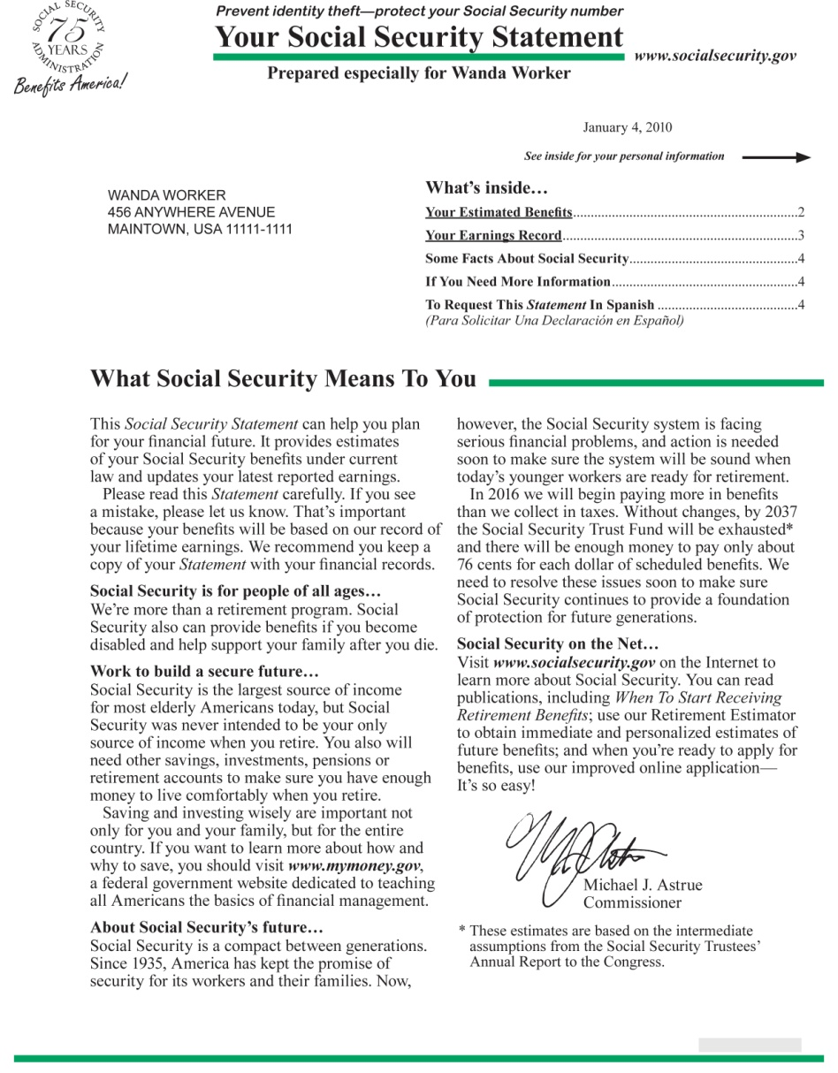
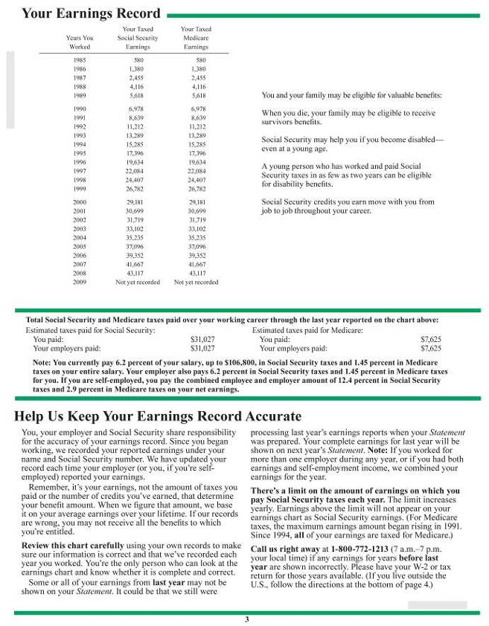
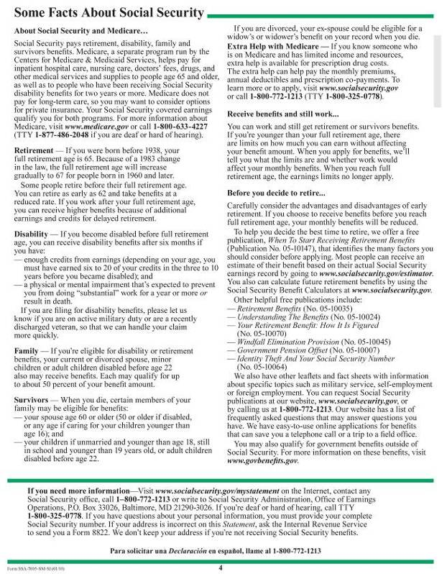
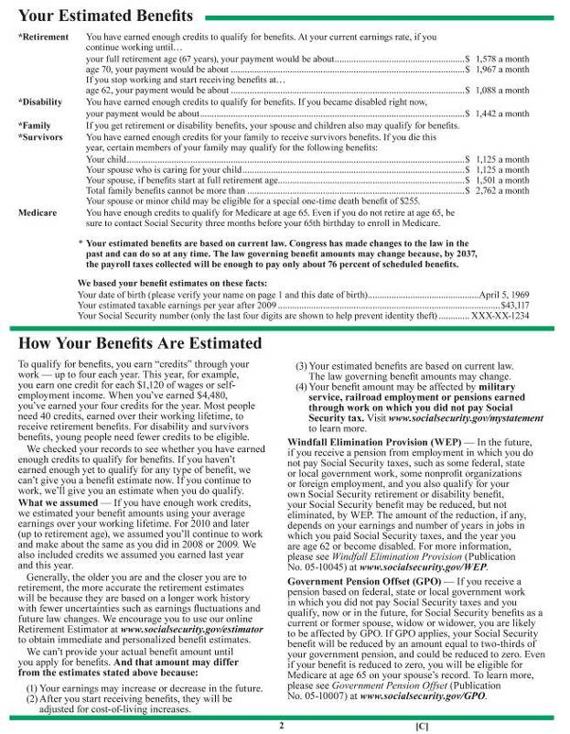
The Social Security Statement
Notes:
(Note to speaker: This slide can serve as an introduction for the Statement.) According to FINRA 2009 National Financial Capability Survey only 66% of non-retired people acknowledge receiving the Statement and the vast majority of those do not use it on their retirement planning.
The SSA only sends statements to workers over the age of 25.

Slide 18
Annual Statement Review
Retirement
Family
Survivors
Your payment amount if you become disabled.
Disability
Medicare
Benefits for full retirement, early retirement and delayed retirement (70)
Shows credits to qualify your family for retirement or disability
Your family benefits in case of your death
Shows if you have enough credits to qualify at age 65.
Important to review those five points of your statement for your financial planning and for any errors/omissions.
Notes:
The statement has extensive and, hopefully, very useful information that should be taken into consideration within an individual overall financial planning. For instance, one could better evaluate how much life insurance they should purchase after checking survivors benefits listed here.

Slide 19
OASI (Old-Age and Survivor Insurance)
Main part of the program and most people refer to it as the “Social Security”
Paid almost $550 billion in 2009
Maximum Social Security Benefit is $2,346 per month
Cost of Living Adjustments are applied to benefits after worker turns 62
Benefits are reduced for earlier retirement, but increased for delayed claims – age 70
Spouses and children can also qualify for benefits from a retired worker.

Slide 20
Age of Retirement
Minimum Retirement Age is 62
Full Retirement Age is 66 for those born after 1943
Full Retirement Age increases to 67 for those born in 1960 or later
Delayed Retirement with increased benefits at Age 70
Notes:
Reminder: Medicare remains at age 65 - no changes.

Slide 21
Month of Election (MOE)
For wages, income counts when it is earned
For self-employed, income counts when you receive it
If you retire mid-year, the income earned before the month of retirement does not affect your benefit

Slide 22
Retirement Benefits
Age of 66 Full Retirement
Credit System of 4 per year
Age of 62 Minimum Retirement
Average of 35 years of work.
Financial Scenarios
Social Security Site Estimator
Current and Future Benefits
Review Annual Statement
10 Years
Apply for benefits 3 months before desired start date

Slide 23
Retirement Benefit Example
Monthly Income of $4,500
Age of Retirement
$685
90% on the first $761
$1,196
32% on Earnings over $761
$1,881
Monthly Benefit
$1,410
Age 62 - 75% of Benefit
$1,881
Age 66 – 100% of Benefit
$2,482
Age 70 – 132 % of Benefit
Benefit Reduction at Age 62 remains for the Life of the Retiree
Notes:
Benefit Calculation, using monthly income, $4,500, on slide
90% on the first $761 in earnings (761 X .90 = $685)
32% on earnings over $761 through $4,586 (4500-761 = 3739, 3739 X .32 = $1,196)
685 = 1196 = 1881 (for example on slide)
15% on earning over $4,586
Maximum Benefit Payment = $2,346
No COLA in 2010 and 2011
Right side of slide percentage based on age.
1881 X .75 = $1,410
1881 X 1 = $1,881
1881 X 1.32 = $2,482

Slide 24
Retirement Benefit Estimator
www.socialsecurity.gov/estimator
Average Earnings of $45,000
Age 62
$1,126
Age 67
$1,707
Average Earnings of $65,000
Age 62
$1,352
Age 67
$2,013
Assumptions: worker born in 1970, 40 credits contribution.
Results taken directly from SSA estimator.
Taxes were not included – potentially up to 85% of your benefit

Slide 25
Social Security Estimator

Slide 26
Social Security Estimator
Notes:
This slide is just to give your audience a brief sketch of the estimator. We should advise them to go online and give it a try. The Choose to Save website listed in the end of this presentation is also a very powerful planning tool.
Estimator does not include any deductions for Medicare premium payments. And assumes that your last year salary would remain unchanged until retirement age.

Slide 27
COLA – Cost of Living Adjustment
Created on the 1972 Amendment, but implemented in 1975.
It ties monthly payments to inflation to protect the purchasing power of your benefits.
Index starts after retirement; pre-retirement benefits are computed using wages only.

Slide 28
Retirement Claiming – Option 1
Claim and Suspend
Best Choice in Most Case
Voluntary Option
Earns delayed retirement benefits (DRCs)
Higher Benefits after Re-Claim
Married Couples should consult with a SSA representative about this option.
Notes:
Good option for those still working and earning a high income.
To maximize your benefits dollars, the ideal is to wait until age 70 to start collecting payments again.
This option offers lots of flexibility for married couples. For instance, a husband claim and suspend at 65 to continue working. His wife, if a lower income earner, can do a spouse claim to start receiving based on his retirement. Later, he can re-claim higher benefits at age 70. She can also switch to her own retirement benefit at age 70 if it pays more than the spousal amount. As a result, both can get the higher delayed retirement credit.

Slide 29
Retirement Claiming – Option 2
Annual Earnings Test
Sensible for Low Income Earners older than 62
Mandatory Reduction
Benefits Reduced by $1 for every $2 Earned over $14,160
Higher Benefits will only start at Full Retirement Age
No Benefits are Withheld after Full Retirement Age
Notes:
The Rule of $1 of benefit reduction applies to retirees that claim benefits before their full retirement age.
During the year of full retirement age (used to be 65, now it is 66, and 67 in the future), $1 of benefit is only reduced for $3 of income earned. No benefit reductions after full retirement age is reached.
The benefit amount withheld will be added back to your payments at your full retirement age – it is not lost.
The Boston College link gives us more details on claiming strategies.

Slide 30
Survivors Insurance
Basics
Who Qualifies for Benefit
Widow / Widower
Children under 18
Divorced Spouse
Dependent Parents over 62
Dependent Parents
Benefits are estimated using average earnings
Also uses credit system – 10 years for full benefit
Exception: only 3 years of work for full benefit payment to children
Notes:
More detail on the next slide.

Slide 31
Survivor Benefits Details
Widow/widower: full benefits at retirement age or reduced as early as 60.
Unmarried Children: younger than 18 (or 19 if still in secondary school)
Stepchildren, adopted children, grandchildren, step grandchildren: special circumstances
Widow/widower: caring for children younger than 16 with disabilities
Dependent Parents: age 62 or older and receiving one-half support from deceased worker
Divorced Spouse: age 60 or older and marriage lasted at least 10 years.
Benefits stop for widow or widower that remarries before the age of 60 but may be started again if the marriage ends.

Slide 32
Disability Insurance
Protection for workers in the event they become disabled.
Studies show that a 20-year old worker has a 3-in-10 chance of becoming disabled before retirement age.
Disability Benefit is estimated on your annual Social Security Statement.
Benefits start on the sixth full month after becoming disabled.
Benefit is based on work history and earnings.
To qualify, a worker must be currently insured.
Notes:
Disability is a complicated process.

Slide 33
Disability Benefit Process
Application
Apply as soon as you become disabled
3 to 5 months process
Disability Claim Interview
Disability Report
Medical records
5-Step Decision
Are you Working?
Names and Addresses of your doctors and clinics.
Work Summary
Online or by phone
Is it a Severe Medical Condition
List of Impairments
Can you do the same work as before?
Can you do any type of work?
Notes:
Workers can disagree on a claims decision and start an appeal process. Depending on the complexity of the issue, the claimant might want to get an attorney involved. A person always has the right to be represented by an attorney or another representative when dealing with the Social Security.
The SSA has two publications giving more information on the appeal process: The Appeals Process and Your Right to Representation. Both can be obtained online or at a SSA office.

Slide 34
Disability Insurance
Social Security Definition
Unable to do the work you did before and cannot adjust to other work due to medical condition
Disability must last or expect to last at least one year
Requirement Test
Recent Work Based on the Age of Disability
Duration of Work under Social Security

Slide 35
Disability Eligibility Test
Age you become disabled
1.5 years of work during the 3-year period before disability began
Between 24 and the quarter you turn 31
Work during half the time for the period after you turn 21 until 31
In the quarter you turn 31
5 years out of the 10 year period until disability began.
Before the quarter
you turn 24
Requirement
Table does not cover all scenarios, for general purpose only
Notes:
The best way to start a disability claim is online at http://www.ssa.gov/pgm/disability.htm.
A disable person might have difficulties leaving their house so the SSA encourages using their online claim.
The SSA will mail you all the necessary forms including medical history disclosures.

Slide 36
Supplemental Security Income
Managed by the SSA but funded by the Treasure
Not based on Work History, it is an assistance program
Nearly 7.7 million of beneficiaries in 2009
Must live in the US or an American territory.
Who is Eligible?
Low-Income over 65
People with Disabilities
Resources Limits
$ 2,000 individual
$ 3,000 couple
Benefit Rate
$ 674 individual
$ 1,011 couple
Blind

Slide 37
Medicare
Health Insurance Program primarily for people over 65 years old
Designed to help with the costs of health care
You pay the premium for the Medicare Part elected
Low income people might qualify for state help
Younger people with disabilities and certain medical conditions can also qualify.
Not the same as Medicaid; which is state-run for low income population
Social Security representatives can help your decision regarding the different plans offered

Slide 38
Medicare Plans
Choice of Plans
Part A: Hospital Insurance
enroll 3 months before turning 65
no extra coverage cost
includes some in-home assistance and hospice care
Part B: Medical Insurance
doctor services
monthly premium by income level
7 months to enroll after Part A – late enrollment triggers premium increases
Part C: Advantage Plans
supplemental health to cover expenses not paid by Part A
monthly premium in most cases
annual election
Part D: Prescription Drugs
available when enrolled in A, B or C
annual election and monthly premiums
important : people with frequent drug needs should enroll immediately
Medicare Plans follow similar rules as retirement benefits – need 40 quarters of coverage for free Part A

Slide 39
Medicare Part A
Eligible at Age 65 if:
Entitled for Disability Benefit for 24 months
Eligible before 65 if:
Eligible for Social Security Benefits
Dependent parent of a deceased and fully insured child
Worked at a government job covered by Medicare
A disabled child, or widow/widower age 50 or older of a government worker fully insured by Medicare
Part A (Hospital Insurance) available for somebody age 65 or older that does not qualify for free coverage. Premium is up to $461/monthly
Apply for Part A regardless of your work or retirement status

Slide 40
Medicare Part B - Enrollment
If you enroll on this month | Coverage starts
- 3 months | The month you become eligible for Medicare
- 2 months | The month you become eligible for Medicare
- 1 month | The month you become eligible for Medicare
Month you turn 65 | One month after enrollment
+ 1 month | Two months after enrollment
+ 2 months | Three months after enrollment
+ 3 months | Three months after enrollment
Important: enroll up to 3 months before age 65 for immediate coverage.
Standard Premium on 2010 = $ 110.50.

Slide 41
Medicare Part B – Special Cases
General Enrollment Period
If you miss the initial enrollment period, you can still enroll every year from January 1 to through March 31
Age 65 & Still covered by a Group Health Plan
Yours or your spouse current employment
Enroll at anytime while you are covered by the group health plan, or on the month that employment ends or up to 8 months after the month your group coverage ends
Monthly Premiums are permanently increased by 10% for each 12-month delay after your initial eligibility period
No late enrollment penalty
Important: if covered by a group health plan with less than 20 employees, must apply for Part B since your employer is not required by law to provide you with coverage after age 65.

Slide 42
Medicare Optional Plans
Part C – Medicare Advantage
Part D – Prescription Drug Coverage
Need to have Parts A and B to qualify
Plans include plans like PPO (preferred provider organization) and HMO
Monthly premium varies for each plan
Need to have Parts A, B or C to qualify -
You can wait to enroll if you have an existing prescription plan that is, on average, as good as Medicare
Late enrollment w/o a pre-existing drug plan would incur a lifelong penalty of 1% per month of delay
For both Parts, apply during initial Medicare enrollment or at annual election period from November 15 to December 31

Slide 43
Dual Entitlement
Retired Beneficiaries
A beneficiary eligible for a Primary Insurance Amount and a higher spouse survivor benefit would get a pro-rated payment from those two.
A child from a divorced couple might be entitled to the highest of benefits from parents and stepparents
Workers and SSI
A worker can qualify for both DI and SSI in the event of a disability
A worker collecting small retirement benefits might also qualify for SSI
A worker with disabilities might qualify for SSI but still keep a low-paid job and pay FICA to future benefits.

Slide 44
When to Contac the Social Security
Age 50 – if Disabled Widow/Widower
Age 60 – if Widow/Widower
Age 62 – for Early Retirement
Age 65 - Medicare
Age 66/67 – Full Retirement
Those are just a few key dates to contact the SSA – our recommendation is to also check with a local office in case of any major life event: death, retirement, disability, financial hardship, etc.
Notes:
Those are just a few key dates/events when contacting the SSA is truly mandatory. However, the SSA actually strives to be a source of information to workers and retirees – people should actually contact them more often either online, by phone or in-person whenever necessary.
Benefits are paid in the beginning of the month, which makes this their busier time. For non-urgent questions I would recommend contact the SSA after the 10th of the month.

Slide 45
Social Assistance
The SSA offers a variety of resources and programs to those in need
SSI assistance payments
Food Stamps and other Nutrition Programs
Medicare Savings Program: help with premiums and deductibles
Extra Help: help with prescription drug plan costs
Ticket to Work: employment support for people with disabilities
Families suffering financial hardship should contact their local Social Security office to review their options and receive advice.

Slide 46
Bigfoot, mermaids and Yetis
Myth
Fact
Trust Fund was taken to the general fund and spent
Immigrants receive Social Security
Clinton started taxing Social Security benefits
Roosevelt promised:
Participation is Voluntary
Pay only 1% of your income
Income Tax Deduction
It was unified in the budget, later it was separated again
Yes, legal immigrants that made FICA contributions do
Reagan did in 1983, Clinton raised the potential taxation
Act of 1935 signed by him:
FICA is a tax, not voluntary
Future tax increases
Rejected Tax Deductions
Notes:
Second myth:
The immigrant myth is probably more relatable to SSI since, in some cases, a legal immigrant might receive this assistance. Normal benefits are only paid to legal immigrants if they qualify for it as any other worker.
Hot Topic Alert: illegal immigrants are a positive contribution to the system since they pay FICA (maybe under a fake social security number) but will never be eligible to benefits.
Third myth:
Reagan signed the 1983 Amendment from Greenspan Commission. He made up to one half of benefits potentially taxable. Clinton raised the potential taxable amount to 85% of benefits.

Slide 47
To-Do List
Review Your Benefits from Annual Statement
Create File for Annual Statement and other SSA mailings
Consider the Age you Want to Retire – run Estimations
Review Your Retirement Strategy – consult an Advisor
Plan when you Want to Claim and/or Take Payments
Notes:
No statements are automatically sent until age 25 but a younger person can request it online too.

Slide 48
www.socialsecurity.gov
Online Applications for Various Programs
Check Status of Claims or Applications
Request Your Earnings Statement
1-800-772-1213: 24-hour automated services or a representative on weekdays from 7 a.m. to 7 p.m.
Forms and Publications also available
Notes:
Since benefits are paid in the beginning of the month, the SSA phone lines and offices get really busy at this time. For non-urgent questions I would recommend contacting the SSA after the 10th of the month, either by phone or in-person.

Slide 49
Useful Websites
www.choosetosave.org/calculators
comprehensive list of financial calculators
http://crr.bc.edu/
Boston College: step-by-step advice on claiming strategies
www.Medicare.gov
detailed information about Medicare plans and programs
www.Benefits.gov
check if you qualify for a variety of government benefits
Notes:
Boston college link is sometimes a bit trick to work. If does not link properly, we can go to their website at www.bc.edu and search on top for “Center for Retirement Research”
The benefits.gov

