Slide 1

Potato Leafhopper
Presentation by:

Slide 2
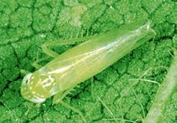
Potato Leafhopper
Damage
  Physical injury to phloem
  Leaves damaged
  Growth stunted, delayed
  Yield loss
Potato leafhoppers cause more damage than any other alfalfa pest in North America.
Notes:
Potato leafhoppers are small (1/8 inch), green, wedge-shaped insects. Adults and nymphs look similar except that adults have wings and nymphs have no wings. Leafhopper nymphs can also be distinguished from other small green insects because they can walk sideways when disturbed.
Potato leafhoppers feed on alfalfa by inserting their extended, beaklike mouthparts (proboscis) into leaves and removing plant sap. As they feed, leafhoppers inject a toxin back into the plant which inhibits water and nutrient transport. Feeding damage results in plant stunting, and the “tell-tale” yellowing of the leaves in a V-shaped pattern starting at the leaf tip.

Slide 3
Potato Leafhopper
Proboscis
Notes:
The potato leafhopper inserts its beaklike mouthpart structure (proboscis) into the food-conducting tissue within leaves (phloem) to extract plant sugars, minerals and other compounds.

Slide 4
Potato leafhopper migrates from Louisiana each spring
Notes:
Potato leafhoppers overwinter in the Southern U.S. Gulf States, and migrate to the Midwestern U.S. with southerly spring winds. They may actually arrive as early as April but do not move to alfalfa or begin rebreeding until second cutting. Thus, infestations are usually expected as mid- to late-season alfalfa pests.

Slide 5
Notes:
Problems typically occur in upper Midwest and Eastern states, though problems have been more widespread in some years.

Slide 6
PLH Life History Characteristics
1. Long range migration/locally dispersive
2. Wide range of host plants
3. Explosive growth potential
Management Implications for Alfalfa:
At the mercy of “regional” population
Must monitor and spray when necessary

Slide 7
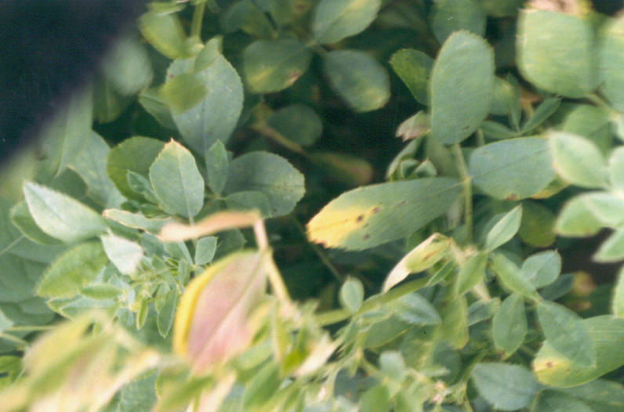
Potato leaf hopper and damage
V-shaped damage on leaf
Notes:
The point of the V is where the leaf hopper inserted its proboscis.

Slide 8
Potato Leafhopper Damage
Yield is reduced with plant stunting
Forage quality is lowered because crude protein is reduced
Source: Improving Alfalfa Forage Quality, CASC
Notes:
The damage caused by potato leafhopper stunts alfalfa plants and reduces yield. It also lowers the crude protein content of the alfalfa.

Slide 9
Potato Leafhopper Damage
New seedings of alfalfa are particularly susceptible to potato leafhopper damage
Failure to control potato leafhopper in the seeding year results in yield loss in subsequent years.
Notes:
New seedings must be monitored carefully and sprayed at threshold. Failure to do so can reduce yield throughout the life of the stand due to stress caused by leafhoppers during early stand establishment. When alfalfa is seeded under a cover crop, a glandular-haired variety is recommended.
Glandular-haired varieties are relatively “resistant” to leafhoppers and can tolerate higher numbers than more susceptible alfalfa varieties. When planting into a cover crop, this is important because it is difficult to achieve adequate insecticide spray coverage to new alfalfa seedings through a cover crop canopy.

Slide 10
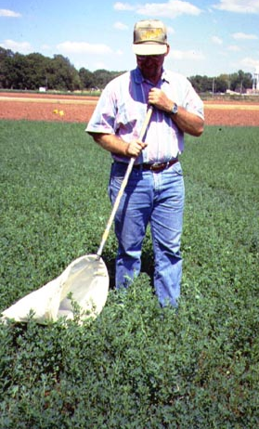
Monitoring
When: Mid-June until end of season
Detection: Sweep net
Sampling: Groups of 20 sweeps at 5 different locations, count potato leafhoppers per sweep
Threshold: Varies with plant height
Notes:
Because leafhopper populations vary from year to year and we cannot predict populations within a given year, fields must be monitored weekly to accurately determine damage potential.
Use a standard 15-inch diameter insect sweep net to take your samples. A total of 100 sweeps should be taken throughout the field. Walk an M-shape through the field, taking 20 consecutive sweeps in each of 5 randomly selected areas.
In order to obtain an accurate population estimate, sample for leafhoppers when alfalfa is dry, and avoid field edges in sweep pattern. Cold, wet or windy conditions may temporarily knock adults and nymphs from plants, resulting in an inaccurate sweep count.

Slide 11
Potato leafhopper scouting and economic thresholds
Alfalfa Leafhoppers
Height per sweep
(inches)
Under 3 0.2 adults
4 to 6 0.5 adults
8 to 11 1.0 adults/nymphs
12 to 14 2.0 adults/nymphs
Notes:
The larger the alfalfa the more PLH it takes to cause economic damage. This occurs both because the older plant is more tolerant of damage and because the PLH will be on the plant less time before it is harvested. Fields should be walked in ‘M’ pattern and twenty consecutive sweeps taken at each of five locations within a field.
The economic threshold is based on average number of leafhoppers/sweep. As you sample the field, keep a running total of the number of leafhoppers caught at each location and divide the total by 100.

Slide 12
Potato leafhopper scouting and economic thresholds
If the average potato leafhopper count exceeds the height of alfalfa in inches
- treat
Notes:
Another way of saying same information as previous slide.
Be very careful when looking for leafhopper nymphs! They won’t be found in the bottom of your sweep net along with adult leafhoppers. Instead, leafhopper nymphs will be found along the collar of the sweep net, near the wire hoop.

Slide 13
Potato Leafhopper Economic Thresholds
The previous economic thresholds are a starting point. To fine tune a treatment decision, spray cost and economic value of crop should be considered.
Notes:
The previous thresholds are the most commonly stated but you also need to take into account the current price of hay and treatment costs (both insecticide and application costs).

Slide 14
Glandular-haired alfalfa and normal alfalfa
Notes:
Stem with glandular hairs on top and without on bottom. The glandular hairs are both a physical deterrent and biochemical control. Glandular-haired alfalfa varieties are relatively “resistant” to leafhoppers, but not immune. And, not all alfalfa with hairs show equal resistance However, glandular-haired varieties can tolerate higher numbers of leafhoppers before economic thresholds are reached.
The following two tables consider the level of leafhopper “resistance” due to varietal selection.

Slide 15
Economic thresholds for spraying potato leafhopper in alfalfa (leafhoppers/10 sweeps), less than 50% resistance
Source: Rice and Lefco, IA State.
Notes:
This table provides potato leafhopper treatment recommendations by plant height and cost of treatment for two hay prices, and alfalfa variety with less than 50% resistance.
For example, if the cost of hay was $120/ton and one had 45 leafhoppers and nymphs per 10 sweeps, one would only spray if the alfalfa was 16 inches tall and the cost of spraying was $14/acre or if the alfalfa was 10 inches high and the cost of spraying was $16/acre.

Slide 16
Economic thresholds for spraying potato leafhopper in alfalfa (leafhoppers/10 sweeps), greater than 50% resistance
Source: Rice and Lefco, IA State.
Notes:
Same format as slide before last. Note that, when the alfalfa variety has greater than 50% resistance, the threshold is 1.5 to 2 times higher than for alfalfa varieties with less than 50% resistance. This means that varieties with greater than 50% resistance can tolerate higher potato leafhopper numbers, thus requiring fewer sprays than varieties with less resistance.

Slide 17
PLH Resistance Level Categories
Only a percentage of plants within a variety
have resistance to PLH
‘Early generation’ glandular haired alfalfa
varieties were Resistant (Less than 50% level)
HR* = Highly Resistant (>50%)
R = Resistant (31% to 50%)
MR = Moderately Resistance (15% to 30%)
LR = Low Resistance (6% to 14%)
*Late generation glandular-haired alfalfa varieties have
over 50% resistance (Highly Resistant = HR).

Slide 18
Glandular-Haired Alfalfa Variety PLH Resistance Ratings
www.uwex.edu/ces/forage
Under “select forage varieties” go to the “marketers …” and then
click on the green “Alfalfa”
Notes:
The UW Extension Forage web site, listed at the top of this slide, provides Potato Leaf Hopper Resistance Ratings (see 4th column) for different alfalfa varieties. The web site lists a wide selection of alfalfa varieties and includes information of disease resistance traits as well as Potato Leaf Hopper resistant traits.
Not all alfalfa varieties include the PLH resistant glandular haired trait. This slide lists several varieties from the UW Extension Forage Research and Extension program website that DO include the PLH Glandular Haired trait.
Please visit www.uwex.edu/ces/forage
Under “select forage varieties” go to the “marketers” heading
Click on the green “Alfalfa” link.
Table provides average yield, fall dormancy scale, winter survival index, disease resistance index for several alfalfa plant pathogens, Roundup Ready trait (Y/N), and Potato Leaf Hopper (PLH) resistance rating due to the glandular hair expression.

Slide 19
Glandular Haired Alfalfa
History
  early development in public sector
  commercial development & ultimate release (1997)
  trait from “exotic” Medicago, but not GMO
Mechanism of resistance?

Slide 20
Mechanisms of Plant Resistance to Insects
ANTIBIOSIS: plants are “toxic”
NON-PREFERENCE: insect will go elsewhere when given choice
TOLERANCE: plants can withstand more injury without yield loss
Notes:
The three mechanisms of host plant resistance, whether the resistance is against plant disease or insects, include: 1)Antibiosis; 2) Non-Preference; and 3) Tolerance, or some combination of these mechanisms.
Antibiosis = plants are “toxic” – A naturally occurring plant biochemical is produced that insects either do not survive on, or cannot reproduce as well on, after feeding. Antibiosis traits lead to lowered survival of pest insects on the crop plant.
Non-Preference = An example, the insect prefers to colonize a smooth stemmed crop plant variety versus one with dense hairs.
Tolerance = Insect thresholds can be increased in resistant crop varieties before economic yield loss occurs, as compared to non-tolerant varieties which would need to be treated earlier, and at lower insect pest density, to protect yield.

Slide 21
Three “Snapshots” from Arlington, Wisconsin, in the Evolution of Glandular Haired Resistance
1997, 1st production year (part of 4 state trial)
2000, seeding year
2003, seeding year
Notes:
The remaining slides in this presentation provide three “snapshots” from UW Madison Entomology and Agronomy Research at Arlington Agricultural Research Station.
The data present three benchmarks of progress in the Evolution of Glandular Haired Resistance to Potato Leaf Hopper. Beginning in 1997 when the GH alfalfa varieties were first commercially introduced, and then 2000 and 2003, by which time PLH resistance levels in GH alfalfa varieties had increased significantly since the original 1997 release.

Slide 22
Conclusions from 1997
UW Entomology/Agronomy Research
on Glandular-Haired Alfalfa Varieties
Overall performance of GH varieties in WI was disappointing (variable but “low” levels of resistance)
Resistance to hopperburn was apparent, and GH varieties supported fewer PLH, but this did not translate into a yield advantage
GH varieties also showed yield “lag” in absence of PLH
Notes:
Initial research in 1997 (data not shown here) can be summarized as disappointing overall. While the 1997 trials showed that the first GH alfalfa varieties showed some resistance to PLH, this resistance was LOW and VARIABLE.
Although resistance to hopperburn was evident (fewer symptoms in the field on GH varieties with low PLH resistance), this did not translate to a yield advantage over traditional, smooth-stemmed non-resistant alfalfa varieties.
The early GH alfalfa varieties also showed a yield “lag” in absence of Potato Leaf Hopper pressure.

Slide 23
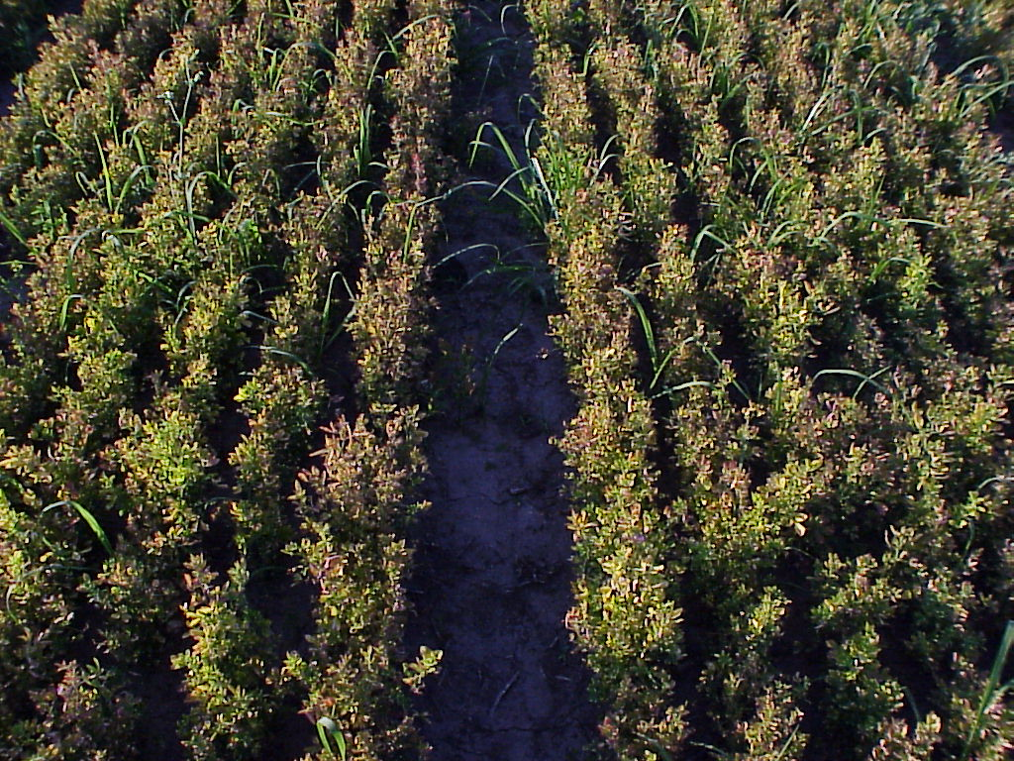
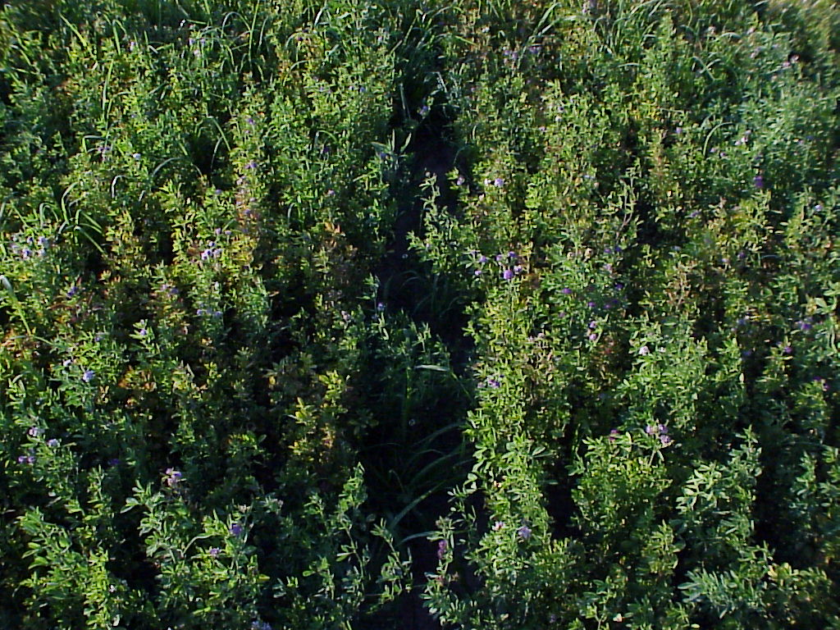
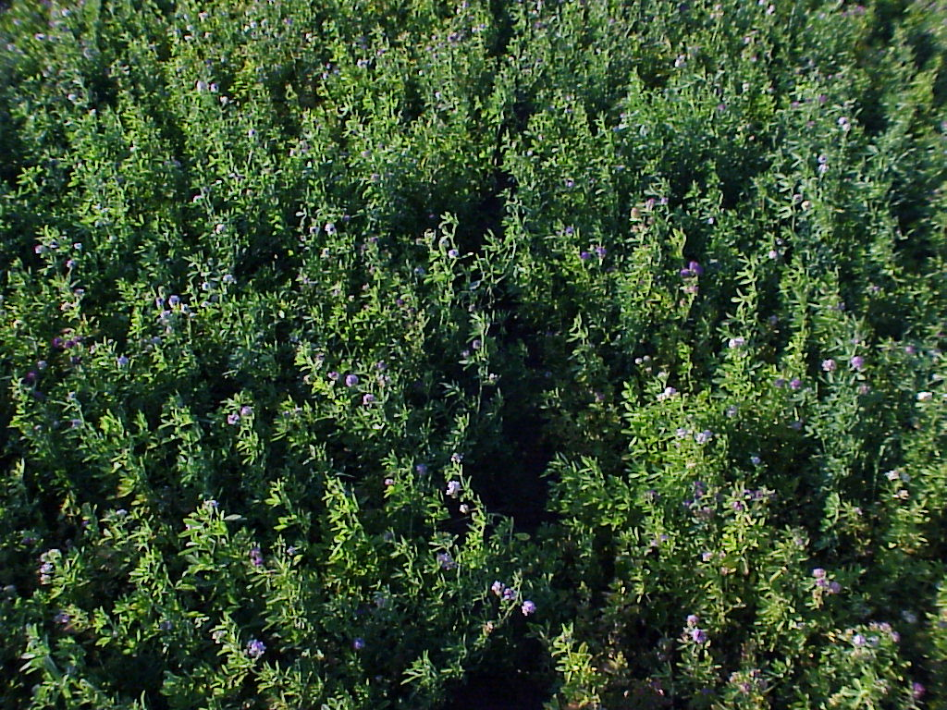
PIONEER 5454
(no resistance)
Arlington 2000
DK 131 HG (53% resistance)
EVERGREEN (79% resistance)
David B. Hogg, John L. Wedberg and Dan J. Undersander
Notes:
In 2000, alfalfa breeders were able to produce seed that was more resistant to Potato Leaf Hopper, a higher percentage of plants within the variety have resistance to PLH.
By 2000, there were both Resistant (30 to 50% resistance) and Highly Resistant (>50%) GH alfalfa varieties available.
Arlington trials compared PLH damage, yield response to insecticide treatment, and Host Plant Resistance as a stand-alone PLH control tactic across three alfalfa varieties.
Pioneer 5454 – the susceptible check, no GH resistance to PLH.
DK 131 HG (53% resistance, the lower end of Highly Resistanct, just over 50%)
Evergreen - at 79% resistance, this is a highly resistant alfalfa variety. GH expression and resistance to PLH significantly higher than the initial varieties released in 1997.

Slide 24
2000 YIELDS (Tons/acre)
[Plots cut July 19]
No PLH
Resistance
53%
Resistance
79%
Resistance
David B. Hogg, John L. Wedberg and Dan J. Undersander
Notes:
In the 2000 Arlington trial the three alfalfa varieties were evaluated under potato leafhopper pressure
Without insecticide (green bar), stand-alone GH resistance
Half-rate Warrior insecticide applied at the standard PLH threshold (blue bar)
Full-rate Warrior insecticide applied at the standard PLH threshold (orange bar).
The three varieties, and relative levels of PLH resistance are located along the X-axis.
The Y-axis indicates the 2000 yields (tons/acre) for each variety x treatment combination (no insecticide GH resistance alone, half-rate Warrior, full rate Warrior).

Slide 25
Conclusions from 2000
Performance of GH varieties definitely improved
Clear yield advantage of GH varieties in untreated plots, and no yield lag in absence of PLH
But GH varieties still lost yield when not protected
David B. Hogg, John L. Wedberg and Dan J. Undersander
Notes:
In 2000 trial, performance of the GH alfalfa varieties with PLH resistance improved, now at 50 to 80% resistance as seen in the 2000 trials (DK131HG 53%) (Evergreen 79%).
When comparing the untreated plots (green bars) across varieties, the GH alfalfa varieties provided a clear yield advantage versus the non-resistant check.
When the GH varieties were not protected at PLH thresholds with an insecticide treatment, they still lost yield.

Slide 26
2003 YIELDS (Tons/acre)
[Plots cut July 30]
No PLH
Resistance
53%
Resistance
HR = High Resistance
More than 50% Resistance
Thresholds:
2X
Reid B. Durtschi, David B. Hogg, John L. Wedberg and Dan J. Undersander, 2003
Notes:
In 2003, the trial was continued, - this time evaluating GH alfalfa TOLERANCE to potato leafhopper more closely. The X-axis shows four alfalfa varieties evaluated at Arlington in 2003.
Again Pioneer 5454 served as the PLH susceptible check (no GH trait)
DK131HG, at 53% resistance served as the PLH resistant variety.
In 2003, two Highly Resistant GH varieties (more than 50% resistance) were evaluated.
The green bars illustrate yield of all four varieties untreated, evaluating stand-alone PLH protection due to the GH trait. Here the orange bar for each variety represents yield when treated with insecticide at the standard thresholds (reviewed earlier in this slide set). The blue bar for each variety represents yield when each variety was treated at twice the standard PLH threshold.

Slide 27
Conclusions from 2003
Performance of GH varieties further improved
Yield responses similar to 2000, but yield loss gap narrowing in unprotected plots*
* plus this was under the most extreme conditions – new seeding with heavy PLH pressure
Reid B. Durtschi, David B. Hogg, John L. Wedberg and Dan J. Undersander, 2003

Slide 28
Summary
GH-based PLH resistance has improved substantially since its (premature?) commercial release in 1997
  % resistance has increased from 30’s to > 80
  agronomic traits, disease resistance also improved
Monitoring still needed for PLH in new seedings
  Evidence from ’03 suggests using 2X threshold
  timing might be the more important issue

Slide 29
Potato Leafhopper Resistance
New seedings should be sprayed at same threshold as non-resistant varieties
With potato leafhopper resistance greater than 50% thresholds can be increased up to 2 times before spraying is necessary.
Notes:
The higher thresholds do not apply to seeding year. Since the alfalfa is so sensitive to potato leafhopper damage, we have kept the same threshold for all varieties. The higher thresholds only apply to alfalfa following the year of establishment.

Slide 30



Credits:
This presentation was created from a collaboration among the following individuals:
Dan Undersander
David Hogg
Bryan Jensen
Eileen Cullen
University of Wisconsin
Richard Leep
Michigan State University
Paul Peterson
University of Minnesota

