Slide 1
Update on PLH Resistant Alfalfa
Mark Sulc
Extension Forage Specialist
Dept. Horticulture & Crop Science
sulc.2@osu.edu

Slide 2
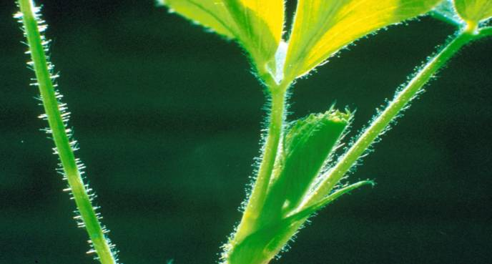
Potato leafhopper resistant alfalfa cultivars were introduced in 1997
PLH-resistant cultivars were developed using germplasm of Medicago species having glandular hairs.

Slide 3
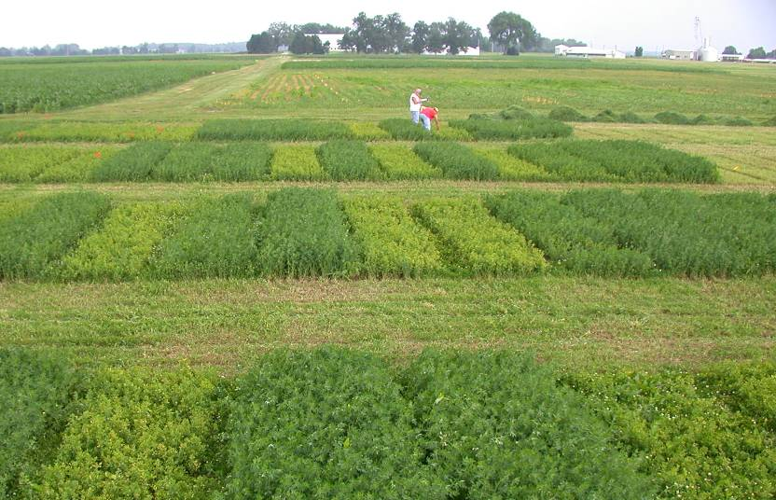
PLH Resistance and Agronomic Performance Have Improved
As levels of PLH resistance have improved,
the need for insecticides declines.
Notes:
Seeding year, very high PLH pressure.
NOTE: Varieties are now being released with >70% resistance.

Slide 4
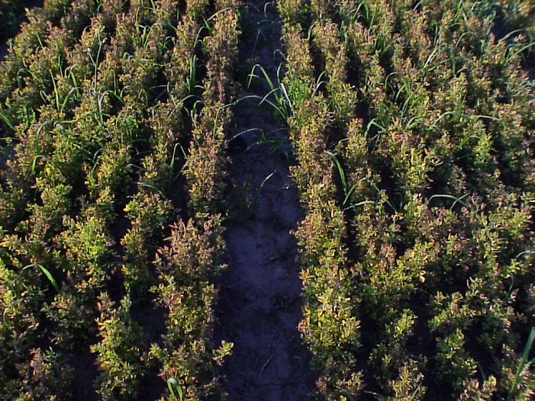
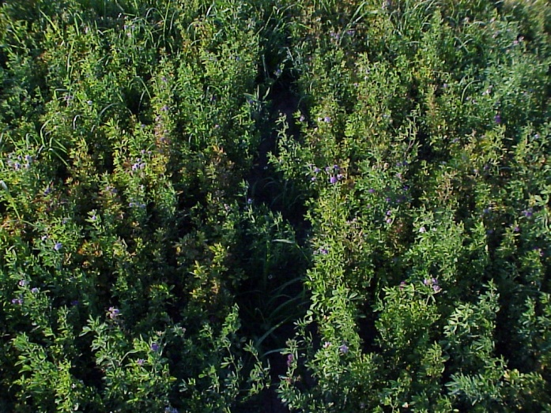
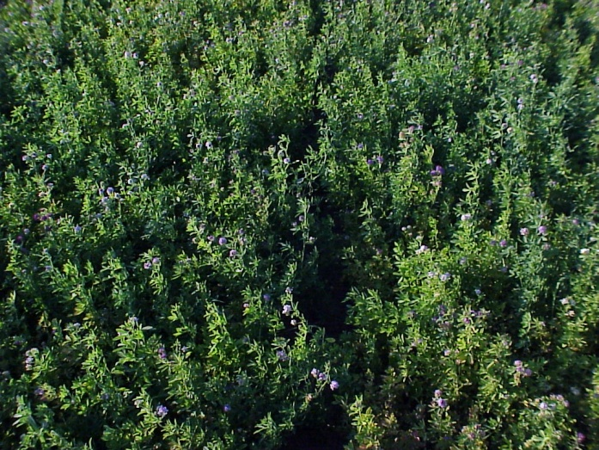
PIONEER 5454
(no resistance)
DK 131 HG (53% resistance)
EVERGREEN (79% resistance)
David B. Hogg, John L. Wedberg and Dan J. Undersander
Notes:
In 2000, alfalfa breeders were able to produce seed that was more resistant to Potato Leaf Hopper, a higher percentage of plants within the variety have resistance to PLH.
By 2000, there were both Resistant (30 to 50% resistance) and Highly Resistant (>50%) GH alfalfa varieties available.
Arlington trials compared PLH damage, yield response to insecticide treatment, and Host Plant Resistance as a stand-alone PLH control tactic across three alfalfa varieties.
Pioneer 5454 – the susceptible check, no GH resistance to PLH.
DK 131 HG (53% resistance, the lower end of Highly Resistanct, just over 50%)
Evergreen - at 79% resistance, this is a highly resistant alfalfa variety. GH expression and resistance to PLH significantly higher than the initial varieties released in 1997.

Slide 5
Average Alfalfa Summer Yield - Per Cut
4 site years – S.Charleston, OH
Resistant varieties limit yield loss

Slide 6
Effect of PLH Resistance on Yield
Ohio 2009-2011 (no insecticide applied)
Yield of susceptible checks

Slide 7
Yield of PLH Resistant & Susceptible Varieties
Iowa & Ohio - 13 harvests average
Notes:
Cost of insecticide treatment + application is about $15/acre. Three insecticide applications were made to get these differences, so cost per acre for insecticide is $45 per acre.
At $200/ton alfalfa value = susceptibles lost $83/acre (0.33 ton x $200) by not spraying, so it paid to spray them, but resistant only lost $20/acre (0.1 ton x 200), so it did not pay to spray the resistant varieties.

Slide 8
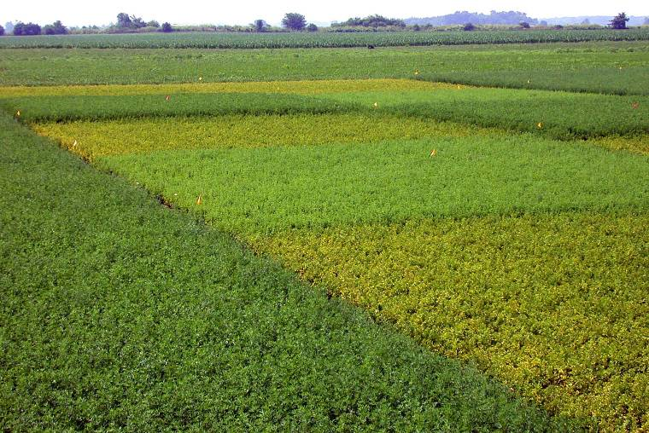
Susceptible vs. Resistant Cultivar
(with and without insecticide July 1, 2002)
Early spray
No spray
Late spray
No spray
Resistant
Susceptible
Notes:
Early spray applied when alfalfa at about 6-7 inches of height. Late spray applied 7 to 10 days later.

Slide 9
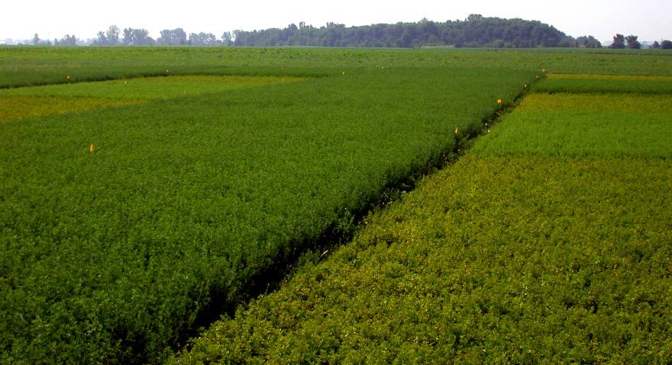
Susceptible vs. Resistant Cultivar
(with and without insecticide June 27, 2002)
Resistant
Susceptible
Notes:
Cannot see treatment effects in resistant variety. Same treatments were applied to resistant as to susceptible.

Slide 10
New Resistant vs. Susceptible
2001-2003 Total Yield
High PLH pressure all 3 years
(total of 17 harvests)
1.0
-1.1
No difference
-4.7
Notes:
Note yield advantage of resistant vs. susceptible in untreated plots (0.9 tons per acre).
Note resistant variety slightly outyielded susceptible in treated plots (by 0.1 ton per acre).
Note untreated resistant was very close to the yield of treated plots (resistant yielded only 0.12 t/acre less than treated susceptible).
This data is VERY ENCOURAGING!!!!

Slide 11
Marginal Return For All Harvests
Gross Revenue Less Insecticide Cost
High PLH pressure all years
Based on:
$150/ton alfalfa value
$15/acre per insecticide application
Notes:
Results from 2001 are VERY encouraging regarding PLH resistant varieties.
Factoring in the alfalfa hay value at a modest $150/ton, and treatment cost at $10/acre per application (3 applications were made, one on each of the 3 cuttings taken), the best value was the untreated resistant variety!
We will continue this research to see if similar results occur consistently.

Slide 12
PLH control in resistant and susceptible varieties
With Resistant Varieties, thresholds are 3X higher, once alfalfa established.
Apply insecticide if PLH are above threshold and harvest is >7 days away.
Lower the threshold when alfalfa is stressed.
Cut early if normal harvest time is within
7 days, then watch regrowth carefully.

Slide 13
Yield when PLH were above economic threshold
Ohio & Iowa 2006-07 (no insecticide applied)
* Yield significantly greater than susceptible checks
¹ Average yield at 10 harvests when PLH caused injury
² % yield improvement over the yield of susceptible checks
³ Checks = 5454, DK140

Slide 14
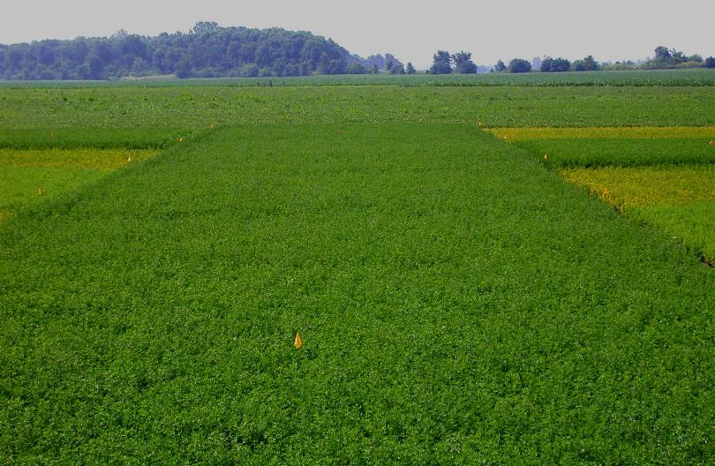
Questions?
Notes:
Results with the most recently developed PLH resistant varieties is very promising. Be sure to check performance records of resistant varieties…not all resistant varieties are created equal!!!
Refer them to our yield trial results. Iowa State also has good yield test results for PLH. Indiana has some as well. But ours and Iowa State’s have the hottest PLH pressure, consistently. We use South Charleston because it always get high PLH pressure.
As you move north and east, PLH damage is more variable in Ohio, but PLH can still be very damaging anywhere in the state. The consistency of damage is greater in western and southern Ohio.

