Slide 1
Industrial Hemp: Managing Your Risk in a New and Evolving Market

Slide 2
Outline
Disclaimers
Evaluating your risk
Resources for establishing a market
Best practices

Slide 3
Disclaimers
My background
Research vs. demonstration/experience-sharing
Do not expect this to save the family farm or get rich quick!

Slide 4
Evaluating Your Risk

Slide 5
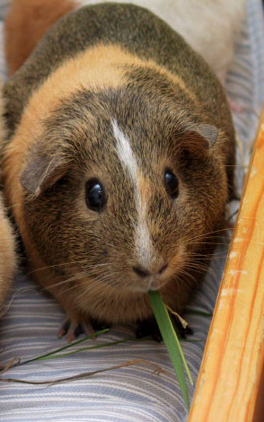
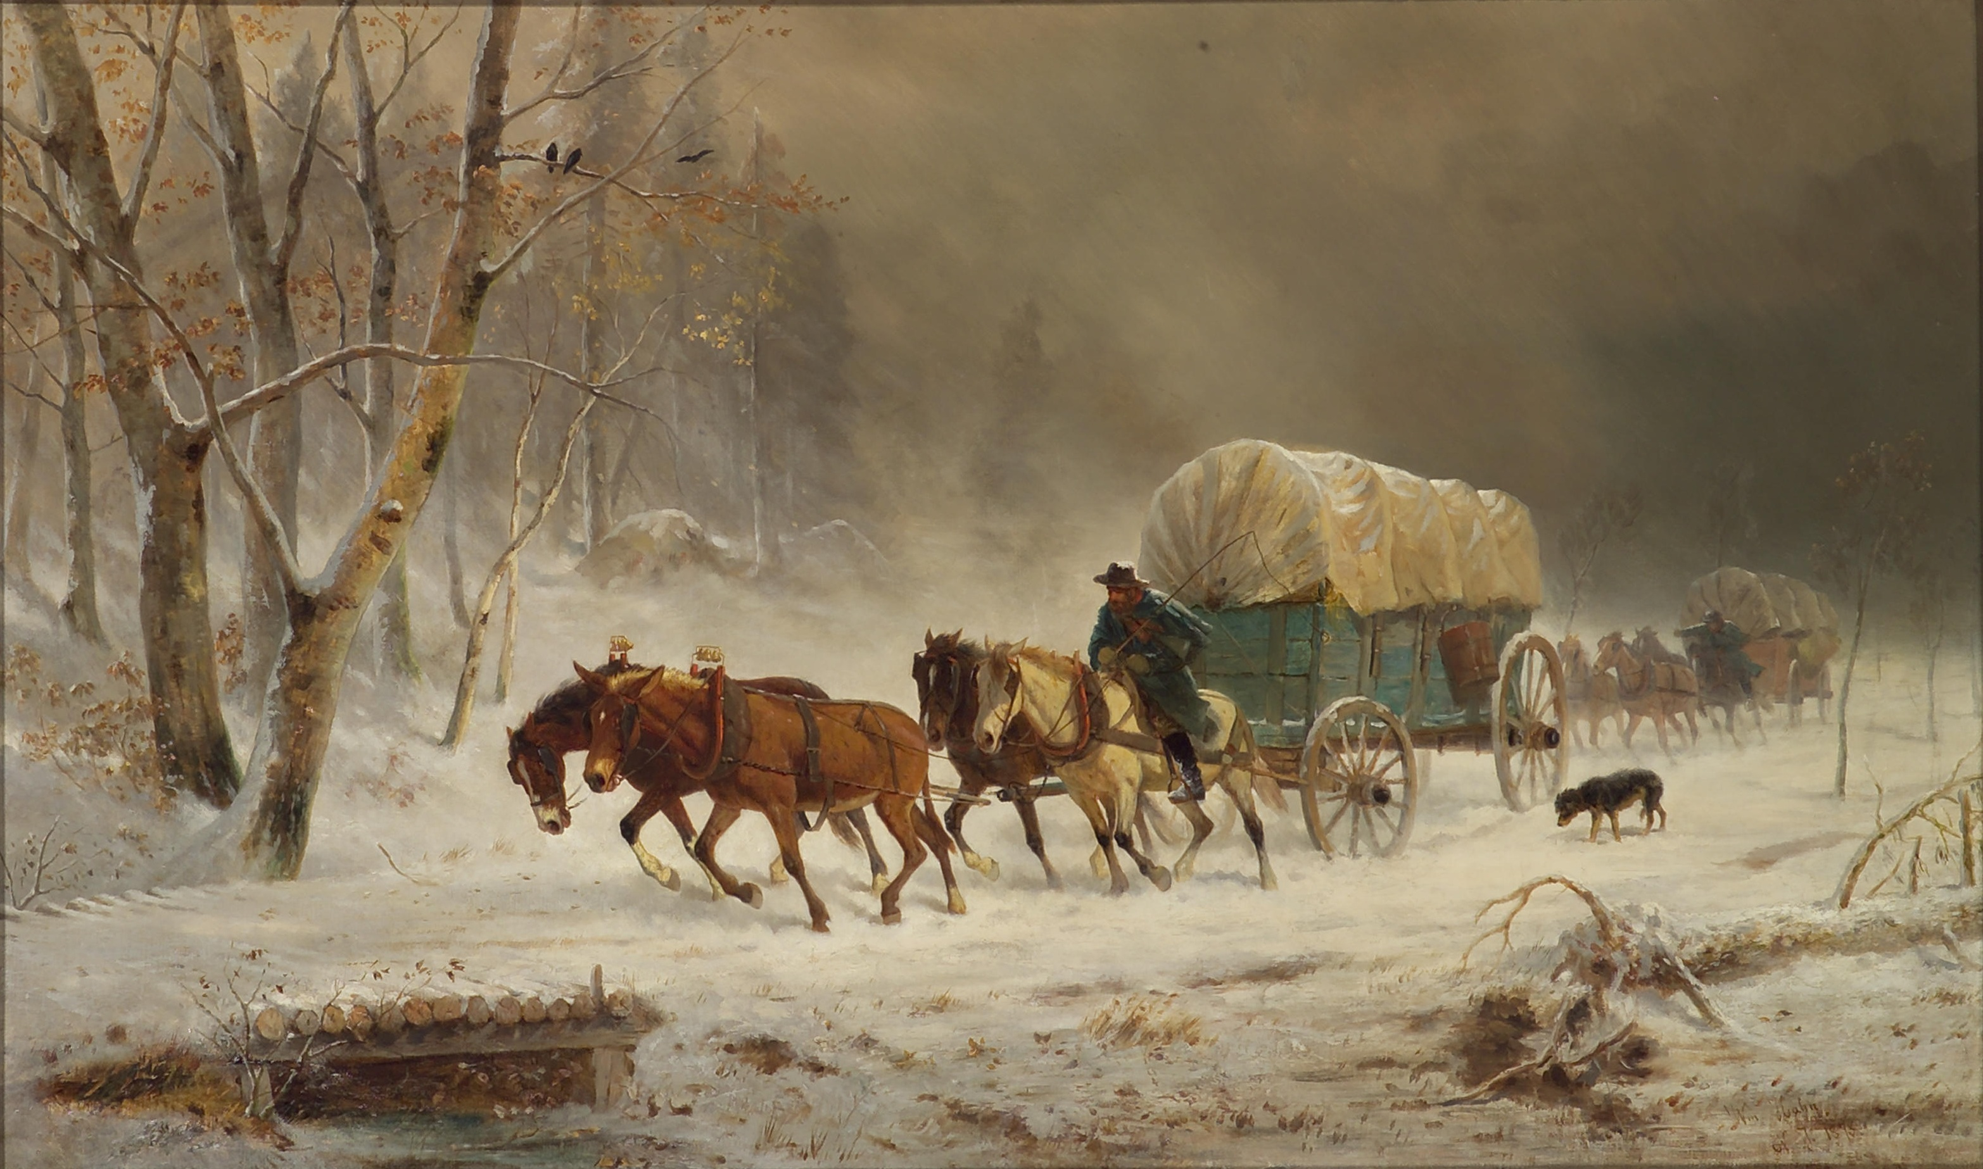
Assessing Risk Tolerance
The first penguin
Guinea pigs
Pioneers
Wild, wild west

Slide 6
What We Don’t Know (No Current WI Research)
Fertilizer recommendations
Weed management
Seeding rate
Water or light requirements
Harvest timing
Storage
Marketing
Pricing
Cost of production
Long-term side effects of CBD usage
Regulatory future (USDA, FDA, etc.)
Supply vs. consumer demand
Banking industry
Law enforcement
Political climate
Domestic markets
Global markets
Can you make money growing hemp

Slide 7
Identifying Risks - Examples
Choose “bad” variety
Test above 0.3% THC
Find a processor
Find a buyer
Inadequate drying and/or storage space
Can’t sell my hemp (unsalable)
Pollen or pesticide drift
Don’t know anything about hemp
Did everything right, still lost everything

Slide 8
Risk | Mitigation options
Field tests above 0.3% THC | Private lab testing, plant more than 1 variety, more than 1 field, submit DATCP harvest notice early, start at manageable size
Bad variety selection (THC levels, susceptibility, etc.) | Plant more than 1 variety
Can’t sell my hemp | Contracts, develop market first, storage plan, start at manageable size
Ran out of storage space | Pre-plan, back up storage, staggered planting, start at manageable size
Field seeded out (pollen contamination) | Remove males promptly, corn/tree barrier, 10-mile radius

Slide 9
Risk | Mitigation options
Can’t find a processor | Find one before grow, storage plan, become processor/partner with one, start at manageable size
Hemp tests positive for pesticide residue | Abide by pesticide label for carryover restriction, consult DATCP approved pesticide list, talk with neighbors, corn/tree barrier, soil test, tissue testing
Can’t sell hemp because heavy metals detected | Soil test, tissue testing
I don’t know anything about hemp! | Attend meetings, talk with other growers, start at manageable size
I lost everything (weather, insects, mold, THC test, etc.) | Understand risks, start at manageable size, be prepared for this outcome

Slide 10
Resources for Establishing a Market

Slide 11
Develop a Network
Buyer-Seller Listing
Directory Listing
Networking Listing
Attend meetings
Talk with other growers
Be careful!!

Slide 12
CBD/THC Testing Results Tool

Slide 13
Potency Testing Results Sharing Tool
Background
CBD and THC data summary
Self-report and laboratory anonymized report
Updates every 15 minutes if there’s new information
Special thank you to WI Hemp Scientific

Slide 14
How to use the information from the tool
Questions it can help answer (based on information included)
How do THC & CBD levels change on average over time?
What is the average THC & CBD content for this variety?
How often did a certain variety test above or below 0.3% THC?
When does my risk of testing above 0.3% begin? Where is the greatest risk of testing too high?
When would CBD content be maximized but still be legal?
Is there a relationship between THC & CBD content in WI and if so what is it?
What are the trends for THC & CBD? Can we say anything about this?
What kind of environmental or other factors might affect THC & CBD content?
When in the season did samples start testing above 0.3% THC

Slide 15
DISCLAIMERS!!!
Subset of data across the state
Sampling method variation
Laboratory method variation
Total vs equivalents
Pre-, at-, or post- harvest data
Cannabinoid levels: factors that influence them, relationships, trends
Notes:
This is a fraction of the samples that were tested across the state. It is not an all inclusive data set.
There is no standard sampling method for private laboratory testing and the sampling DATCP uses is entirely their own. I heard of one account personally from a grower who said they didn’t have the heart to sample from their best plants. I am questioning whether growers were able to collect a truly representative sample or not. On the opposite side, what if a grower ONLY sampled from their best plants? Could that overestimate cannabinoid levels just as ONLY sampling from average or suboptimal plants would underestimate them?
There are no standard laboratory methods for prepping and/or analyzing cannabinoid levels. This could cause variation between laboratories. The same sample sent to different labs could yield different results. Research has shown this is true even when standards are in place as there is variation between operators, different climates, laboratory equipment, etc.
There is also no standards in how the results are given. Some laboratories use a total value and some use equivalent values that may make some mathematical adjustments to account for some variation.
We don’t know when this testing was done: was it before, at or after harvesting? We can’t say that the samples that tested above 0.3% THC had to be destroyed or not because we don’t know when the sampling occurred, and again DATCP is the only entity that can do the testing in order to issue a fit for commerce certificate.
We also don’t know a lot about factors that influence cannabinoid levels—at least not from a university research standpoint in Wisconsin. For over 5 decades it was illegal to grow, which means there was 0 research being conducted by the university at that time. A lot of catch up is required to learn what can make cannabinoid levels change, relationships between various cannabinoids such as CBD and THC, and what we can call trends or say with any sort of consistency or reliability

Slide 16
Best Practices

Slide 17
10 Best Practices for Mitigating Risk
Do your research
Understand your risk
Treat hemp like any other business
Create a business plan
Develop a quality product
Set a fair price
Make a budget
Develop your market first
Weigh costs vs. benefits
Be cautious

Slide 18
Questions?
Liz Binversie
920-391-4612
eybinversie@wisc.edu

