Slide 1
Industrial Hemp 2019 Overview and Resources

Slide 2
Outline
Overview of statewide industrial hemp production for 2019
Keys to success
Pesticide drift video (Dr. Werle)
Resources
Pollen drift video (Leah Sandler)
Importance of neighbor communication
Activity time!
Notes:
Today, we’re going to take a broader look at the 2019 growing season; What you need to help you be successful; Pesticide drift issues; Where you can find resources; Pollen drift issues; The value of communicating with your neighbors; And then we will finish with an activity for those who said they want to participate.

Slide 3
Processor Licenses Issued in 2019
TOTAL= 588
Data source: Department of Agriculture, Trade and Consumer Protection
Graphic developed by: Liz Binversie, Extension Brown County
Notes:
This data was provided courtesy of the Department of Agriculture, Trade and Consumer Protection. The data is based off of the license and registration applications they received this year. At the time, they were still processing some applications so this information is not complete and this information may change because some of these numbers are estimates of what the grower thinks they will do. It will be interesting to compare these to the actual numbers provided by the end of year report due to DATCP.
So here, we see the total number of processor licenses issued for 2019. There were a total of 588 compared with 99 from last year. This is 6x the number of processor licenses issued last year. The darkest green represents counties that have 50 or more licenses, the next bracket is 11 to 49 licenses, then six to ten, and one to five. Counties that are shaded white didn’t have any licenses and gray means they couldn’t share this information and keep the grower or growers private.
Also I should note that at the time this report was run, there were 75 pending licenses. So if you watch the DATCP video from the Agronomics of Hemp webinar series on the YouTube channel, you’ll see a discrepancy between numbers and this is why.

Slide 4
Processor Locations Registered in 2019 (Estimate)
TOTAL= 640
Data source: Department of Agriculture, Trade and Consumer Protection
Graphic developed by: Liz Binversie, Extension Brown County
Notes:
Here we see the number of locations that processors registered for 2019. This is an estimate and could change. A location might not pan out or maybe the location moves somewhere else or other changes could happen that increase or decrease these numbers. But this hopefully gives you an idea of the potential number of processor locations for 2019.

Slide 5
Grower Licenses Issued in 2019
TOTAL= 1,269
Data source: Department of Agriculture, Trade and Consumer Protection
Graphic developed by: Liz Binversie, Extension Brown County
Notes:
In this map, we see the number of grower licenses issued for 2019. Last year there were 245 grower licenses issued. So this year there are Because the license is good for the lifetime of the grower, if we add last year and this year’s numbers we get 1,514 total licenses issued for the state of Wisconsin for the life of the program, or the last two years. However, this doesn’t give us a good indication of how many growers actually grew something or could grow something. It just tells us how many people got a license. The other component that you need to complete in order to grow is the annual registration application.
At the time this report was run, there were 150 pending applications. Again, this will be different than what’s show on the YouTube video from the Agronomics of Hemp webinar series. I also know that there are some refunds too on the grower annual fee. The license is non-refundable but you could still get your grower license fee back if you decide not to grow. Your license, again, does not expire but you will have to return the physical license to DATCP in order to receive your refund.

Slide 6
Growing Locations in 2019 (Estimate)
TOTAL= 2,042
Data source: Department of Agriculture, Trade and Consumer Protection
Graphic developed by: Liz Binversie, Extension Brown County
Notes:
This year there were 2,042 growing locations submitted through the registration applications received by DATCP. If you do the quick math, you’ll see there are more growing locations than licenses, even if you add this year and last year together. That is because growers may have more than one location where they’re growing hemp. So from these numbers, we can’t tease out how many growers submitted the annual application form. The official program, by the way, is called The Industrial Hemp Research Pilot Program. So if you see that, you know what it is.

Slide 7
Registered Growing Acres in 2019 (Estimate)
TOTAL= 15,526
Data source: Department of Agriculture, Trade and Consumer Protection
Graphic developed by: Liz Binversie, Extension Brown County
Notes:
Lastly, here is a map of the estimated growing acres planned for 2019. I stress this is an estimate because what actually gets planted could be much less or could be more than these numbers. Last year, 185 growers applied for the annual registration but only 135 planted. There were about 1850 field acres planted and 22 greenhouse acres. I don’t have numbers of what was registered last year vs what was actually planted. But this is 8x the number of acres planted last year. Even if only half of the acres are actually planted, that is still a significant increase from last year.

Slide 8
What Does This Mean for Growers in 2019?
Large demand, limited supply, increased prices
Infrastructure extremely critical
Increase risk of drift issues
Neighbor relations/communication even more critical
Notes:
So as you could see from the maps there is a significant increase in grower and processor licenses and estimated acreage that will be planted. That means there’s going to be an increased demand for inputs such as seed, plants, processor capacity, you name it. And while it’d be great if these things grew on trees, there’s a limited supply for some of these inputs that could drive prices up and increase your expenses. Earlier in the year, I was talking with a grower who said that availability of seed was becoming an issue and that prices had almost doubled what they were previously. About a month or so ago, the University researchers were having issue getting seed from an out-of-state supplier because they said until things were cleared up with taking seed across state lines, they weren’t accepting payment. On the chance that things don’t go as they should, they didn’t want to have to deal with refunds. That all got worked out, but these are some of the kinds of challenges that were happening. I’m sure others in this room can share their own stories.
This year it’s going to be even more important that we have the infrastructure needed to process what is harvested to what can be sold as a final product. I have heard from more than one person who said they’re still storing what they harvested and/or processed from last year. So some things to think about are how will I process what I harvest? Can I do it in such a way that I can store it long enough to find a buyer for it? Do I have the space to store it? Can you ensure the product will retain its quality while in storage? Ideally you will have a buyer lined up and some back up plans too, but the reality is that there is a real possibility that you may not be able to sell it right away and what is your plan for that?
With more growers on a finitely sized landscape, you’re going to have more neighbors. Some may be growing the same thing as you, others may not. So there’s increased risk of pollen drift between fields. Even if your neighbor isn’t growing hemp, but they’re growing something else, your fields could be at risk for pesticide drift too. How you plan to work with your neighbors is going to be very important.

Slide 9
Rodrigo Video
Notes:
So this segues into our first video about drift. Dr. Rodrigo Werle is the University of Wisconsin-Madison and Extension Weed state specialist. He wasn’t able to make it tonight so he put together this video about pesticide drift.

Slide 10
Keys to Success
Knowledge
Experience
Market
Plan
Notes:
So Dr. Werle went over some recommendations and some tips for helping you be successful this growing season. The knowledge you are gaining today and hopefully continue to get as you go through this season is extremely important. This is a huge learning curve for everyone. I mean the most experienced grower in the state only has 1 year of experience on a crop that hasn’t been grown in about 50 years. Even our most seasoned farmers have a learning curve because each crop is different and has its own unique challenges. So I hope that no one feels embarrassed that they don’t know as much as they think they should. The truth is that we are all learning and hopefully we can do that together and help each other out.
Experience is something that last year’s growers have, but even if you don’t have any experience at all, you can try to find someone who does have that experience and can share that with you. If you’re a farmer but never grown hemp specifically, you still have a lot of transferrable knowledge and some basics of growing crops to at least give you somewhat of a base to start with. Don’t underestimate your experiences and skill set, but hopefully you are open to learning and trying new things that might not be what you’re used to.
Market, market, market. I can’t stress how important it is to find a market for your product. I know that is not easy because there isn’t a really good, easy way to find out who is processing near you. But you can see if someone from last year can refer you to a processor or maybe you’ll hear of somebody by word of mouth. Maybe someone knows someone who knows someone. I’m working on a resource to hopefully help growers and processors make that connection and DATCP is working on allowing growers and processors to opt in or opt out of sharing their information, but that hasn’t passed into law yet and with talking with DATCP there isn’t a plan right now on how to do that since it’s not currently legal to do anyway. The plan is that myself and others from the university and DATCP will have a meeting once that is put into effect and see how we can work together or complement each other to get this information out there.
And finally, plan. What is your plan for setting up a processor and/or buyer? What is your plan for storage if that’s needed? What happens if you have a failed crop either due to high THC testing or weather issues or any number of things that could go wrong this season. Unfortunately, this is not a get rich quick scheme and takes a lot of time, labor, and TLC. So what is your plan, what is your backup plan, and what is your backup to your backup plan? Do you have a written agreement with those you’re working with like a processor or buyer? Are there clear expectations on what each party is agreeing to do or provide for the other party? Do you feel comfortable entering into an agreement or is there something or somethings that need to be amended so you do feel comfortable? And I am not a legal expert by any means so I would recommend consulting with an attorney for these legal questions or any contract questions. But in general, it is a best practice to get all agreements in writing so that expectations are clear and there is a written plan. You may also want to consider having some kind of language in there about what happens if there’s a failed crop or the quality isn’t met or whatever other scenarios you think you may face and what the plan is so there aren’t any surprises. Also, it’s very important to read the fine print and fully understand what it is you are agreeing to.

Slide 11
Resources
Websites: https://fyi.extension.wisc.edu/hemp (not “live” yet!)
Brown County Extension (www.browncountyextension.org, ag→forms & documents)
YouTube: https://www.youtube.com/channel/UCRajwFBcj7rIcXAD7ZXMnCg
Directory (February meeting)
Email list
Text list
Funding: judy information
Notes:
So I started to mention about resources to help get you connected with people and information. The first is a website I am working on that hopefully will be approved so it can go live. But I’ll share some screen shots in a moment to let you see what’s on there right now.
The second website is the one for my county extension office. Since the FYI website isn’t available yet, this is where you can find some of the handouts and resources from the meeting I hosted in February. This content will also be included in the FYI website once that’s public. I have a directory of growers and processors and other professional support. There are links to the DATCP industrial hemp website and PDFs of the presentations and also recorded video from the sessions.
The videos from the February meeting as well as one hosted in Dane county by my ag institute director is also housed on the YouTube channel. There are some other videos there including one by Dr. Werle on pesticide carryover and this is where we will be posting any future video content including webinars, how-to videos, and so on. And in about another week or so, I’m hoping to be able to customize the link so it’s a little easier to type out.
I mentioned the directory which I will pass around.
I also manage an industrial hemp email list so if there’s anything hemp related, I’ll send out an email to that group. I also have a text sign up if you prefer to get information via text.
And finally, there may be some ways to help fund your endeavors….

Slide 13
Website screen shots

Slide 14
Leah video
Notes:
So another speaker who was not able to make it tonight is Leah Sandler who works for the Michael Fields Agricultural Institute. She did her master’s research on CBD hemp and recorded this video about pollen drift for tonight’s meeting.

Slide 15
Neighbor Communication
Find your neighbors
Who is within 10 miles of you?
Word of mouth, online directories, consultants/service providers
Talk often
Be respectful
Agree to disagree
Notes:
So as you’ve seen from the two videos, it’s really important to have good communication with your neighboring growers. If you are growing CBD hemp, Leah showed us the potential for drift up to 10 miles. So it’ll be important to try to do some asking around to see who is growing within the radius. Use the FYI website, talk with friends and neighbors, maybe take a drive around or at least keep your eyes out for nearby fields. You could also ask suppliers or consultants in the area if they know of anyone they’re working with that is nearby you.
Talk often, especially around key times like when someone is spraying pesticides or scouting for male plants. See what they are experiencing or things that maybe are working well or not working well for them.
Be respectful. Farmers tend to be pretty independent and strong-willed so when you get a bunch of similar personalities together, there’s the potential for stepping on someone’s toes. Just remember that you can’t force anyone to do anything, but hopefully you can work something out to make the best of the situation.
And in some cases you may have to agree to disagree. I am only sharing this in the hopes that you don’t have to use it, but just know that there are mediation services available through the Wisconsin Farm Center which is run through DATCP as well if you have any really serious disputes. But again, hopefully you won’t run into this. And again, communication and respect is going to be key.

Slide 16
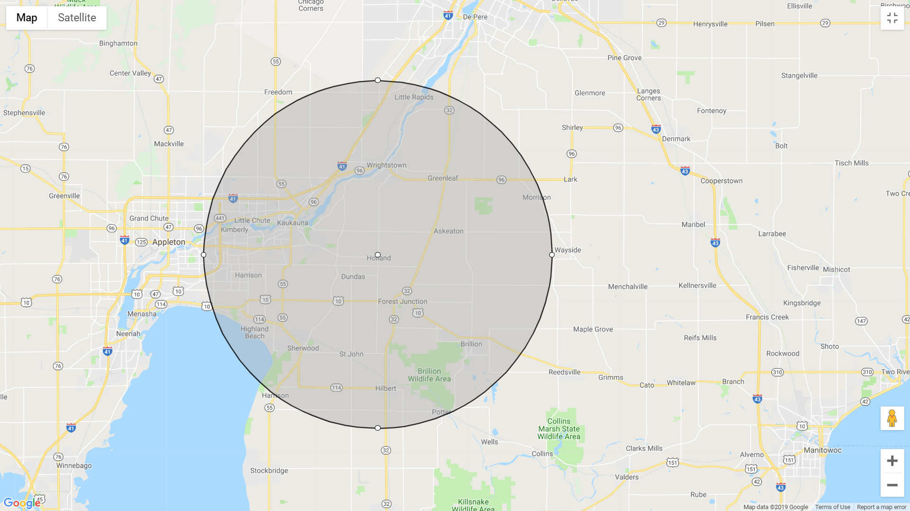
10 mile radius of
Van Abel’s
Notes:
So I’m going to start transitioning us towards this activity for those who signed up to do it but these first couple slides are a wrap up and are for everyone.
Here is a visual of a 10 mile radius of where we are. That’s a lot of farmland and a lot of potential for nearby neighbors.

Slide 17
Grower Licenses Issued in 2019
TOTAL= 1,269
Data source: Department of Agriculture, Trade and Consumer Protection
Graphic developed by: Liz Binversie, Extension Brown County
Notes:
Now imagine what it would look like if we mapped out those 10 mile radius circles for all of 1200+ licensed growers planted hemp, plus the 135 that planted last year too.

Slide 18
Activity Time!
Notes:
So, now for those who signed up to participate in this activity, we’re going to get started here and those that didn’t are free to mix and mingle with each other. Then at the end of the activity we’re going to all come back together and that will conclude the educational portion of the evening and I will turn it over to Tim Mickelson to continue with the networking portion of the evening.

