Slide 1
Credit and Debt:
Make it work for you!
Name, county, and date here

Slide 2

All Credit is Not Equal
Notes:
Discuss that there are different types of credit and different ways we use credit.

Slide 3


Affordable Credit vs.
Too Much Credit
Notes:
Talk about this idea and examples. Take away – even “good” credit, like a school loan or mortgage, is “bad” if it’s not affordable for your income.

Slide 4
When you use credit, you’re spending money before you earn it.
Notes:
All credit has this in common – “good” or “bad”.

Slide 5
Types of Credit:
Revolving Credit Account
Credit cards – MasterCard, Discover, Visa,
JC Penney, etc.
Charge Account
Utilities, dentist, cell phone, etc.
Installment Loans
Car loan, mortgage, student loan, payday loan, etc.
Notes:
Review different forms of credit we may use.

Slide 6
Types of Credit
Secured vs. Unsecured
Dischargeable vs. Non-dischargeable
Notes:
Different forms of credit are handled differently by creditors and in bankruptcy.
Secured credit examples – car, house, loan where item is used as collateral
Non-dischargeable debt in bankruptcy examples – taxes, student loans (under all but most dire situations), child support, etc.

Slide 7
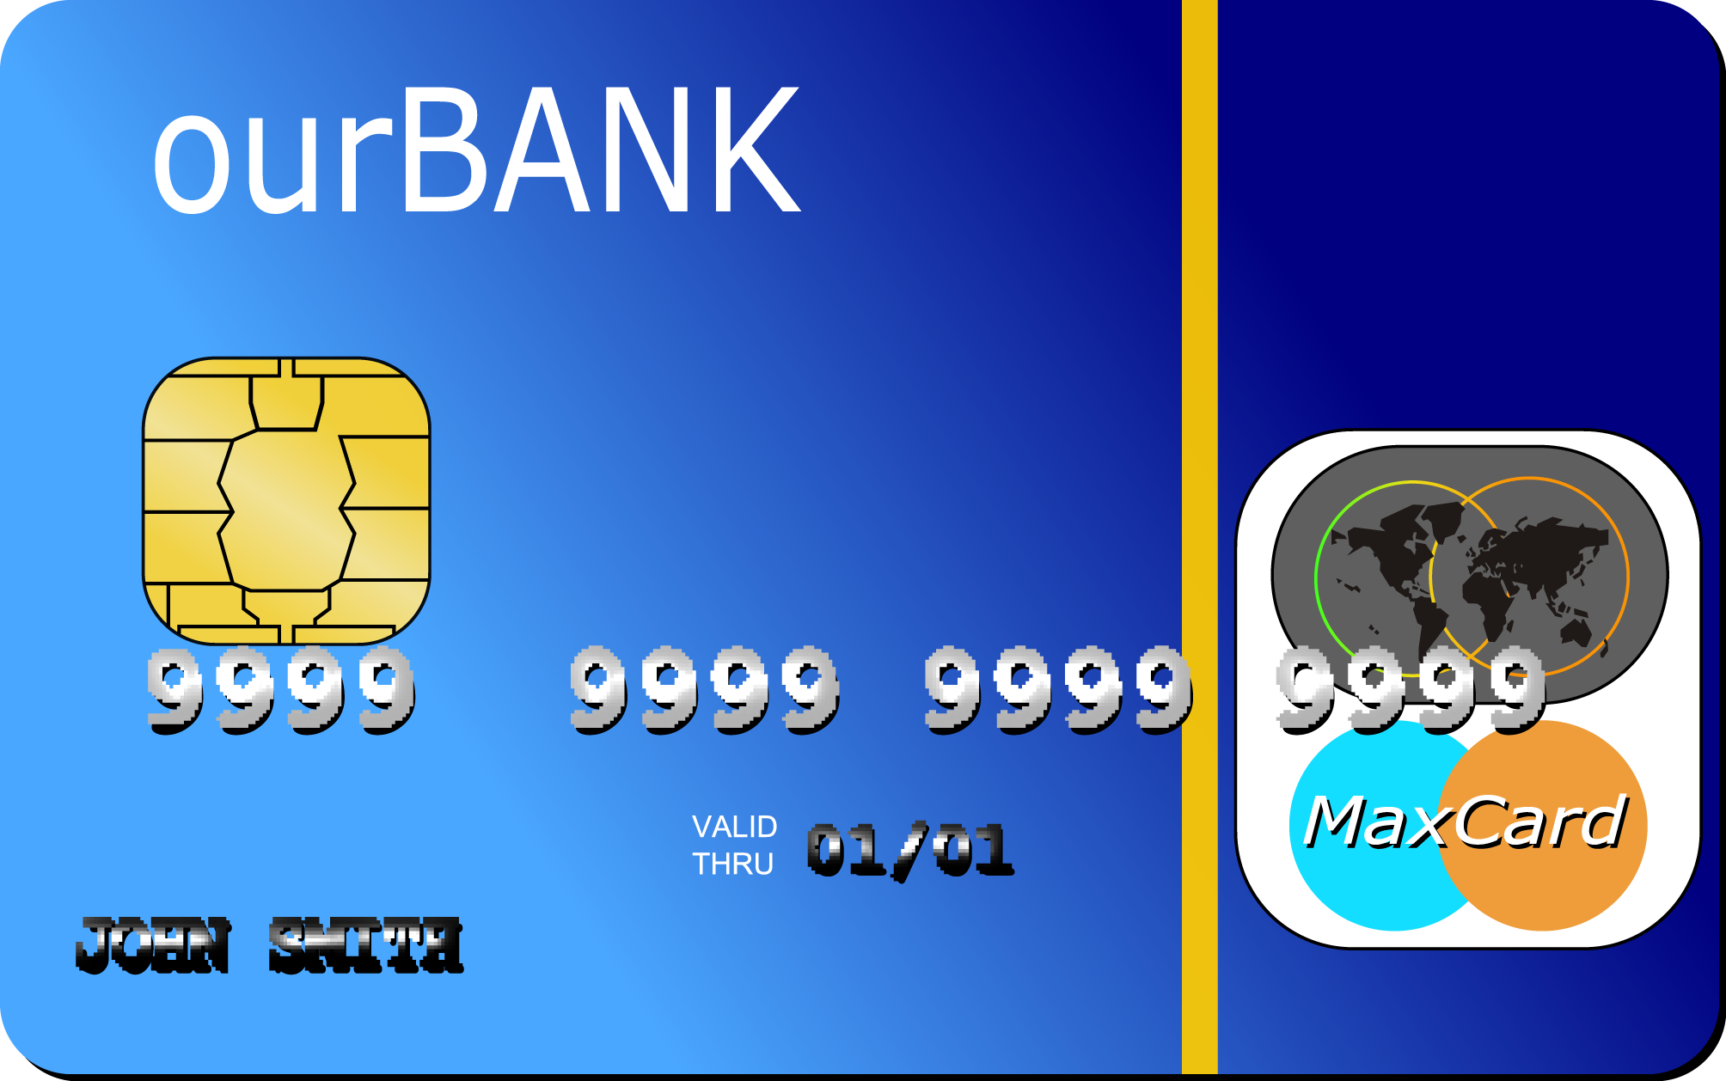
What’s the Difference?
Credit Cards
Debit Cards
Prepaid Cards
Secured Credit Cards
Notes:
There are many different forms of plastic out there today - each has it’s pros and cons. You could go through the list and ask for a show of hands for anyone who’s ever used one of these cards. (depends on how much personal sharing the group is comfortable with) Or you could ask for a show of hands if they know anyone who’s ever run into trouble with any of these types of cards.

Slide 8
Credit Cards
Pros:
Cons:
Credit history
Emergencies
Perks
Disputes
$50 liability
Interest rates
Fees:
Late
Cash Advance
Overlimit?
Annual fee?
Notes:
Pro – builds positive credit history only if used positively; some people have a credit card they keep tucked away just for emergencies
Con – You can’t opt out so that your credit card doesn’t approve going over your limit.

Slide 9
Debit Cards
Pros:
Cons:
No interest
Quick cash
Limit spending
Online payments
Credit History
Fees:
Point of sale
Who’s ATM?
Overlimit?
$500 liability?
Notes:
Pros – accepted in many more places these days
Cons – not reported to credit bureaus (even if it has a visa/mc logo on it); 2014 CFPB study = avg household spending $29/yr on debit fees if person opts in to overdraft vs. $7 if opt out and watch account balance; ATM fees average $4.57 per transaction if out of network. stolen card can wipe out account if you don’t catch it; need to opt out of overlimit to avoid fees
NOTE – CARD Act: FI’s must give you option to opt-in to overdraft fees for debit and ATM purchases, but they don’t have to give you a choice for checks and automatic transactions.

Slide 10
Prepaid Debit Cards
Pros:
Cons:
No interest fees
No bank account
Online payments
Safer then cash
Limit spending
Credit History
Earn no interest
Fees:
Activation
Monthly
ATM
Overlimit?
Notes:
Pros – helps those without bank accounts or those who want to limit spending
Cons – Doesn’t build credit history (although a few high cost cards are offering this feature to report to bureaus), some have high transaction fees

Slide 11
Secured Credit Cards
Pros:
Cons:
Safer than cash
Build savings
Liability
Could build or rebuild credit history
Ties up money
Interest rates
Fees:
Maintenance
Late
Overlimit
Notes:
Pros – help for people wanting to build/rebuild credit BUT only if the company reports to the credit bureau (some don’t)
Cons – ties up your money required in a bank account; some have high fees

Slide 12
When you do use credit… know how much today’s credit will cost you tomorrow.
Notes:
Explore some examples next about how interest can really add up.

Slide 13
Current Credit Card Balance = $1,715.24
Minimum Payment Due = $18
Due Date = 21 days
If you make no additional charges on this card and each month you pay… | You will pay off the balance on this statement in about… | And you will end up paying an estimated total of…
Only the minimum payment | 12 years | $2,685 (969.76 in interest)
$55 | 3 years | $1,977 (Savings = $708)
Notes:
Example of new “black box” warnings on credit card statements. I added the information in red that will not appear on a statement. (This assumes a variable interest rate between 16-24% depending on types of charges made) You can ask if anyone has noticed these on a credit card statement?

Slide 14

Subprime Types of Credit
Pay Day Loans
Rent to Own
Car Title Loans
Pawn Shops
Rapid Tax Refund
Anticipation Loans
400-800%
40-700%
Notes:
Additional examples of higher cost credit.

Slide 15
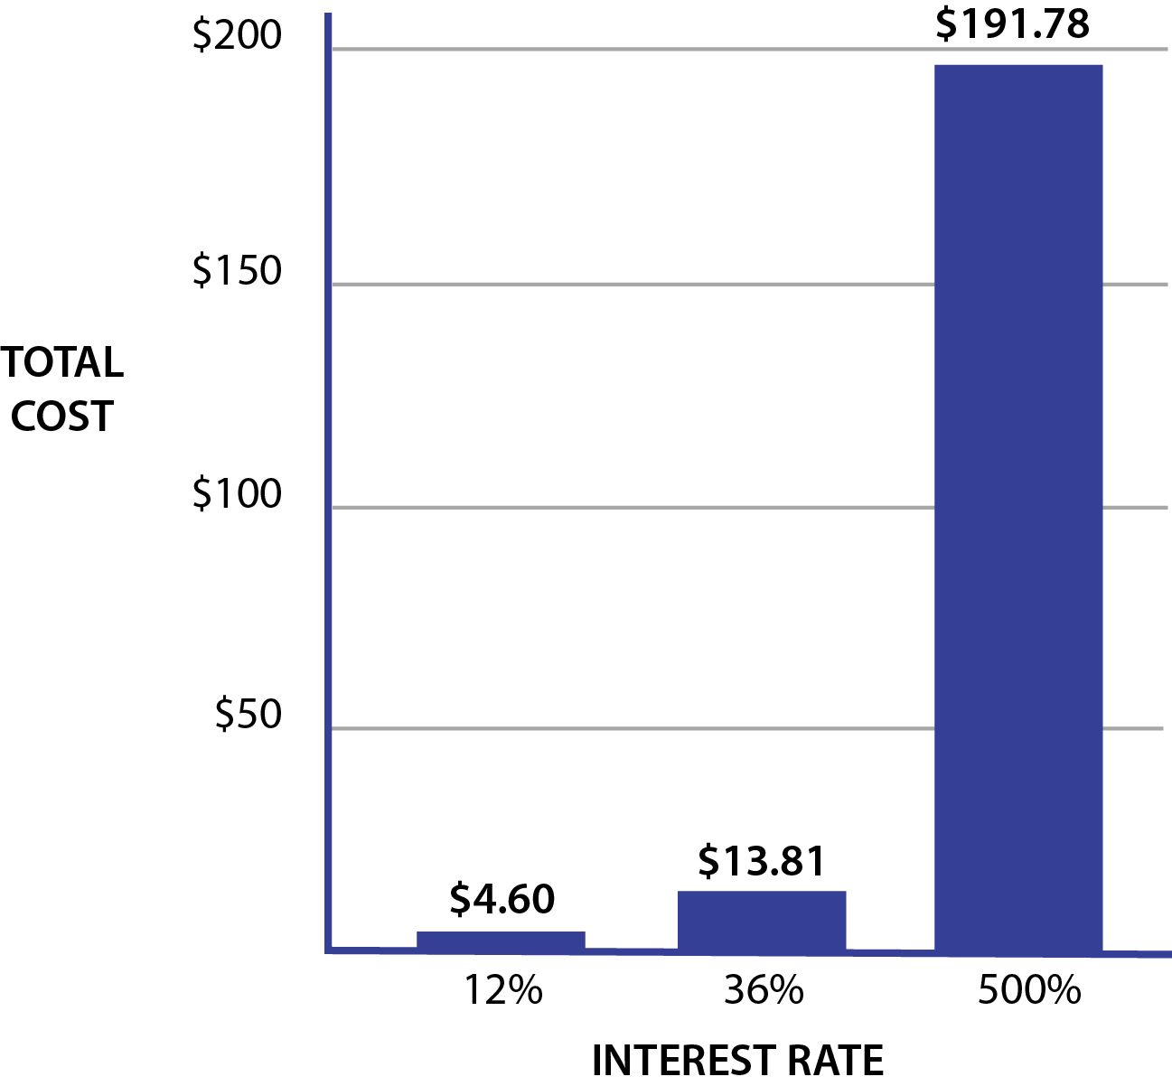
Pay Day Loans
Interest Cost on a $200 Loan Outstanding for Ten Weeks
Interest really adds up when the loan
is rolled over: 4 times = $191 in interest
Notes:
Higher cost credit options become overwhelming quickly when you start to roll over the loan. You could ask how many people know someone who’s had trouble paying off their loan.

Slide 16
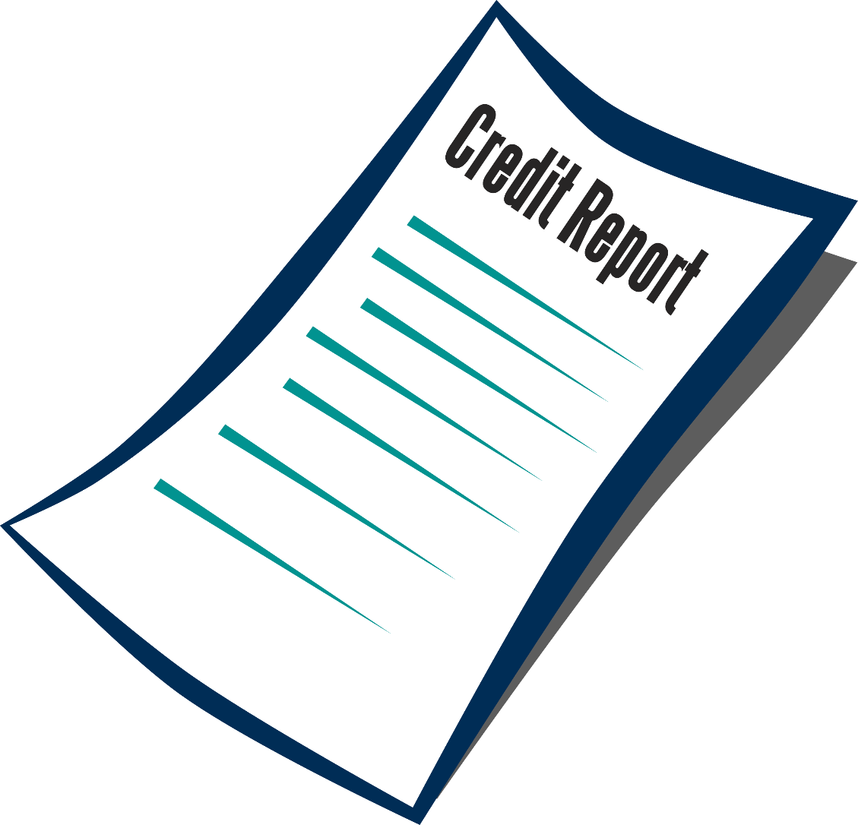
Who cares about your credit?
Creditors/Lenders
Insurance Companies
Landlords
Employers
Utility Companies
Government Agencies
YOU!
Notes:
Before you bring the list up on the screen, ask group to answer this question. Some may have stories to share about how their employer, landlord, or insurance company checked their credit.

Slide 17

Credit Reporting Agencies
Equifax
Experian
TransUnion
Notes:
Each agency has information from a variety of sources, therefore, not all your reports will be identical. How many people have ever seen a copy of their credit report? They will need to have had a credit/trade line open for at least 6 months in order to have a credit report, so some younger participants or those with no credit use, might not have a report. It’s still good to check though, just in case someone else has been using their name and social security number for credit.

Slide 18

FREE Credit Report
www.annualcreditreport.com
1-877-322-8228
Annual Credit Report Request Service
PO Box 105281
Atlanta GA 30348-5281
Check for mistakes!
Notes:
Refer to credit report order form in handouts (I like to supply a stamped addressed envelope so they can pop it right in the mail – then I offer to meet with anyone who’d like help reviewing their report when it comes) If you’re meeting in a facility with computers, they can look up and print off a report right away.

Slide 19


Credit Scores
FICO Score most widely used
Vantage Score – 3 Bureaus
Many other “score” brands
Credit
Score
Excellent
Average
Poor
Notes:
Different types of scores, plus these go up and down each month depending on data reported to bureaus.

Slide 20
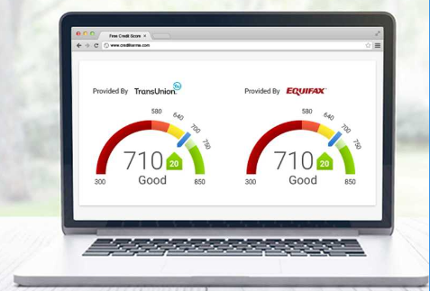
Free Educational “Credit Score” Services:
Creditkarma.com
Credit.com
Quizzle.com
Freecreditscore.com
Discover card
Likely not the same
score your lender uses.
Notes:
IF clients want a benchmark score.

Slide 21
FICO Score
Source: Fair Isaac Corporation
Types of Credit in Use
Payment History
10%
New Credit
10%
35%
15%
Length of Credit History
30%
Amounts Owed
Notes:
Use FICO for the example since it’s widely used by creditors. Review handout on what lowers and raises your credit score.

Slide 22

Check Your Credit Report Campaign
“5 minutes 3 times per year”
2/2, 6/6, 10/10
http://fyi.uwex.edu/creditreport/

Slide 23
Signs that you have more expenses than income:
Income
Lost sleep.
Behind on bills.
Carry a credit card balance.
Spending money for interest and late fees.
Not able to save for future purchases.
Increase in money arguments.
Spending
Notes:
Can use this or not as a transition slide to when credit becomes unmanageable.

Slide 24
Catching up on credit payments:
Try not to take on any new debts.
Make a list of all your debts.
Figure out how much money you can pay towards debt.
If you have money for payments - Use “PowerPay”
Notes:
Options to pay off debt – if people have money to put towards payments. Some people may not have additional money to pay off debt and may want to seek credit counseling to explore other options.

Slide 25
“Power Pay” Concept
Pay your credit payments as usual.
When first loan is paid off . . .
. . . apply that payment to the next loan.
When loan two is paid off . . .
. . . add that payment to the next loan.
Continue this process until all loans are paid off.
Utah State University Extension www.powerpay.org or app store
Notes:
Plus other tools are available on line.

Slide 26
Power Pay Strategy
 | Discover | MasterCard | Doctor
April | $22 | $35 | $35
May | $22 | $35 | $35
June | $57 | $35 | $0
July | $57 | $35 | ---
August | $57 | $35 | ---
September | $0 | $92 | ---
October | --- | $57 | $35
…and so on | --- | $92 | $0
Notes:
Walk through example so people get idea.

Slide 27
But what if there’s not enough money?
Income
Spending

Slide 28
If you have don’t have money for minimum payments:
Talk with your creditors
Financial counseling
Debt management plans
Debt consolidation
Bankruptcy
Notes:
Options for people in financial distress:
Talking with creditor – always first option!
Budget counseling through CCCS or UWEX
Debt management – can lower total debt but still need money for payment plan
Debt consolidation – beware – lots of scams out there!
BK – last resort, need to talk with attorney and go through $ counseling, costs avg $1300-2000

Slide 29
When you can’t pay bills . . .
Act now!
Notes:
Handout with local resources. Kind of a downer to end – so instill a ray of hope!

