Slide 1

Welcome to the
2015 North Central Region
4-H Volunteer e-Forum!
“Find the Heart of 4-H”
Notes:
Slide #1
Slide time: 15 seconds
Rachelle – Welcome to the 2015 North Central Region 4-H Volunteer e-Forum: “Find the Heart of 4-H”!

Slide 2
“The Heart of Community”
Notes:
Slide #2
Slide time: 5 seconds
Rachelle - Tonight is the first e-Forum session. Tonight we focus on “The Heart of Community”.

Slide 3

Welcome from
4-H National Headquarters
Doug Swanson
National 4-H
Program Leader
Notes:
Slide #3
Slide time: 3 minutes
Rachelle - Before we get started, we want to kick off this e-Forum series with a few words from Doug Swanson, our National 4-H Program Leader.
[Online Facilitator – please play streaming audio recording of Doug Swanson, National 4-H Program Leader]

Slide 4
Congratulations North Central Salute to Excellence Award Winners!
Jeremy Smith, Indiana
2015 Volunteer of the Year
Keith Waddelow, Indiana
2014 Outstanding Lifetime Volunteer
Barbara Determan, Iowa
2015 Outstanding Lifetime Volunteer
Angela Baumer, Ohio
2014 Volunteer of the Year
Notes:
Slide #4
Slide time: 1 minute
Rachelle:
The North Central Region would like to take a moment to congratulate the 2014 and 2015 Salute to Excellence Regional Award Winners.
Angela Baumer of Ohio, and Jeremy Smith of Indiana received the Volunteer of the Year awards.
Keith Waddelow of Indiana, and Barbara Determan of Iowa received the Outstanding Lifetime Volunteer awards.
Additional information about each of these outstanding volunteers is included on the handout that you’ll receive this evening and is also posted on the Volunteer Specialists Web site.
[Host Site Facilitators, please distribute the “2014 and 2015 North Central Region 4-H Salute to Excellence Award Winners” handout to your participants.]

Slide 5
Tonight’s E-Forum Program:
The Heart of Community
Cathy Johnston, University of Nebraska
Pat McGlaughlin, University of Illinois
Rachelle Vettern, North Dakota State University
Notes:
Slide #5
Slide time: 2 minutes
Each of us will introduce ourselves quickly.

Slide 6

1) Encourage youth voice in the community.
2) Incorporate civic education in 4-H.
3) Build skills for youth civic engagement.
4) Develop 4-H service learning experiences.
Notes:
Slide #6
Slide time: 1 minute
Cathy:
The learning objectives for tonight's “Heart of Community” e-forum session are:
Volunteers will be prepared to help youth find their voices as they become actively engaged in their communities.
Volunteers will learn the importance of civic education and incorporate community engagement activities in 4-H experiences.
Volunteers will develop skills to guide youth as they become civically engaged in positive community change
Volunteers will understand how to collaborate with 4-H youth for an educational service learning experience.

Slide 7
4-H’ers are 3.3 times more likely to contribute actively to their communities when compared with youth who do not participate in 4-H and 25 percent more likely to contribute positively to their families and communities, (Lerner & Lerner 2013).
Notes:
Slide #7
Slide time: 1 minute
Cathy:
Many of you have seen the research from the 4-H Study of Positive Youth Development conducted by Richard M. Lerner, Jacqueline V. Lerner, and Colleagues.
This slide highlights some of the results from the research that confirms the importance of focusing on the Essential Element, “generosity”, in our 4-H club and community activities.

Slide 8
Community Engagement Poll Questions
Share Your Perspective!
I believe that community engagement is an important part of the 4-H experience
My club engages in service learning projects.
Notes:
Slide #8
Slide time: 4 minutes
Cathy:
[Online Facilitator, please upload these poll questions.]
We’re going to ask you to respond to two poll questions related to community engagement:
Tell us how important you believe community engagement is to the 4-H experience. 1 is not very important; 5 is extremely important.
Does your 4-H Club engage in service learning projects? Please answer Yes or No.
Host site facilitators, please take a few minutes to collect the responses from the participants at your site. Determine the most frequent response and respond to the poll for your group collectively.
[Presenter, provide a summary of the responses received to the poll questions before moving to the next slide.]

Slide 9
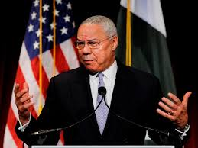
Gen. Colin Powell
“By teaching young people the joys of service, we make good citizenship a vital, transforming and continuing aspect of our national character.
.
Notes:
Slide #9
Slide time: 30 seconds
Cathy:
General Colin Powell, 35 year veteran of the U.S. Army, former Chairman of the Joint Chiefs of Staff and U.S. Secretary of State, and the founder of “America’s Promise”, often talks about citizenship and the value of service learning. He is quoted as saying, “By teaching young people the joys of service, we make good citizenship a vital, transforming, and continuing aspect of our national character.” This quote frames what we will talk about this evening.

Slide 10
COMMUNITY SERVICE:
Helping to better others
Learning is secondary and un-intentional
Youth learn life skills and process
Notes:
Slide #10
Slide time: 1 minute
Cathy:
Community Service
According to Roxanne Turner of Michigan State University Extension, in community service, “The goal is to help these groups or people to better their program or life in some way, and we hope the youth providing the service will learn things such as life skills and processes along the way. However, the learning is secondary and unintentional.”
Community service is a wonderful project that many 4-H clubs (and other organizations and individuals) participate in to help churches, individuals, organizations, schools and communities. The goal is to help these groups or people to better their program or life in some way, and we hope the youth providing the service will learn things such as life skills and processes along the way. However, the learning is secondary and unintentional. Community service volunteering is a fantastic life skill from which we should all take the time to learn and grow. But is there another way that can benefit both the youth doing the work and the ones receiving the service in a more obvious way?
[See more at: http://igrow.org/4h/healthy-living/difference-between-community-service-and-service-learning1/#sthash.dV0SUlHN.dpuf ]

Slide 11


SERVICE LEARNING:
Community Service on steroids
Enriches learning by engaging youth in meaningful service
Planned integration with established learning objectives
Notes:
Slide #11
Slide time: 1 minute, 30 seconds
Cathy:
Service learning is a community service on steroids, with intentional learning being the primary goal, and the service secondary. Although you may say, “Well it sounds rather rude to put the service second when you are trying to help people,” I guarantee that the group being helped will not get less service due to this process, but more.
The youth providing the service come up with a plan, assist the group, and then reflect back on the event. They will learn from the very early stages the concepts of generating ideas on how to help; putting together the process; performing the task; and then reflecting back to see how they could have improved their plan.
They reflect on areas of the project by asking questions such as, What did they learn? Does the group need further help? Should they have chosen a different task to be more successful? and so forth.
Through this reflection process, the youth may be able to help the group further, or be more educated for the next group they help, but most certainly they will be able to recognize their own personal growth and understanding of the situation due to their participation in the project.
Service learning provides tangible results that please stakeholders and help enhance program sustainability and future funding. There are benefits to both forms of service, but service learning provides more bang for your buck and should often be considered as the better choice.

Slide 12
Elements of Service Learning
Integrated Learning
High Service
Youth Voice
Reflection
Collaboration
Evaluation
Notes:
Slide #12
Slide time: 1 minute, 30 seconds
Cathy:
This slide shows some elements of high quality service learning to take into consideration:
Integrated Learning: When integrated learning occurs, the service activity enhances the important knowledge, skills, or goals of the class, school, or youth group.
High Service: Work that is considered high service meets a real need in the community (as defined by the community), is age-appropriate, well-organized, and gets something done.
Youth Voice: Youth should be engaged in as many aspects of project planning as possible.
Reflection: Reflection should take place before (to prepare), during (to troubleshoot) and after (to process) service activities.
Collaboration: All stakeholders (including administrators, agencies, businesses, community members, parents, youth, volunteers, and teachers) are involved in planning, execution and evaluation.
Evaluation: Evaluation seeks to measure progress toward the learning and service goals. All partners, especially youth, are involved in evaluation.

Slide 13
Tips for conducting a service learning project
Start Small
Youth take the lead
Set clear goals
Talk with partner agency
Explore the causes of social issue
Lead by example
Plan ahead
CELEBRATE!!!
Notes:
Slide #13
Slide time: 2 minutes
Cathy:
TIPS for conducting a Service-Learning project with youth:
* Start small and be successful.
* Seek youth ownership and leadership of the service project.
* Be clear and explicit about the goals for the youth - learning, leadership and personal development.
* Explore the causes for the social issues the youth are addressing.
* Plan far enough ahead to allow community organizations to participate - usually a minimum of four weeks.
* Serve the youth; lead by example.
* Conduct formal reflection with the youth.
* Maintain open and regular communication with the volunteer coordinator at the agency for the service project.
Celebrate when the project is over and recognize youth accomplishments. Media coverage of the project is an excellent form of recognition.
Conduct an evaluation of the project with the youth, parents, agency, clients, etc.
Recognize the community organization's efforts - through thank-you cards, letters, newsletter article, etc.
HAVE FUN!
I want to leave you with this famous quote by General Colin Powell, “By teaching young people the joys of service, we make good citizenship a vital, transforming and continuing aspect of our national character.”
[See more at: http://igrow.org/4h/healthy-living/difference-between-community-service-and-service-learning1/#sthash.dV0SUlHN.dpuf]

Slide 14
Brainstorm Service
Learning Project Ideas
In the chat pods, please list service learning ideas that reflect the learning of the specific project area.
Animal Science
Fine and Fiber Arts
STEM
Food and Nutrition
Notes:
Slide #14
Slide time: 8 minutes
Cathy:
[Online Facilitator, please make four chat pods for this slide.]
[Host Site Facilitator: Divide your site participants into 4 groups by their project interest. Have them brainstorm ideas and the facilitator will enter the ideas into the chat boxes.]
At your site, divide into 4 small groups based on these 4-H project areas and brainstorm ideas for service learning projects that relate to and might increase the learning in the area listed. For example, if you are in the Animal Science Projects group, you might take your pets to a nursing home for a visit with the residents. You will have 4 minutes for discussion and then we’ll give you three minutes to view other groups’ answers.
Host site facilitators, please type your groups’ ideas into the appropriate chat pod.
[Allow 7 minutes for on-site brainstorming and discussion.]
What a great list of ideas! As you can see, there is an opportunity to relate your service learning event to the project areas in which the youth are already working. This makes the projects more meaningful to the youth.
Pat will now help us explore strategies for service learning.

Slide 15
Getting to the
Heart of the Issue
Discover data
Determine decision makers
Define the issue
Deliver the message
Notes:
Slide #15
Slide time: 1 minute 30 seconds
Pat:
Cathy has provided you with a great introduction to community service and service learning and taken you to the step of identifying the focus for your service learning work.
Now we will explore strategies to use during the developmental work of your club service experience.
There are many different ways to approach identifying an issue. In some instances, it will start from an observed need that you see in your community. At other times it might be more content based – there is a cause or a subject matter that you are passionate about, and you pursue a service outreach to align with that cause. A cause or subject matter issue is what we are going to think about as we explore issues today.
If you have a desire to get others excited about an issue, then you need to know about it from all angles. It needs to be more than just a feeling that something is important. This is when we drill down and identify the local decision-makers you need to keep in mind as you are looking for information AND also as you begin sharing how this service experience impacts others.
You also need to identify data that tells a story about why this is an issue. We know the human interest story can convince a lot of people that this is an issue about which they should be concerned. If you are looking to stimulate change, secure funding to support your effort, or to get others involved, you need to have some data to back up what you say.
And finally, be realistic about how much you can accomplish. Keep your service experience manageable.

Slide 16
The Youth Difference
Power of Youth Voice
Community stakeholders
Youth & Adult Partnerships
Equal partners
Local and state legislators
Built on trust
Notes:
Slide #16
Slide time: 2 minutes
Pat:
First we want to think about the stakeholders – who do we need to connect with who will have an interest in how this impacts the community?
You might wonder if making connections with stakeholders is really a role for youth. The answer that I get from community leaders as well as community and state legislators is, YES! Youth today have an important voice that they can and should share with all who will listen. Key stakeholders talk with adults all the time. Stakeholders love having the opportunity to hear the perspective of a youth or teen who is knowledgeable about a cause that they believe is important in their community.
To be effective in working with stakeholders, youth need to become familiar with who the community leaders are and what community government looks like. They need to see how it is structured; look at the local governmental website to see what is there; and become familiar with the board members – figure out what their interests are. It may involve teens talking with board or council representatives. The group may want to identify a list of questions that are used to get information from a range of people and then shared with the whole team. These discussions may help identify a key stakeholder who shares their concerns and is interested in supporting the change effort.
Create a strong youth-adult partnership. This requires intentional training to help the youth and adults understand what the other group brings to the table. Discover how they can work together as true partners. They will NOT be effective if their relationship is ADULT DRIVEN. Youth must be viewed as equals – and then must STEP up and take the lead. To be successful, both groups must have trust with the other.

Slide 17
Identify Stakeholders
Use the Stakeholder Identification Worksheet as you brainstorm key stakeholders with an interest in this service learning project.
Animal Science
Fine and Fiber Arts
STEM
Food and Nutrition
Notes:
Slide #17
Slide time: 5 minutes
Pat:
As I mentioned, today we are going to continue thinking about service experiences associated with a subject matter interest area.
Using a service learning project idea you identified earlier related to either Animal Science; Science, Technology, Engineering & Math (STEM); Food & Nutrition; or Fine & Fiber Arts – work as a group at your site to identify stakeholders who would be key to talk with or interview to gain their perspective of the issues associated with your service focus.
For example, perhaps you were looking at a service issue that falls under the Food & Nutrition area – the issue is youth in your community who are food insecure. They have enough to eat during the week when they are getting lunch provided at school; however on weekends or during summer, there is no guarantee that they will have access to food. The question you need to answer is – who are key stakeholders that could 1) either help you in your effort to provide food for those food insecure families; AND/OR 2) key stakeholders that need to learn of the impact your group is making.
You should have a worksheet to use as you brainstorm together. Identify key stakeholders who will have or who you believe should have an interest in this topic.
[Host Site Facilitators: please distribute the handout, “Stakeholder Identification Worksheet”, to your participants.]
We will give you 3 minutes to work on this at your site.
[Host Site Facilitators, please ask your participants to complete the worksheet. [Allow 3 minutes for on-site activity.]
Thank you – this is a first step toward either connecting with local people of power with your story and the impacts being made; OR those who can help you in your efforts. Use this worksheet as you plan service learning projects with your 4-H youth. Youth may have very different views as to who key stakeholders are in the community, and it is important to gain their perspective.

Slide 18
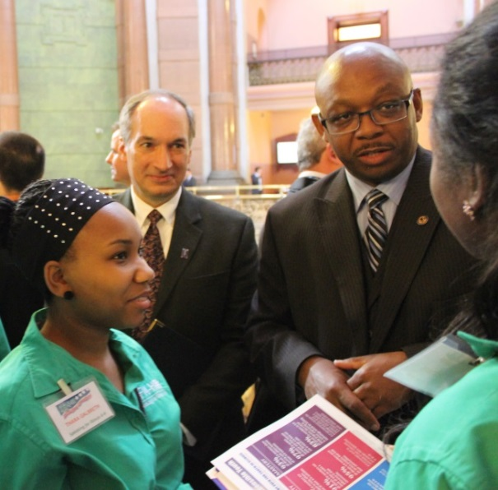
Discovering the Data
Trustworthy Data vs. Personal Opinion
Examples of Existing Data
Survey & Observation Skills
Stakeholder Interviews
Community Mapping
Notes:
Slide #18
Slide time: 2 minutes
Pat:
Essential to any change effort is gathering data about the problem, including public opinion about BOTH the problem or issue that has been identified, and ALSO the proposed change.
In order to collect data that will be respected by key stakeholders or governmental officials and the general public, it is necessary that youth learn of the importance of objective data and how to collect different types of data. Once they know that, they can collect and analyze a variety of factual data. The final piece will be deciding how to present the data in a way that makes sense – both to the target audience and to the teens.
Trustworthy – it is important that the data they share come from a trusted source, not just a personal opinion. It is critical to know and share where you got your information. People will ask.
Existing Data Collection - look at information that is already available from reputable websites; reports; or local coalition information.
You can also collect data you get through observation – you visit places, watching for the issue and taking notes; or creating a survey for community members with a short list of questions, using a multiple choice option. Consider doing a community “walk around” where you go as a group, walking through the community but doing it with the lens of identifying where there are overlooked issues.
Interview key stakeholders which might include a number of people, depending on the issue…community officials, business leaders, even the general public who may be affected by the issue. In some cases, you might conduct an interview.
There are many different places you can go to find and gather data. The key is to make sure what you have tells the whole story.

Slide 19
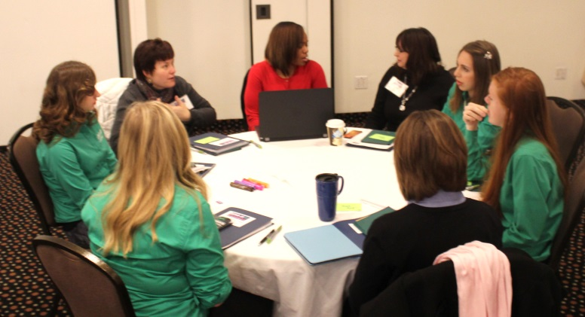
Survey & Observation Options
Survey Options
Observation
Monitoring of behavior or actions
Low tech
Paper Survey
“Man on the street” questions
High tech
iPad Survey
E-mail Survey
Notes:
Slide #19
Slide time: 2 minutes
Pat:
Youth should play an active role in data collection. One method of seeking community input is a survey to collect information by asking “average” community members a short list of questions. Surveys have less questions than interviews, they can be easy multiple choice, and they are easy to tally and analyze. Once you have your questions, you can go low tech – using a simple paper survey with a group of people in a classroom setting or on the street; or you can choose to go high tech, and have the questions loaded onto an iPad so people read and respond. This provides you with an electronic summary of the responses. If you have email addresses for a target group, then you can email the link to the survey directly to them.
Your method of gathering the responses depends on resources you have available.
Another strategy that doesn’t involve a survey, but that can also be effective, is observation. Identify key locations in the community impacted by the service focus. Target a time when people will be in that area and record how their behavior and actions are impacted. For example, if the focus of service is on inadequate playground equipment in a local park, including how often children are waiting to use the playground equipment, note any safety issues that exist with current playground equipment. Record this information on multiple visits to add validity to your assessment.
Observation data can be a valuable tool as it provides data gained from the source of your planned service. You do not have to rely on the willingness of someone to stop and give their input, and it allows you to make decisions based on what you see people do rather than what they say they do.

Slide 20
Stakeholder Interviews
Interview Guide
Key Questions
Needs-based
Strength-based
Notes:
Slide #20
Slide time: 2 minutes
Pat:
Interviews are a good way to find out how community stakeholders feel about the service topic. You have already identified stakeholders who have a vested interest in the focus of your service project, now it is time to get their input. Interviews typically involve more questions than surveys, and they take more time, because there is always the potential for conversation to generate more questions. When conducting interviews with multiple stakeholders, it is important that you use a standard set of questions so each has the same opportunity to provide input.
We have provided you with a handout that gives some examples of two different types of questions when trying to decide if a stakeholder’s organization or their position might be a natural partner and support in a service project effort. Please take it out now. You will see that there are needs based questions and strengths based questions as well as other instructions.
These are the questions to ask a community stakeholder who you believe might be a partner in supporting a service project.
When involving youth in data collection, always have youth work in pairs or small groups accompanied by an adult.
[Host Site Facilitators: distribute the handout, “Sample Interview Questions for Stakeholders”, to the participants.]

Slide 21
Data Driven Decision-Making
Animal Science
Fine and Fiber Arts
STEM
Foods and Nutrition
Use the Data Collection Worksheet as you brainstorm data collection strategies that best support this service learning project.
Notes:
Slide #21
Slide time: 6 minutes
Pat:
Going back again to the service learning project you identified earlier related to either Animal Science; Science, Technology, Engineering & Math (STEM); Food & Nutrition; or Fine & Fiber Arts, work as a group at your site to identify which of the data collection strategies best support your service learning project. In most cases you will want to have more than one method of data collection.
Use the “Data Collection Identification Worksheet” to guide discussion at your site as you brainstorm together.
[Host Site Facilitators, please distribute the handout, “Data Collection Identification Worksheet”, to your participants.]
We will give you 3 minutes to work on this at your site. Host site facilitators, please try to type in some of the responses you hear as appropriate.
[Allow 3 minutes for sites to complete this activity.]
This gives you some practice in working with 4-H youth to develop a plan for securing the data to support your service learning project. Use this worksheet as you plan service learning projects with your 4-H youth. Youth are a key source of information about what is going on in your community. They see and hear things from different sources and it is important to gain their valuable input.
[Host Site Facilitators, please ask your participants to complete the worksheet. Facilitators, please point out some of the answers. ]

Slide 22
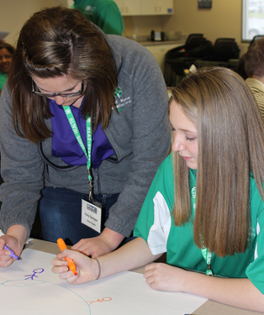
Putting it All Together
Community Mapping
Identify where the issues are in a visible or tangible way.
Use the data to make informed decisions.
Notes:
Slide #22
Slide time: 1 minute
Pat:
Using the data that has been collected, create a visible representation of what you have learned. This may be an actual map that has identified physical locations of interest, or it may be a diagram that identifies multiple issues related to the service learning project. You will find some examples of service learning community mapping in your handouts.
[Host Site Facilitator, please distribute these community mapping handouts to your participants.]
The important piece of information that you should always keep in mind when seeking and exploring data is that the data is there to help you make informed decisions.
Use the data you have collected as you move forward in carrying out your service learning project.

Slide 23




Which of the following data collection options will best support our
4-H service learning project?
Notes:
Slide #23
Slide time: 3 minutes
Pat:
[Note: Online Facilitator, please bring up Poll Question.]
As you are thinking about data and how it can support your service learning project, please take a moment and respond to the following question at your site and then input your group response into the poll.
Which of the following data collection options will best support our 4-H service learning project?
Existing data – census data; School Report Card data; local health department data
Surveys – paper
Surveys – electronic
Observation Data Collection
Stakeholder Interviews
Other
[Allow 2 minutes for local discussion.]
[Host Site Facilitators, please discuss this question with your participants and report your group’s consensus in the Poll Question.]

Slide 24
Break
We will begin again in 10 minutes.
Notes:
Slide #24
Slide time: 10 minutes
Pat:
It is now time for a 10 min. break. We look forward to you rejoining us as Rachelle moves us into the nuts and bolts of planning and implementing your service learning project.
[Online Facilitator, please play some background music.]
[Host Site Facilitators, please invite your participants to enjoy some refreshments, take a stretch break, and return in 10 minutes.]

Slide 25
Service Learning-
Ideas for Your 4-H Program
4-H Facilities
4-H Promotion
Community Center
Holiday Boxes
Birthday Parties
Welcome signs
Pet shelter supplies
Bike-Hike trail
Stuffed animals for children
Military Service Members
Public Servant Appreciation
Notes:
Slide #25
Slide time: 2 minutes
Rachelle:
Successful Service Learning experiences come from meaningful service learning opportunities. Included on the slide are some ideas that may spark ideas for you and your 4-H members that may lead to a deeper service learning experience.
Refer to the handout “Service Learning Ideas for Your 4-H Program” for a further description of these ideas.
[Host Site Facilitators, please distribute the “Service Learning Ideas for Your 4-H Program” handout to your participants.]
Question: What do you think leads to an in-depth service learning experience?

Slide 26
Carrying Out Service Learning
Create Project Plan
Raise Funds
Promote/Market your project
Control risk
Reflect
Evaluate/Celebrate
Notes:
Slide #26
Slide time: 1 minute
Rachelle:
This slide highlights the pieces of an effective service learning experience.
We will explore each of these pieces and how they apply to your 4-H club or group’s service learning experience.

Slide 27
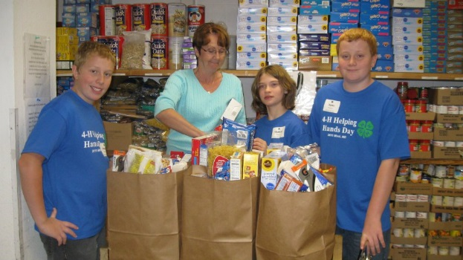
Planning Your Project
Identify 4-H club service project managers
Set beginning and ending dates
Create an action plan for service project
Assign individuals to each task
Give each task a completion deadline
Project managers do frequent check-ins to identify challenges and meet deadlines
Create supply list
Notes:
Slide #27
Slide time: 2 minutes
Rachelle:
Let’s dig deeper into implementing the service learning process with your 4-H youth.
The first step is to put a good plan in place:
At your 4-H club meeting:
Identify 4-H club service project managers: These may be older youth, or youth who are most excited about the service learning experience and have strong organizational skills.
Set beginning and ending dates: Have a timeline to ensure planning and project pieces are completed on time.
Create an action plan for service project: Having a clear, step-by-step action plan ensures you will have less bumps along the road when implementing your service learning project.
Assign individuals to each task: Service learning projects should include tasks suitable for all age groups. Assign everyone a responsibility as you plan your project and have older youth and adult volunteers be there to coach and support when needed.
Give each task a completion deadline: To move along with your service learning project planning, each task should have a deadline that needs to be met. This is a great life skill our youth will use throughout their lifetime.
Project managers do frequent check-ins to identify challenges and meet deadlines: good project managers are great cheerleaders, supporters, and problem-solvers. Check-ins help move the planning process along.
Create supply list: Having a good supply list that project managers check and re-check before the service learning event or events is important to make sure you have the materials to complete the project or projects successfully. Running to get more materials and supplies takes time and human resources away from the educational experience.

Slide 28
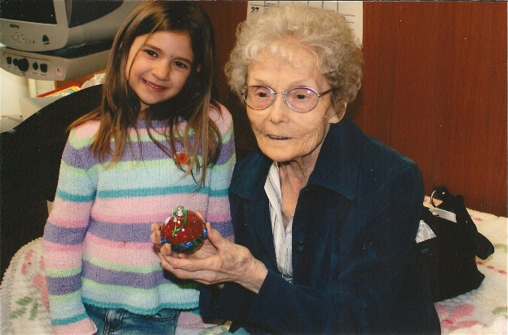
Raising Funds for Your Project
Develop a budget
Follow fund-raising policies for use of 4-H name and emblem
Prepare 4-H Club members to answer questions from donors
Ensure fund-raising is honest
Keep accurate records
of funds raised
May partner with 4-H
Foundation to assist
Notes:
Slide #28
Slide time: 2 minutes
Rachelle:
Develop a budget: This is another key life skill that 4-H members learn as a part of the Service Learning process. Having youth develop a budget that includes materials, supplies, transportation and other expenses is the first step in moving the project forward.
Follow fund-raising policies for use of 4-H name and emblem: Follow the 4-H National Headquarters Fact Sheet: Fundraising: Private Support for the 4-H Program that are located in this session’s references or at: http://nifa.usda.gov/sites/default/files/resource/Fundraising%20Private%20Support%20for%204-H%202011.pdf
Prepare 4-H Club members to answer questions from donors: Have 4-H Youth ready to answer questions about the service learning project, needs assessment, budget, what will be accomplished, etc. Do a practice session with your 4-H members prior to their fund-raising efforts.
Ensure fund-raising is honest: During the practice session, cover the basics of honest reporting to donors as to what the money will be used for and how it will be reported.
Keep accurate records of funds raised: Have reporting sheets to keep financial reporting accurate, and assign the 4-H club treasurer or assigned fund-raising chair to manage donor income. This may be a good role to have a youth-adult partnership with youth and adult fund-raising co-chairs.
May partner with 4-H Foundation to assist: Your State’s 4-H Foundation is well versed in fund development and may be a good partner for a large project. They may also be willing to provide an educational webinar related to raising funds in the name of 4-H.

Slide 29

Promoting/Market 4-H Service Learning Events and Impacts: Know Your Audience
Facebook-family and friends
Twitter-reporters, legislators, donors, supporters, companies, other agencies, future audiences
Instagram-other young people
Pinterest- others looking for great service learning ideas
Clip art credit: www.erictownsendblog.com
Notes:
Slide #29
Slide time: 5 minutes
Rachelle:
It is important to market your service learning project prior to the event, during, and after the event. Assign these responsibilities to your 4-H club reporter or your 4-H social media manager for your group. You may even want to create a marketing team.
Think about the audiences you want to reach as you plan:
Facebook-family and friends
Twitter-reporters, legislators, donors, supporters, companies, other agencies, future audiences
Instagram-other young people
Pinterest- others looking for great service learning ideas
Activity: Please pull out your Social Media Marketing Plan worksheet.
[Host Site Facilitators, please distribute “4-H Service Learning Marketing Plan” to your participants.]
Take 3 minutes to work on this individually at your site related to social media you may use during your service learning project. Please share some of the ideas your site found in the main chat pod.
[Allow 3 minutes to work on this task.]

Slide 30
Promoting and Marketing
4-H Service Learning
Blog- eBlogger and Word Press
YouTube channel
Extension Web site
News-paper
Notes:
Slide #30
Slide time: 1 minute
Rachelle:
Remember to get press releases for those participating in your 4-H service learning experience and don’t forget these marketing venues too:
Blog- Google’s eBlogger and Word Press are free.
YouTube- does your Extension Office have a channel? Ask them to post your 4-H Service Learning videos.
Extension website- ask your local county support staff to upload your club Service Learning activities and photos.
Newspaper-your 4-H club reporter should develop a relationship with the reporter on the education, healthy living, and/or technology beat.

Slide 31
CONTROLLING RISK
Reduce risk
Share the risk
Avoid the risk
Notes:
Slide #31
Slide time: 1 minute
Rachelle:
Service Learning should be a positive, educational experience that includes minimal risks. As your 4-H group is planning their project, consider these three things:
Reduce risk: Control hazards, establish emergency procedures, and provide adequate supervision.
Share the risk: Carry accident/medical insurance and use consent forms / permission slips.
Avoid the risk: Decide not to conduct the activity if it is judged to be too risky (Purdue, 2011).
For more detailed information on controlling the risk, visit the Purdue publication: “VolunteerIN 4-H Toolkit for Success: Planning and Carrying Out a Service Project” located in the list of references and at: https://extension.purdue.edu/4h/Pages/volunteerToolkit.aspx.

Slide 32
Reflect
At each stage of the service learning process:
…
…
Analyze actions taken, project’s impact, what worked, what didn’t, contribution of the work
Use a variety of techniques: group discussion, journaling, art projects, public discussion
Notes:
Slide #32
Slide time: 1 minute
Rachelle:
At each stage of the service learning process:
Analyze actions taken, project’s impact, what worked, what didn’t, contribution of the work.
Use a variety of techniques: group discussion, journaling, art projects, or public discussion.
Do what works best for your 4-H club or group.

Slide 33
Reflection Questions
What? What did we do? What did we see, touch, smell? What did we experience? How did I feel about the experience? What did I learn that I didn’t know before?
So what? How do I interpret what I experienced? What did the experience mean to me? What did I learn about myself, my community, my world? What life skills did I learn?
Now what? What will we do to build on the experience? What will our next project be? How will I use the skills and knowledge learned to continue to meet community needs?
(Hairston and Jamison, 2009)
Notes:
Slide #33
Slide time: 1 minute
Rachelle:
Reflection Questions:
Here are some examples of reflection questions you can use when processing the service learning experience with your 4-H members after the service learning experience. Remember, this refection is where the learning really happens and where youth are provided an opportunity to apply what they learned to their lives.
What? What did we do? What did we see, touch, smell? What did we experience? How did I feel about the experience? What did I learn that I didn’t know before?
So what? How do I interpret what I experienced? What did the experience mean to me? What did I learn about myself, my community, my world? What life skills did I learn?
Now what? What will we do to build on the experience? What will our next project be? How will I use the skills and knowledge learned to continue to meet community needs?

Slide 34
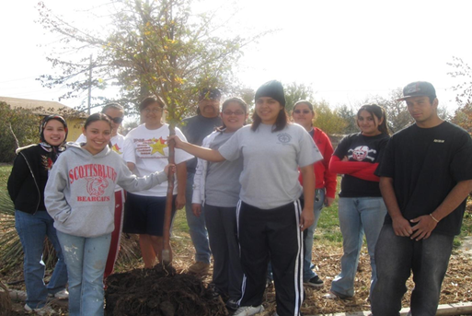
Evaluate/Celebrate
Evaluate
Collect feedback
Show others what was accomplished and learned
Highlight the impact of the work
Celebrate the work!
Notes:
Slide #34
Slide time: 1 minute
Rachelle:
Evaluate: Work with your youth to determine the method your group would like to use-interviews, observations, electronic, paper, record keeping
Collect feedback from direct and indirect beneficiaries, stakeholders, 4-Hers who volunteered, parents, and Extension professionals
Show others what was accomplished and learned
Highlight the impact of the work
Celebrate the work! Have the youth involved plan a way to celebrate their accomplishments. This is a great way to review what was learned, highlight their contributions and plan for future.

Slide 35
Make service learning a part of every club meeting.
Put it on the business meeting agenda.
Give members time to brainstorm ideas, research community issues, plan the project.
Implement the project and evaluate the results
Celebrate the accomplishments.
Notes:
Slide #35
Slide time: 1 minute
Cathy:
Making service learning a part of every club meeting gives your club members a sense of the importance of giving back to others and the community. It also gives them time to explore and research community issues that need to be addressed. They will be able to make a concerted effort to plan and implement their project.

Slide 36
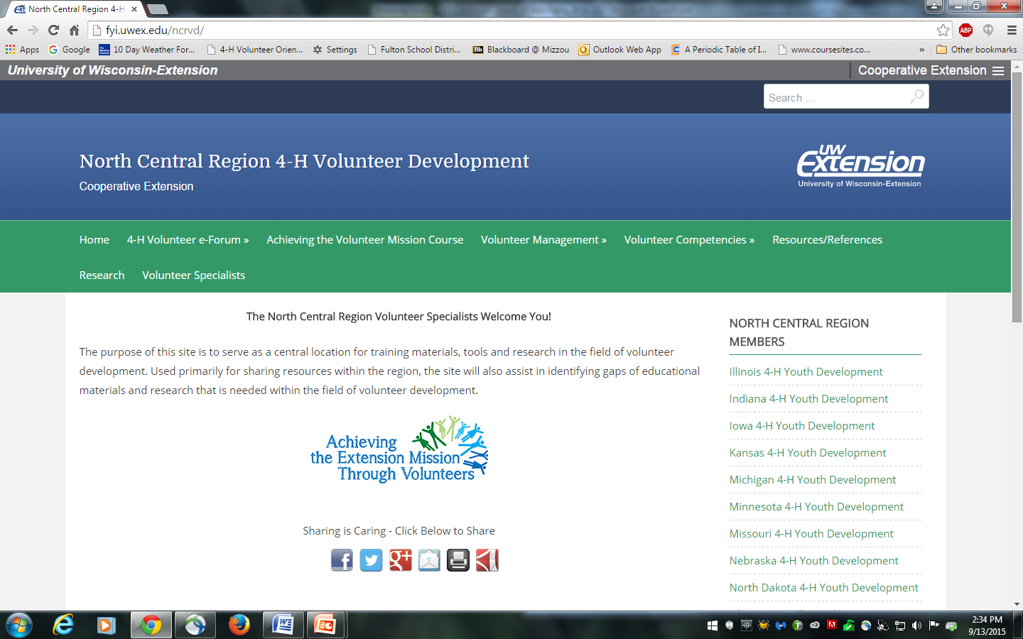
E-Forum Resources
http://fyi.uwex.edu/ncrvd/4-h-volunteer-e-forum/
Notes:
Slide # 36
Slide time: 30 seconds
Pat – We encourage you to access tonight’s PowerPoint file and additional resources presented in this and all other e-Forum sessions, please visit the North Central Region Volunteer e-Forum 2015 Web site: http://fyi.uwex.edu/ncrvd/4-h-volunteer-e-forum/

Slide 37
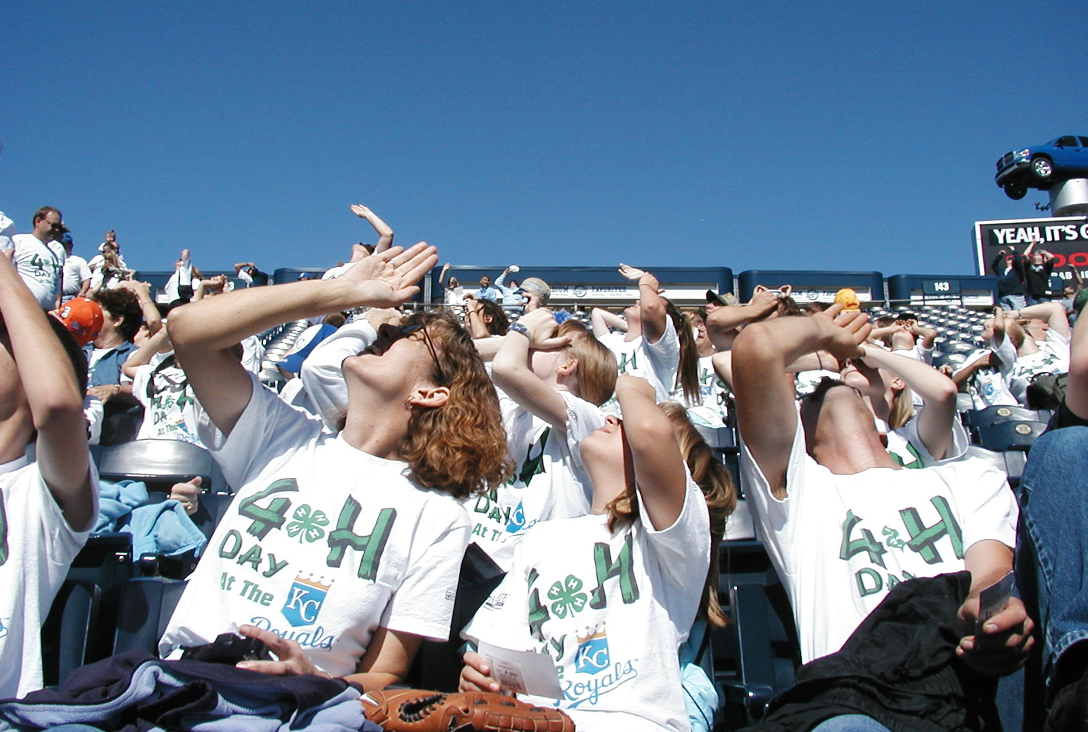
What’s up? Please share your feedback with us!
http://tinyurl.com/2015-NCRVeF-Belong
Notes:
Slide #37
Slide time: 1 minute
[Host Site Facilitator: Provide participants with access to the survey by having a laptop or tablet in the meeting space at the end of the session. Be sure to place the device(s) in a private location so participants feel comfortable and free to answer questions confidentially.]
Pat - We welcome your feedback from tonight’s e-Forum session. We have a short, confidential survey posted at the website listed on the screen. Your input will help us improve the quality and also content of future volunteer training opportunities. You can complete these tonight, using a laptop, smart phone, tablet … (location in the meeting room).
Or, you can complete the survey at home by going to this web address: http://tinyurl.com/2015-NCRVeF-Community

Slide 38
2015 e-Forum Sessions
The Heart of Community (Thursday, November 5 and Tuesday, November 10)
Encouraging the Heart of Leadership (Thursday, December 3 and Tuesday, December 8)
Thursday programs will be held from 7-8:30 p.m. (ET)
Tuesday programs will be held from 8-9:30 p.m. (ET)
Local activities will begin 30 minutes prior to the start of the program.
Notes:
Slide # 38
Slide time: 30 seconds
Pat - We hope you will join us, and bring other 4-H volunteers, to the remaining North Central Region 4-H Volunteer e-Forum sessions!
Encouraging the Heart of Leadership is scheduled for Thursday, December 3 and Tuesday, December 8, and we hope you will be able to join us on one of those two evenings. If you missed the Heart of Belonging session, it is archived on the North Central Region 4-H Volunteer Specialist web site.

Slide 39
References
4-H National Headquarters Fact Sheet: Fundraising: Private Support for the 4-H Program http://nifa.usda.gov/sites/default/files/resource/Fundraising%20Private%20Support%20for%204-H%202011.pdf
Hairston, J.E. and Jamison, K. (2009). Conducting 4-H community service learning projects. Communications and Marking, College of Agriculture and Life Sciences, Virginia Polytechnic Institute and State University. http://pubs.ext.vt.edu/384/384-160/384-160_pdf.pdf
Lerner, R. M., & Lerner, J. V. (2013). The positive development of youth: Comprehensive findings from the 4-H study of positive youth development. Medford, MA: Institute for Applied Research in Youth Development, Tufts University. http://www.4-h.org/about/youth-development-research/positive-youth-development-study/
National 4-H Council, (2015). National 4-H Council Marketing Toolkits: http://www.4-h.org/Resource-Library/Promotional-Toolkits/Toolkits/Social-Media-Toolkit.dwn
National 4-H Citizenship Model - http://4h.ucanr.edu/files/197571.pdf thy)
Purdue, (2011). VolunteerIN 4-H toolkit for success: Planning and carrying out a service project https://extension.purdue.edu/4h/Pages/volunteerToolkit.aspx
Rider, A. (2013) Difference Between Community Service and Service Learning. South Dakota State Cooperative Extension. http://igrow.org/4h/healthy-living/difference-between-community-service-and-service-learning1/#sthash.HGlAyUSe.dpuf
Search Institute for Learn and Serve America’s National Service-Learning Clearinghouse (2009). Service-Learning in Community-Based Organizations: A Practical Guide to Starting and Sustaining High-Quality Programs. http://r.search.yahoo.com/_ylt=AwrTcdvE.BJW.a0AdiQnnIlQ;_ylu=X3oDMTE0Y3VxczNuBGNvbG8DZ3ExBHBvcwMyBHZ0aWQDRkZYVUk0M18xBHNlYwNzcg--/RV=2/RE=1444112709/RO=10/RU=http%3a%2f%2fwww.michigan.gov%2fdocuments%2fmdch%2fService_Learning_in_Community_Based_Organizations_456079_7.pdf/RK=0/RS=PX1_oA4sOGGQjND3dPQLJ1HM8Uc-
University of Illinois, Center for Prevention Research and Development. Engaging Youth for Positive Change. www.cprd.illinois.edu/eypc
Walfred, M. (2014) Marketing 4-h – a study in non profit promotion. University of Delaware Cooperative Extension. https://walfredtechtalk.wordpress.com/2014/11/24/marketing-4h-a-study-in-non-profit-promotion/
Notes:
Slide # 39
Slide time: 15 seconds
Pat:
This slide provides you with a list of all of the references that were used to support this session, all of which you should be able to access online.

Slide 40
Thank you for joining us this evening!!
Notes:
Slide # 40
Slide time: 15 seconds
Pat:
Thank you for joining us this evening! Have a safe trip home!

