Slide 1
Welcome to the 2015 North Central Region 4-H Volunteer e-Forum! “Find the Heart of 4-H”
Notes:
Slide #1
Slide time: 15 seconds
Jane - Welcome to the 2015 North Central Region 4-H Volunteer e-Forum: Find the Heart of 4-H

Slide 2
“The Heart of Belonging”
Notes:
Slide #2
Slide time: 5 seconds
Jane - Tonight is the first e-Forum session. Tonight we focus on “The Heart of Belonging”.

Slide 3
Welcome from 4-H National Headquarters
Doug Swanson
National 4-H Program Leader
Notes:
Slide #3
Slide time: 3 minutes
Jane - Before we get started, we want to kick off this e-Forum series with a few words from Doug Swanson, our National 4-H Program Leader.
Doug – Streaming audio recording of Doug Swanson, National 4-H Program Leader

Slide 4
Congratulations North Central Salute to Excellence Award Winners!
Jeremy Smith, Indiana
2015 Volunteer of the Year
Keith Waddelow, Indiana
2014 Outstanding Lifetime Volunteer
Barbara Determan, Iowa
2015 Outstanding Lifetime Volunteer
Angela Baumer, Ohio
2014 Volunteer of the Year
Notes:
Slide #4
Slide time: 1 minute
Pat:
The North Central Region would like to take a moment to congratulate the 2014 and 2015 Salute to Excellence Regional Award Winners.
Angela Baumer of Ohio, and Jeremy Smith of Indiana received the Volunteer of the Year awards.
Keith Waddelow of Indiana, and Barbara Determan of Iowa received the Outstanding Lifetime Volunteer awards.
Additional information about each of these outstanding volunteers is included on the handout that you’ll receive this evening and is also posted on the Volunteer Specialists Web site.
[Host Site Facilitators, please distribute the “2014 and 2015 North Central Region 4-H Salute to Excellence Award Winners” handout to your participants.]

Slide 5
Presenters
Tammy
Jane
Brenda
Notes:
Slide #5
Slide time: 2 minutes
Tammy - Good evening. I am Tammy Gillespie, interim volunteer systems coordinator for Missouri 4-H. I currently work with regional faculty and staff who, in turn, work with 7,000 4-H volunteers. I am also a 10 year 4-H volunteer, having served in the role of club leader, Clover Kid leader and project leader. I previously worked for the Arkansas Advocacy and Protection Agency and so inclusion of all youth in 4-H is a topic that has been an interest of mine for a long time.
Jane - Hi I am Jane Hayes-Johnk, youth program specialist serving 4 counties in SW Iowa. I spend my time supporting county staff, providing training for a variety of volunteers, new and experienced leaders, teachers, committee members, youth councils, coordinating a variety of youth programs including after school, YMCA, day camps. Reward comes from positive feedback from 4-H members, parents, leaders and staff who I work with.
I like the changes we make to adapt and be flexible to the needs of 4-H members and families.
Brenda - Good Evening. I am Brenda Welch, youth program specialist serving three counties in northwest Iowa. I am also the co-chair for the Iowa 4-H Clover Kids Curriculum Team. I spend my time supporting county staff, training new and experienced volunteers, and promoting the use of Cooperative Extension resources in schools, after-school programs, and 4-H clubs. Over the past year, I have spent time educating teachers and extension staff on the use of technology, specifically Interactive Print, with their students.

Slide 6
Objectives
Identify elements needed for a safe, inclusive environment
Identify barriers to inclusion
Notes:
Slide #6
Slide time: 1 minute
Jane - We are excited that you are participating to learn and share about inclusive 4-H settings that foster a sense of belonging in all members.
4-H today is a rich mixture of family backgrounds, ethnic heritages and members with a variety of physical, mental and social abilities.
Our objectives for “Heart of Belonging” training include:
Identify elements needed for a safe and inclusive environment – a caring adult, safe places, mastery of skills, community service, self-determination, decision making, active participation, and engaged learning.
We will also explore barriers to inclusion – our goal in 4-H is to provide opportunities to members to see, talk, and participate in hands-on learning.
Barriers may be allergies, chronic health conditions, mobility, or learning styles. These barriers may be temporary (a young person on crutches) or long – term ( a 4-H member in a wheel chair).

Slide 7
Objectives
Make changes that promote inclusion for all
Discover resources to support an inclusive 4-H club/group environment
Notes:
Slide #7
Slide time: 40 seconds
Jane - Our third objective is to promote inclusion…
Some of you may have lots of experience working with youth and celebrate having a diverse and vibrant club or group. On the other hand, some of you may have a large group of enthusiastic youth who are a bit of a challenge. Or you may have little direct experience and are concerned about your abilities to work with youth who have physical disabilities, chronic health issues or emotional, behavioral, or mental disorders, or youth from different cultures.
And fourth, and final, objective is that you will discover resources to help you create more inclusive program environments.
Sharing ideas tonight is a great way to learn from each other.

Slide 8
…and justice for all
The U.S. Department of Agriculture (USDA) prohibits discrimination in all its programs and activities on the basis of race, color, national origin, age, disability, and where applicable, sex, marital status, familial status, parental status, religion, sexual orientation, genetic information, political beliefs, reprisal, or because all or part of an individual’s income is derived from any public assistance program.
Notes:
Slide #8
Slide time: 1 minute, 20 seconds
Jane - Now read the words in the “justice” statement that is found on all Extension documents across the country.
[PAUSE: 30 seconds as they read]
As we read this statement, we understand the power of belonging and inclusion in the 4-H program and all Cooperative Extension Service programs.
The 4-H program is part of the United States Department of Agriculture (USDA). Our mission is to provide inclusive programming for youth, families and communities.
Examples of our inclusive 4-H programming:
Offering written materials in languages other than English
Making financial assistance available for participation
Providing learning in accessible settings
Now Tammy is going to introduce us to the foundation of an inclusive environment.

Slide 9
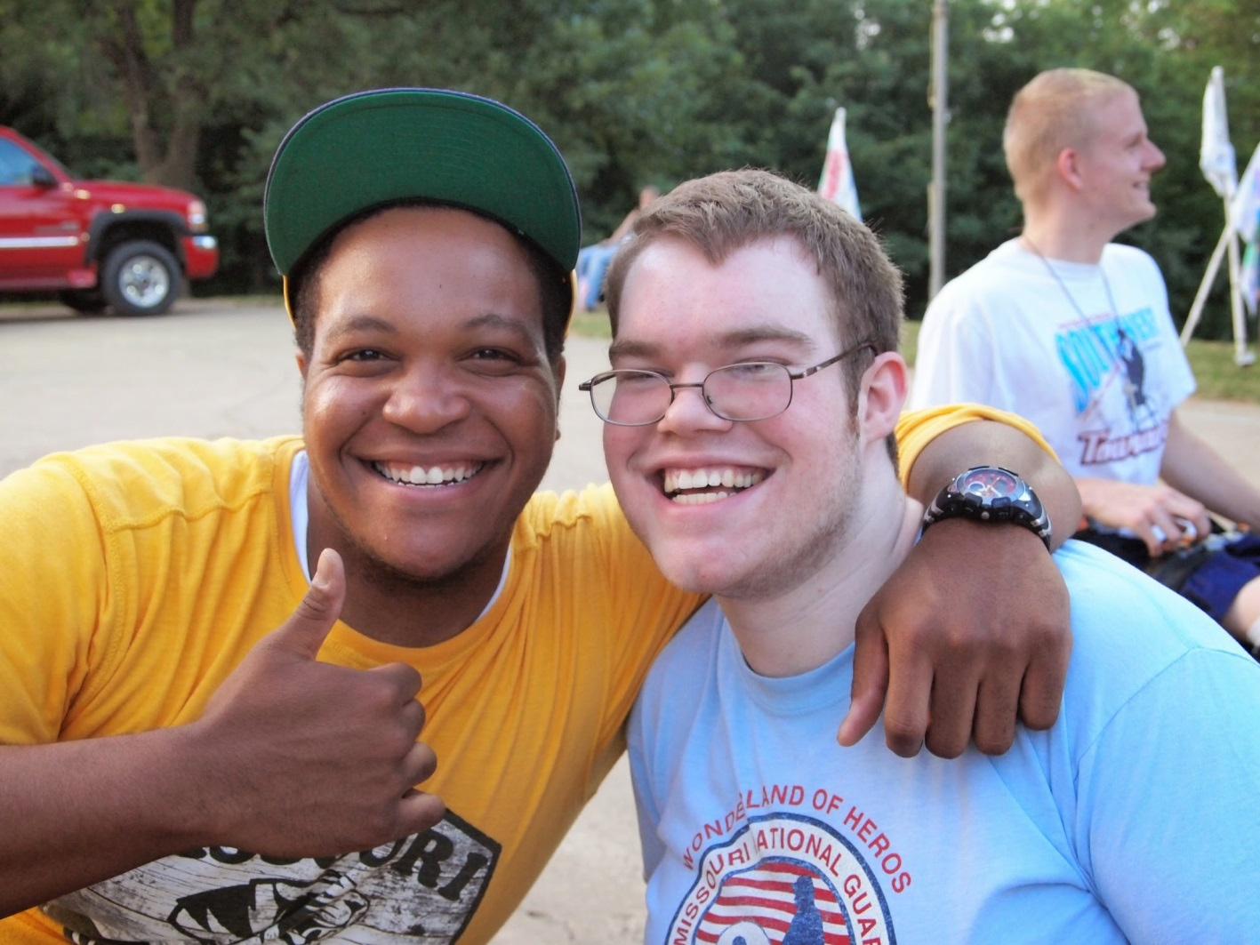
Welcome!
Photo credit::Tammy Gillespie
Notes:
Slide #9
Slide time: 1 minute
Tammy - Creating a welcoming environment for everyone is key to positive youth development. The first few minutes of a session set the tone for continued positive interactions.”
[Host site: Make sure you have the “Welcoming and Encouraging” handout available for each participant or have one to pass around, referencing North Central Volunteer web site listed at the end of this presentation.]
According to over 50 years of research done by the Weikert Center for Youth Program Quality, a welcoming atmosphere:
Nurtures self-worth (“You matter.”)
Makes them feel known and recognized
Connects them positively to a group or community
Gives them instant ownership of the space or activity
In the next slide we are going to do an activity to move beyond a welcoming environment and begin thinking about making it inclusive for all.

Slide 10
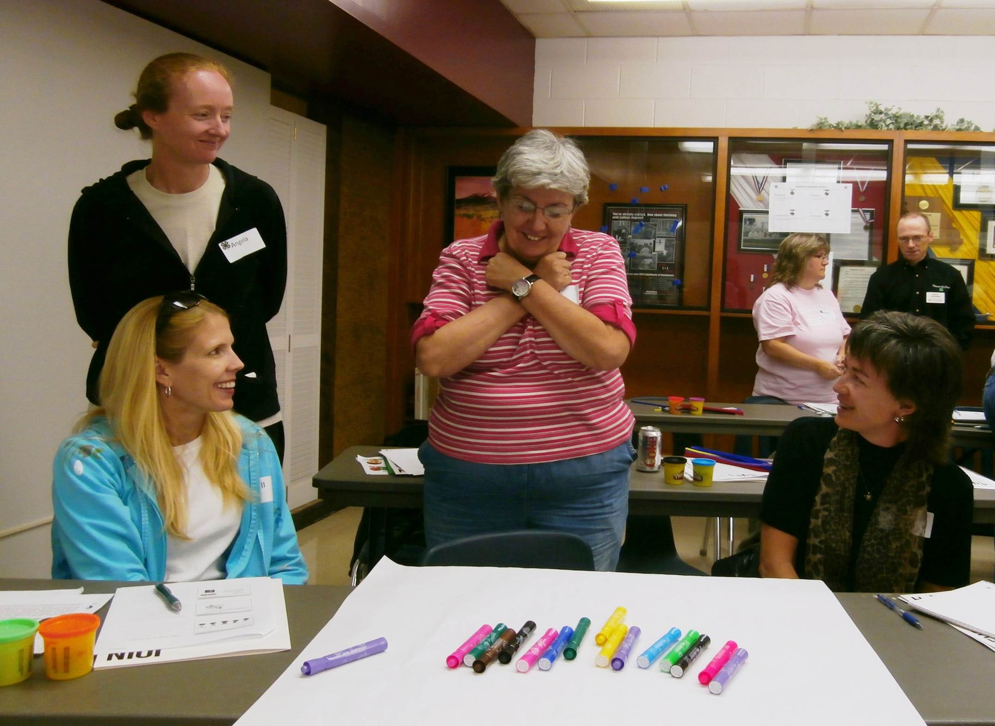
What makes YOU feel included?
Photo credit: Tammy Gillespie
Notes:
Slide #10
Slide time: 10 minutes total
[Host site: Post flip chart paper pre-labeled “Inclusion list: I feel welcome, safe and included when…” Be prepared to help each person form a pair or a trio for the next activity. Make sure each person has access to sticky notes on their table.]
Tammy - Let’s begin our activity by individually thinking about what inclusion means to each of us. From your adult perspective, what makes you feel included when you go to a 4-H program (e.g., club meeting). In other words, what makes you feel welcome, safe and included?
Now I’d like each person to write at least two things that make them feel welcome, safe or included at 4-H programs. Use the sticky notes, writing down one idea per sticky note.
Once you have two things written down, turn to a person near you and share what you have written down.
After a few minutes, take your sticky notes and place them on the flip chart labeled, “I feel welcome, safe and included when….”
[Host site: Move throughout room during the next 2 minutes, listening to paired discussions so you can be prepared to ask a few participants to briefly share their thoughts on what makes an adult feel welcome. At the end of two minutes, refocus the group. If needed, use an active focusing strategy (e.g., Clap once if you can hear me, “Raise one arm/and make a peace sign” or “Rainfall”. Source: yale.edu/peace/focus.html.]

Slide 11
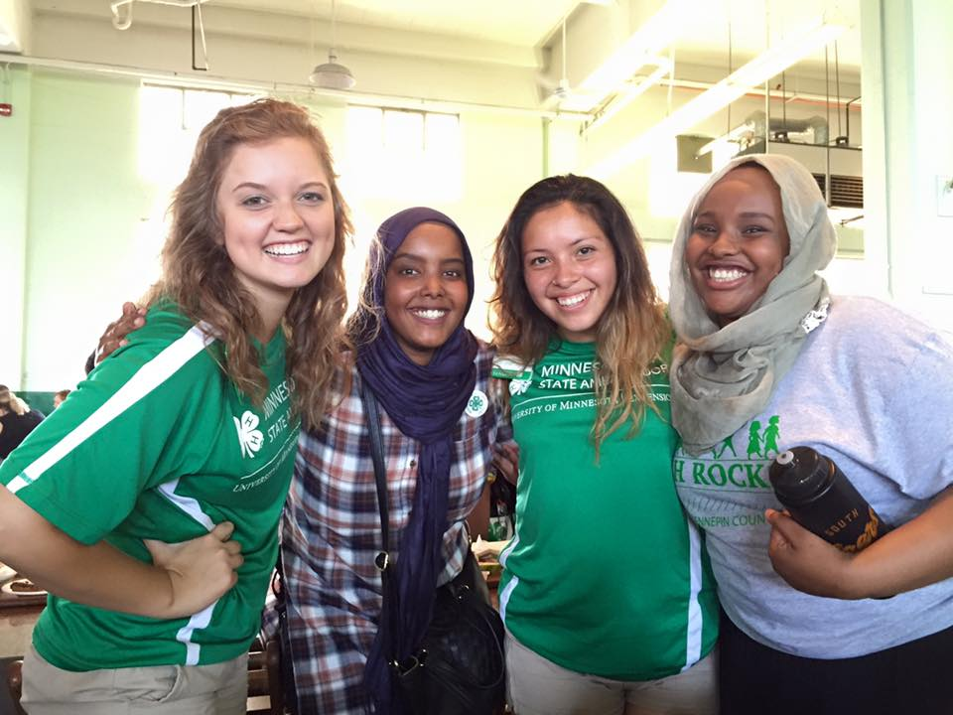
Photo credit: Molly Frendo
What makes YOU feel welcome?
Notes:
Slide #11
Slide time: 5 minutes
Let’s use a “popcorn” feedback process by asking a few people to quickly share 1 or 2 things that make them feel welcome. Would anyone be willing to briefly share an idea of what makes them feel welcome, safe or included?
[Host site: Solicit two or three different participants’ ideas, thanking each respondent for sharing. Try to limit total feedback to no more than 2-3 minutes.]
You have all come up with some important ways to help adults feel welcome, safe and included. We will refer to our flip chart list in our next activity.

Slide 12
Different perspectives
What else would be added to your “I feel welcome” list if you were…
a seven year old?
a junior or senior 4-H member?
someone with a physical disability?
someone with a behavioral disability?
from a different culture or ethnic group?
Notes:
Slide #12
Slide time: 5 minutes
Tammy - Now we are going to ask everyone to stretch your thinking a bit. Let’s consider what others need in order to feel welcome, safe and supported. Continue working with your same partner from the last activity. Imagine you are one of the individuals listed on this slide (e.g., a seven year old). What would make a seven year old feel welcome? For example, if I were a seven year old, I think that I would feel welcome and included if someone asked me to play a game with them.
So now it is your turn. What would be added to your “These things make me feel welcome-safe-included” list? You have four minutes to work on this activity with your partner.
[Host site: As with the previous activity, circulate throughout the room, listening carefully for different ideas that participants have for helping people with different perspectives feel welcome. At the one minute mark, ask if there is anyone that would like to briefly share the perspective you focused on and what that person might need to experience in order to feel welcome, safe and included? Thank each participant for their comments.]
As caring adults and leaders, we want everyone to experience a warm welcome. But, the reality is that it can be challenging to know everything about different age groups, abilities and backgrounds. The following information shows what Iowa State University did to help their faculty, staff and volunteers increase their capacity to provide more inclusive environments – for everyone.

Slide 13
Hot Sheets
The Law
Making Adaptations
Learning Disabilities
Emotional and Behavioral Disabilities
Attention Deficit Hyperactivity Disorder (ADHD)
Children and Youth with Autism
Notes:
Slide # 13
Slide time: 2 minutes [Host site: If you haven’t already, distribute Iowa State University “Hot Sheets”.]
Brenda - In 2010, Iowa 4-H started using “Hot Sheets” as a way to introduce the various 4-H project areas to 4-H members, leaders, and families. In 2014, Iowa 4-H collaborated with Dr. Linda Impecoven-Lind, from Iowa State University's School of Education to create Hot Sheets to explain different disabilities and tips for working with youth with various disabilities. Dr. Lind has been a 4-H leader and 4-H parent as well as a teacher and professor, so she shares our passion for working with all young people. As of today, six Hot Sheets have been created addressing the following topics:
The Law - This sheet addresses the Americans with Disabilities Act of 1990; Section 504 of the Rehabilitation Act of 1973; and the Individuals with Disabilities Education Act.
Making Adaptions – This sheet discusses the differences between Adaptations, Accommodations, and Modifications; as well as General Adaptations that 4-H Leaders can make.
Learning Disabilities – The Learning Disabilities Hot Sheet discusses a wide group of varying disorders that have a negative impact on learning. Disabilities such as Dyslexia, Dyscalculia, and more are discussed.
Emotional and Behavioral Disorders – Emotional and behavioral disorders are generally not physically observable; however the behaviors exhibited by youth with them is often apparent and deemed as misbehaviors. Learn more about the wide range of these disorders on the Emotional and Behavioral Disorder Hot Sheet.
Children and Youth with Autism – The Children and Youth with Autism sheet discusses Autism Spectrum Disorder which is a group of complex developmental brain disorders that can cause significant challenges in the areas of communication, social functioning, and behavior.
Attention Deficit Hyperactivity Disorder (ADHD) – Up to 5 million children are affected by ADHD. Individuals with ADHD have difficulty staying focused, paying attention, controlling one’s behavior, and hyperactivity.
As we go through the training tonight, you will have a chance to look at these Hot Sheets more in depth and use them as a resource.

Slide 14
Hot Sheets
Definition/
Description
Working with Individuals
Characteristics
Useful websites
Photo Courtesy of: Iowa 4-H
Notes:
Slide # 14
Slide time: 3 minutes
Brenda - Let’s take a couple minutes now to explain the various parts of the Hot Sheets. Let’s take a look at how the Hot Sheets are structured. You should have had some of them shared with you just a moment ago.
Almost all of the Hot Sheets start with a definition or description of the disorder or issue at the top of the front side. This definition includes an explanation of the larger disorder as well as specific names of the various disorders falling under that topic.
Below the Definition, is the Characteristic section. This section will list the characteristics or behaviors or issues that youth with the disorder will exhibit. For example, the Learning Disabilities Hot Sheet breaks the characteristics down into sections based on the type of learning disability. So, youth with a reading disability will confuse similar words; have trouble with phonics; and problems reading multi-syllable words. Or a youth with a Mathematics disability could have difficulties in memorizing number facts and solving word problems.
On the back side of the Hot Sheets are Tips for working with individuals who have that specific disorder. Many of the tips listed are easy to implement and require just a small change. For example, the first tip for working with individuals with a learning disability is to “Show rather than explain.” So, if I was teaching how to measure dry ingredients, I would actually have a measuring cup and a bag of flour and I would demonstrate measuring a cup of flour. An unexpected benefit to most of the tips is that they work for all 4-H members, not just those with a disability.
Finally at the bottom of the Hot Sheet is a list of Additional Resources or useful websites. For more information on learning disabilities, visit the National Center for Learning Disabilities or LD Online.

Slide 15
Remain silent
Listen for instructions
Notes:
Slide #15
Slide time: 30 seconds
[Host site: Make sure everyone has a blank sheet of paper and a pen or pencil to write with.]
Jane - We sometimes hear about “walking a mile in someone else’s shoes.”
This next activity will provide some insight into what it is like for a young person with Attention Deficit Hyperactivity Disorder (ADHD).

Slide 16
Notes:
Slide #16 Slide time: 1:45
Jane – Please remember that everyone needs to remain silent during this activity. You are going to follow the directions exactly as I read them to you. You must remain silent during the exercise and may not ask to have directions repeated, nor may you discuss them with each other.
1. On the left hand side of your paper, about halfway down from the top, draw a vertical line about two inches long, which is parallel to the side of your paper and at the base of the line, draw a second line at a right angle to the first, making it twice as long as the first line.
2. Draw a third line at the end of the second, two inches long, parallel to the first and connected to the second at a right angle. Connect lines one and three at the top, and at the mid-point of line four put a dot.
3. On the bottom line, place a dot one third of the length in from both ends, then connect these dots to mid dot on line 4.
4. Place a dot at mid point on the bottom line, and draw a line from the upper left-hand corner of the figure to the mid-point dot on the bottom line, then do the same from the upper right hand corner.
5. Using the left half of the top line of the figure as a base, complete an equilateral triangle, and using the remaining right hand of the top line of the figure as a base, draw another equilateral triangle next to the first.
6. Draw a circle inside each of the upper triangles of the figure, then draw a smaller circle inside each of the larger circles. Fill the small circle in solidly with your pen or pencil.
You have now completed your drawing.

Slide 17
What does your drawing look like?
Notes:
Slide #17
Slide time: 1:30
Jane – Let’s take just about one minute to see what our drawings look like. Go ahead and hold up your drawings for others to see.
[Host site: wait a minute for sharing to take place.] Okay, thank you for sharing. Let’s talk about this activity.
[Web Host: access the Adobe Connect file share pod in order to share previously uploaded “Owl Drawing” pdf documents.]
If you were able to follow the instructions, this is the picture you would have drawn. It is supposed to look like either a fox or an owl.
How does that compare to our drawings? Many youth with disabilities, regardless of the type of disability, have a difficult time remembering multi-step directions. They often get confused if more than one direction is given at a time. The exercise we just completed forced you to draw an unknown object strictly by listening and remembering every detail given in PERFECT order.
Frustrations may arise when adults are giving instructions to youth. Often, adults think the youth are not listening or paying attention when in reality, some may be suffering from Attention Deficit/Hyperactivity Disorder (ADHD).

Slide 18
Kansas
Nebraska
North Dakota
South Dakota
Impacted your ability to complete the task?
Iowa
Minnesota
Missouri
Wisconsin
What were you feeling?
Illinois
Indiana
Ohio
Michigan
Similar behaviors at meetings?
Notes:
Slide #18
Slide time: 8 minutes
Jane - States have been assigned a question to respond to. Please record responses in your chat pod.
[Web host: Switch to poll pod by states]
We will allow 3 minutes for state groups to respond in their chat pods.
Kansas, Nebraska, North Dakota, South Dakota: What impacted your ability to complete the task?
Iowa, Minnesota, Missouri, Wisconsin: What feelings did you experience during this activity?
Illinois, Indiana, Ohio, Michigan: What similar behaviors do you see at club meetings?
After 3 minutes in chat pod
Jane - Individuals with ADHD have difficulty staying focused and paying attention, difficulty controlling behavior. (Allow 2 minutes to process responses.)
Take the next 2 minutes to talk about strategies you could use in your club when working with youth with ADHD. Type your responses in the chat box.
2 minutes Ask groups to share.
Thank you for sharing your suggestions for working with young people.
A good reference piece is available from University of Wyoming Cooperative Extension Service. It is called, ”Inclusive 4-H: Youth and AD/HD” and is included in your resource list. (We will now take a short break. Break for 7 minutes.)

Slide 19
Club Scenarios
Barriers
Describe the barriers.
Adaptations
What adaptations are needed?
Guidelines
What guidelines/rules prevent participation?
Notes:
Slide #19
Slide time: 7 minutes
Brenda - We just experienced what it might feel like to be a youth with Attention Deficit Hyperactive Disorder. We are now going to return to our role as a 4-H volunteer or staff member and look at other disabilities that our youth might have.
In a minute, but not yet, we will be dividing you into three different groups based on states. Each group of states will be examining a different Club Scenario based on a youth with a type of disability. Also, in order for everyone at a site to have a voice in this activity, you will need to divide into groups of 3-4 at each site. After reading through the Scenario your state has been given, your group of 3-4 people will need to answer the questions on the “Heart of Belonging: Club Scenario” worksheet. (NOTE: WE NEED TO CROSS REFERENCE WITH WORKSHEET!)
These questions include:
1. Describe the barriers to belonging to 4-H for this youth in this situation. Barriers are those things that would make a youth unable to join 4-H or not able to participate in an activity. 2. What are the adaptations (physical, environmental, etc.) that must be made for the 4-H member during the club meeting? For assistance on what an Adaptation is, please review the “Making Adaptations” Hot Sheet.
3. What guidelines/rules does your club or county have that might be difficult for the 4-H member with that specific issue to meet? Think about the unspoken rules and guidelines as well as those that are written. An example might be that all beef animals have to be in the ring at the same time with the 4-H member showing them. This might disqualify a 4-H member from showing a beef animal who is in a wheelchair. By the way, a solution, which has been done in this instance, was to have the 4-H member show the beef animal alone in the ring before the rest of the animals. Another possible solution is to have a substitute showman.
At your site, please take 5 minutes to discuss the respective club scenarios for your state according to the worksheet. We’ll then ask you to report back.

Slide 20
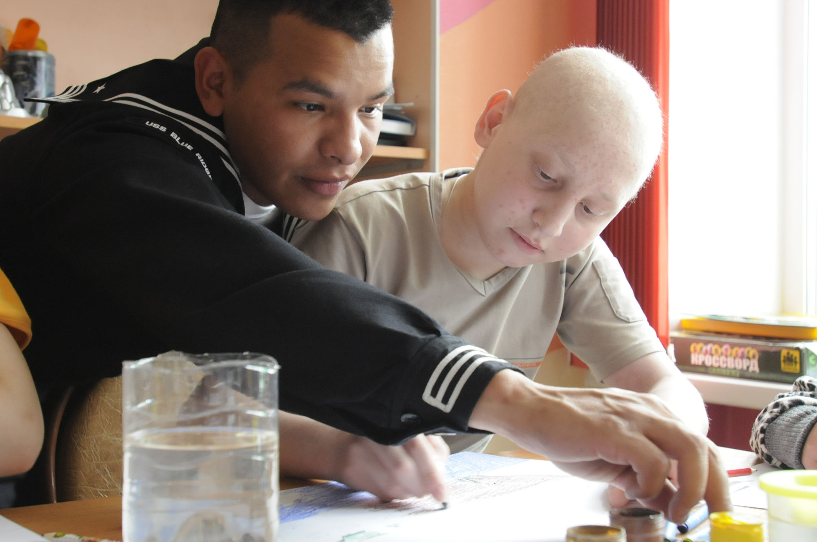
Club Scenario 1
By U.S. Navy photo by Mass Communication Specialist Seaman Brian A. Stone [Public domain], via Wikimedia Commons
Notes:
Slide #20
Slide time: 30 seconds
Brenda - The following states will be working with club scenario 1:
Kansas Nebraska
North Dakota
South Dakota
Aaron has been diagnosed with cancer. He is currently being treated at a Children’s Hospital a few hours away. During the time that he is in treatment, he should not be around others who are sick due to a repressed immune system. He will be in and out of the hospital for the next 6 months to a year. He loves being in 4-H and does not want to miss out because he is sick.

Slide 21
Club Scenario 1
Barriers
Describe the barriers.
Adaptations
What adaptations are needed?
Guidelines
What guidelines/rules prevent participation?
Notes:
Slide #21
Slide time: 5 minutes
Let’s process this scenario. First, what are the barriers Aaron might face during his treatment from cancer? Second, How could the 4-H program be adapted to allow him to continue to participate?
Third, Consider your own 4-H program or club. What guidelines or rules does your program have in place that might make things difficult for Aaron to participate?
[Web host: Create three chat pods labeled as follows:
Barriers
Adaptations
Guidelines]

Slide 22
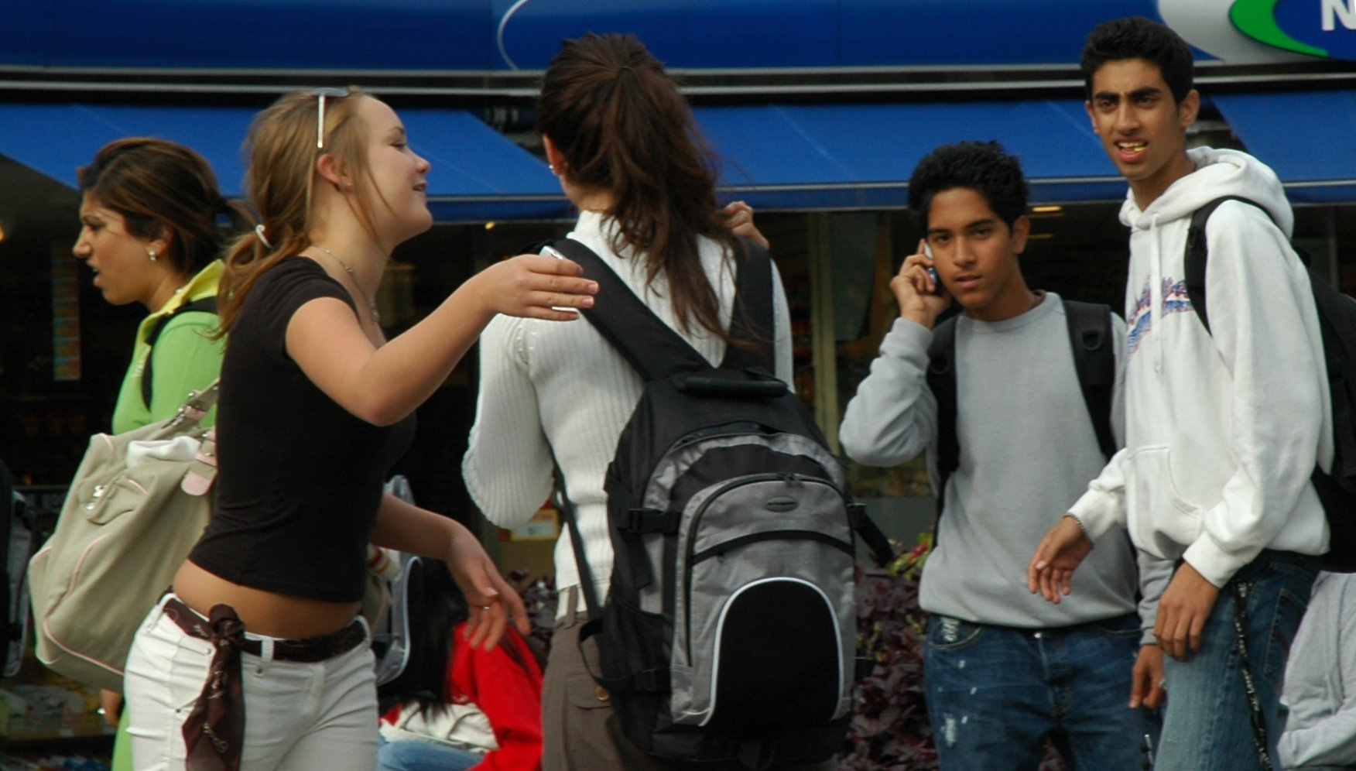
Club Scenario 2
https://commons.wikimedia.org/wiki/File:Diversity_of_youth_in_Oslo_Norway.jpg#file
Notes:
Slide #22
Slide time: 25 seconds
Great job. Let’s try a second scenario. Iowa, Minnesota, Missouri, and Wisconsin will discuss this one. Maria’s family recently moved here from another country. Her parents are not fluent in English. They do not understand the 4-H program and are very hesitant to allow her to join a program that might encourage activities or beliefs that do not fit into their cultural heritage.

Slide 23
Club Scenario 2
Barriers
Describe the barriers.
Adaptations
What adaptations are needed?
Guidelines
What guidelines/rules prevent participation?
Notes:
Slide #23
First, what are the barriers Maria might face as a child with immigrant parents? Second, How could the 4-H program be adapted to allow her to participate?
Third, Consider your own 4-H program or club. What guidelines or rules does your program have in place that might make things difficult for Maria to participate?

Slide 24
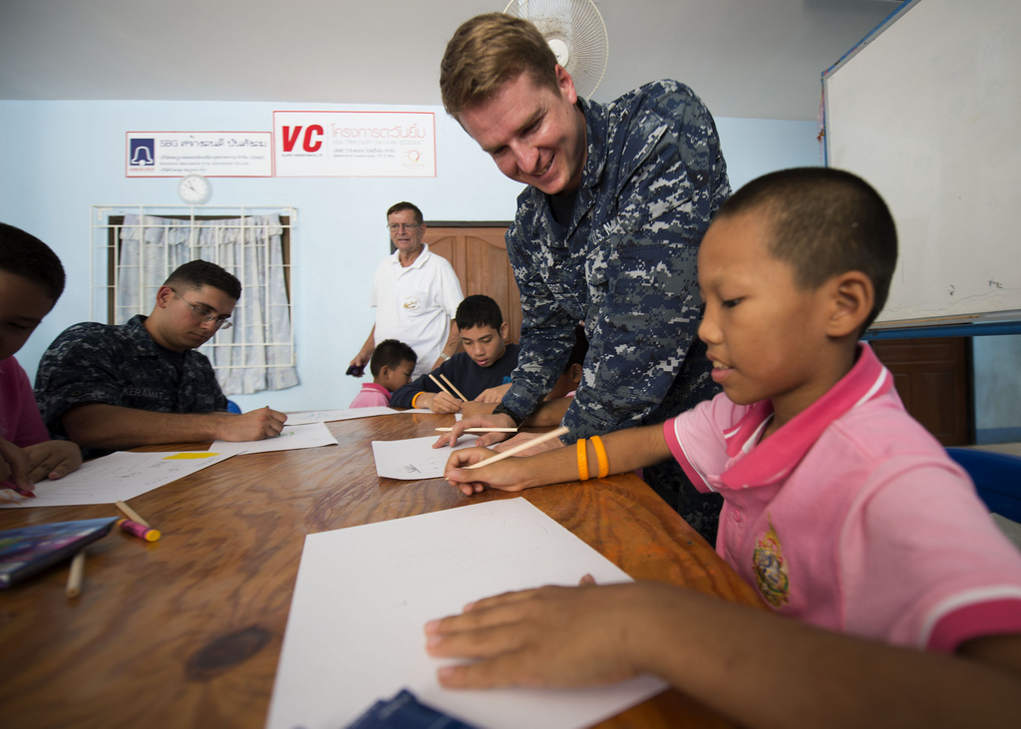
Club Scenario 3
By U.S. Navy photo by Mass Communication Specialist 3rd Class Mackenzie P. Adams,
https://www.flickr.com/photos/us-pacific-command/10595524515
Notes:
Slide #24
Let’s do one final scenario for Illinois, Indiana, Ohio, and Michigan to discuss. Dillon is a 6th grader. He has been diagnosed with Autism. He can handle being in groups, as long as they are small and he can sit by himself. He does not handle noisy and crowded scenarios well, such as the fair.

Slide 25
Club Scenario 3
Barriers
Describe the barriers.
Adaptations
What adaptations are needed?
Guidelines
What guidelines/rules prevent participation?
Notes:
Slide #25
Just like last time: what are the barriers might Dillon face as a child with autism? Second, How could the 4-H program be adapted to allow Dillon to participate?
Third, Consider your own 4-H program or club. What guidelines or rules does your program have in place that might make things difficult for Dillon to participate?

Slide 26
Club Scenarios Processing
Notes:
Slide # 26
Slide time: 1 minute
Barriers can get in the way of feeling a true sense of belonging. When someone cannot be part of the group, they feel excluded. Sometimes considering adaptations for inclusion can seem overwhelming, but often inclusion is a matter of creative problem solving, great teamwork between Extension professionals and volunteers, and planning ahead.
Sometimes it's a matter of simple changes or simply knowing what adjustments need to be made ahead of time, while others it might be necessary to connect with your Extension staff person to see what resources the University can provide.
When we work together to overcome barriers and implement inclusive policies, we begin to create an environment that welcomes and includes all.

Slide 27
Final Thoughts
Parents: Your Best Resource
Special Accommodations
More Resources
Notes:
Slide #27
Slide time: 1 minute 40 seconds
Brenda - One thing that hasn’t been addressed by us yet, is the need for good communication between parents and volunteers and staff. And this isn’t just for youth with special needs or from different cultures – but for all youth. Keeping those communications clear and frequent helps avoid confusion, misunderstandings, and hurt feelings. One of the previous e-Forum sessions focused on parent involvement. We encourage you to watch the recorded e-Forum from November 18, 2013 to learn more. In a few moments we will provide you with the web site where all e-Forum presentations and resources are posted.
If there are youth with special needs in your club or group, make sure you have a chat with the parent to understand as much as possible the unique needs of that young person. What are the physical, emotional, or behavioral challenges that you need to understand so you can be that caring adult who insures the young person has a fun, safe, meaningful 4-H experience? If you have young people from different cultures, ask about language or cultural needs to make it a great experience. Feel free to ask your county, regional, or state 4-H staff if you need additional help or resources to make sure the communication lines are clear.
Something else we want you to be aware of is the issue of Special Accommodations. In Iowa, we have a Special Accommodations Request Form that can be filled out by families requesting special accommodations. This form is part of the procedures for our Land Grant University, Iowa State University. Check with your county, regional, or state 4-H staff to determine if your state has a form and what the procedure is concerning its use.
Finally, we have included more resources in your training packet. These resources include a handout on Creating 4-H Club Guidelines. This handout will help you work with your club members on establishing club guidelines that are inclusive and respectful for all members. There is also a handout on the Chain of Diversity activity which your site may have led as a pre-activity for this session. Every person in the group will create links that list items that they have in common with the large group and that are unique to them. These links are then all connected to show how unique and similar the group really is.

Slide 28
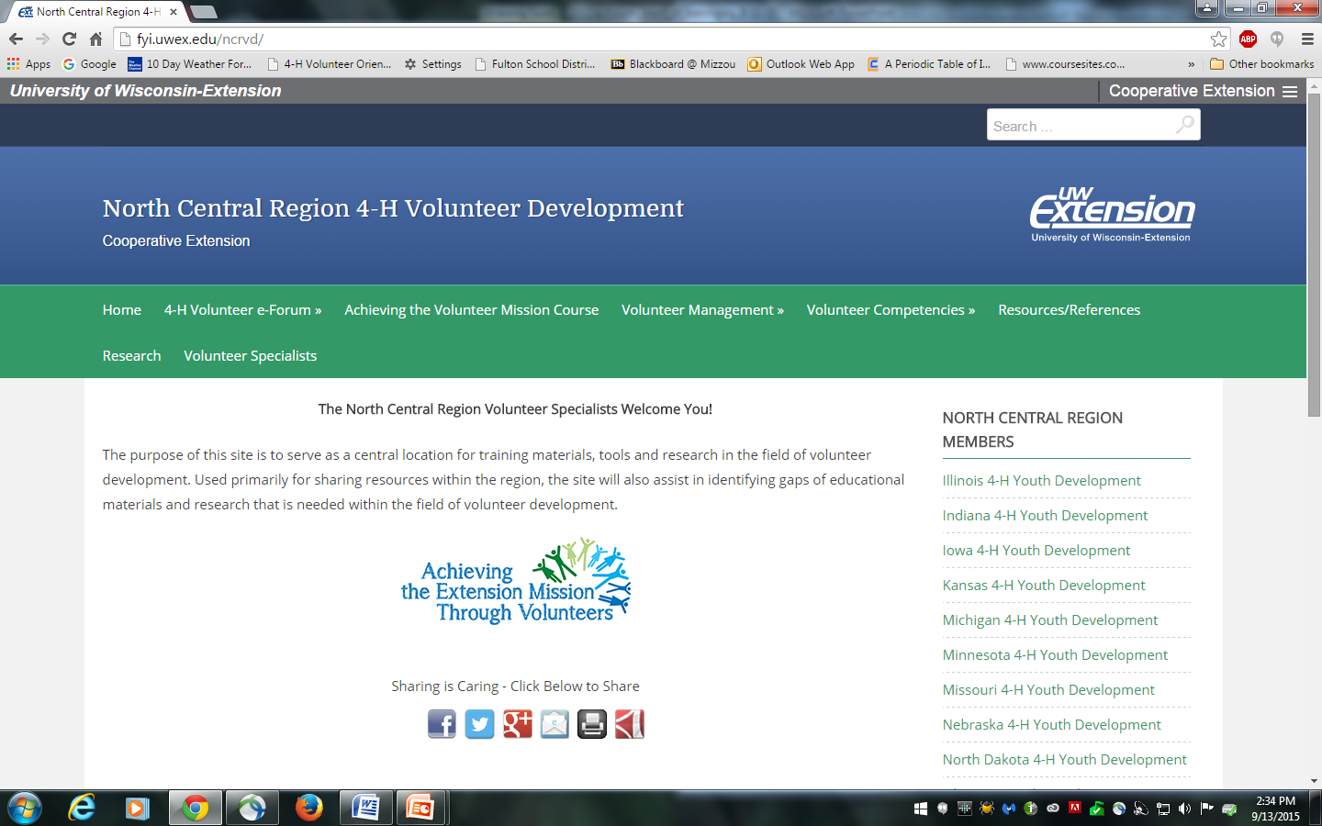
E-Forum Resources
http://fyi.uwex.edu/ncrvd/4-h-volunteer-e-forum/
Notes:
Slide #28
Slide time: 30 seconds
Tammy – We encourage you to access tonight’s PowerPoint file and additional resources presented in this and all other e-Forum sessions, please visit the North Central Region Volunteer e-Forum 2015 Web site: http://fyi.uwex.edu/ncrvd/4-h-volunteer-e-forum/

Slide 29
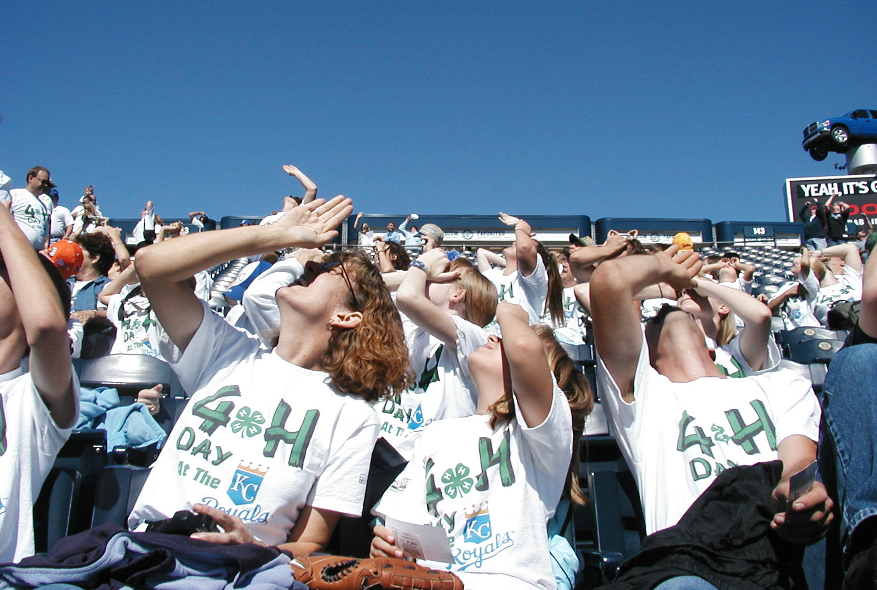
What’s up? Please share your feedback with us!
http://tinyurl.com/2015-NCRVeF-Belong
Notes:
Slide #29
Slide time: 1 minute
[Host site: Provide participants with access to the survey by having a laptop or tablet in the meeting space at the end of the session. Be sure to place the device(s) in a private location so participants feel comfortable and free to answer questions confidentially.]
Tammy - We welcome your feedback from tonight’s e-Forum session. We have a short, confidential survey posted at the website listed on the screen. Your input will help us improve the quality and also content of future volunteer training opportunities. You can complete these tonight, using a laptop, smart phone, tablet … (location in the meeting room).
Or, you can complete the survey at home by going to this web address: http://tinyurl.com/2015-NCRVeF-Belong

Slide 30
2015 e-Forum Sessions
The Heart of Belonging (Thursday, October 8 and Tuesday, October 13)
The Heart of Community (Thursday, November 5 and Tuesday, November 10)
Encouraging the Heart of Leadership (Thursday, December 3 and Tuesday, December 8)
Thursday programs will be held from 7-8:30 p.m. (ET)
Tuesday programs will be held from 8-9:30 p.m. (ET)
Local activities will begin 30 minutes prior to the start of the program.
Notes:
Slide #30
Slide time: 1
Jane - We hope you will join us, and bring other 4-H volunteers, to the remaining North Central Region Volunteer e-Forum sessions!
Remember, we are offering three different topics, or programs, and offering each one on two different dates and times.
The Heart of Belonging (Thursday, October 8 and Tuesday, October 13)
The Heart of Community (Thursday, November 5 and Tuesday, November 10)
Encouraging the Heart of Leadership (Thursday, December 3 and Tuesday, December 8)

Slide 31
Thank you for joining us this evening!!
Notes:
Slide #31
Slide time: 30 seconds
Jane - Thank you for joining us this evening! We look forward to seeing you again. Have safe travels home.

