Slide 1
A NCR Volunteer Specialist Project
Course Survey Results

Slide 2
Project Team
Josset Gauley, University of Wisconsin Madison – Evaluation & Program Development Specialist
NCR Volunteer Specialist Research Team Members
Rebecca Harrington, University of Minnesota
Sarah Maass, Kansas State University
Patricia C. McGlaughlin, University of Illinois
Kandi O'Neil, University of Wisconsin - Madison
Kari Robideau, University of Minnesota
Rachelle Vettern, North Dakota State University

Slide 3
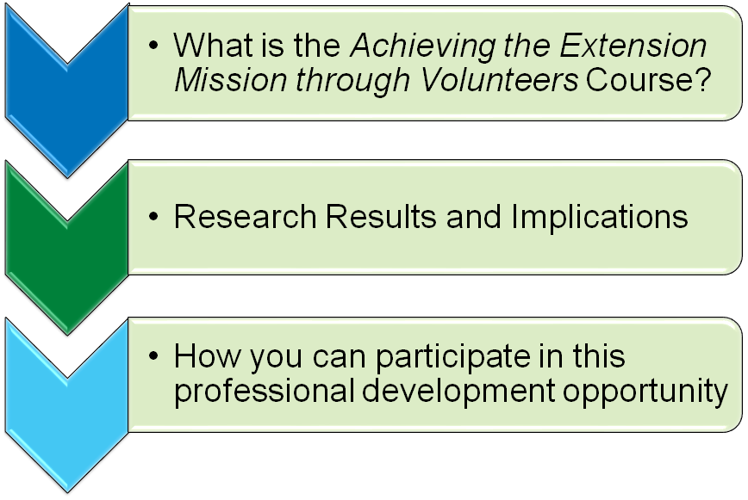
Today We Will Discuss:

Slide 4
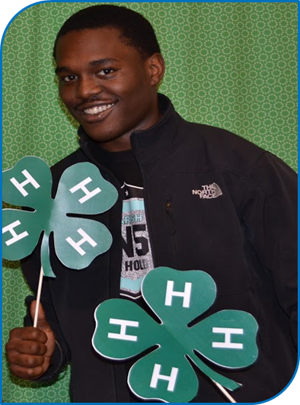
Course Overview
AEMTV is an online cohort course for novice and experienced professionals who work with volunteers to enhance and deliver Extension programs.
The course is designed to
Build staff and organizational capacity in volunteer management & development
Frameworks used:
ISOTURE Model
Developmental Stages of the Extension Professional
https://fyi.extension.wisc.edu/ncrvd/achieving-the-extension-mission-through-volunteers-course/

Slide 5
What Do Colleagues Say About the Course???
Notes:
https://www.youtube.com/watch?v=3CJebZ1g3jA&feature=youtu.be
https://www.youtube.com/watch?v=3CJebZ1g3jA&feature=youtu.be

Slide 6
Document volunteer systems knowledge gained
Assess to what extent participants applied what they learned
Assess the impact of a cohort-based online learning experience

Slide 7
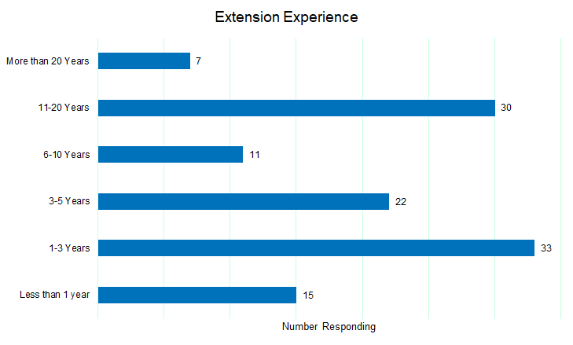
Sample: Years of Experience
130 individuals from 17 states completed the survey
Extension Experience
More than 20 years
11-20 years
6-10 years
3-5 years
1-3 years
Less than 1 year
Number Responding

Slide 8
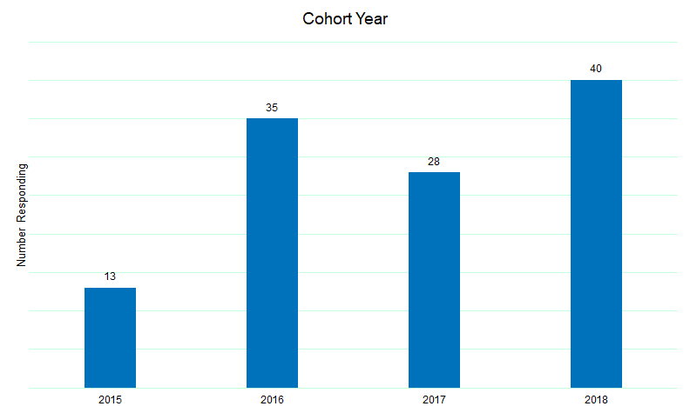
Sample: Year of Participation
Cohort Year (when respondent took the course)
Number Responding

Slide 9
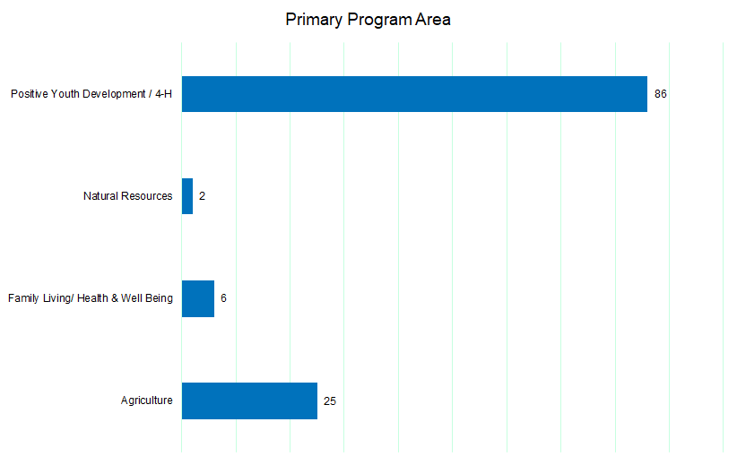
Sample: Program Area
Primary Program Area
Positive Youth Development/4-H
Natural Resources
Family Living & Health & Well Being
Agriculture

Slide 10
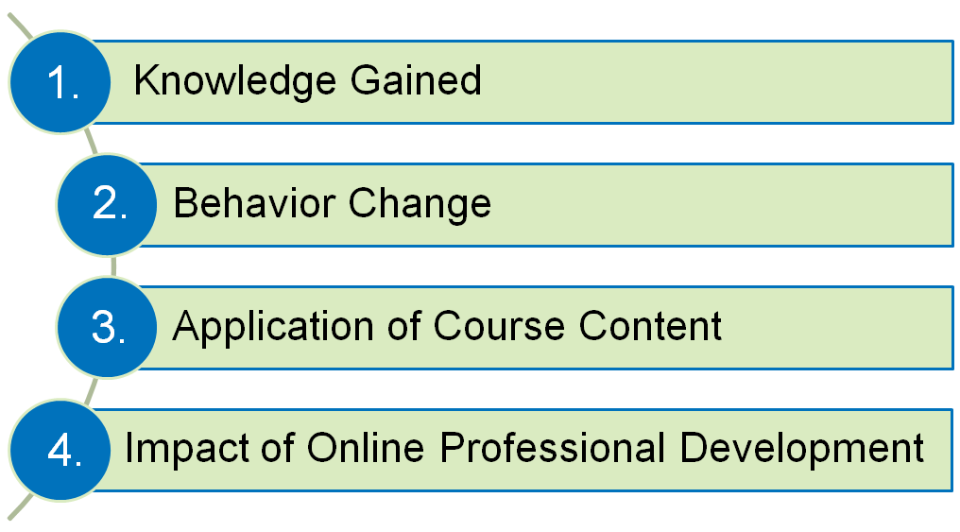
Research Results & Implications

Slide 11
95% learned to articulate how volunteerism impacts Extension Programming
95% can develop volunteer role descriptions
93% learned how to analyze volunteer delivery systems
93% were comfortable applying best practices in selecting volunteers
90% learned coaching strategies
89% learned to align recruitment with specific volunteer roles

Slide 12
Comments
“I took this 3 years ago. And the long lasting impact was recognizing how to match volunteers with the type of service they will best at, seeking good volunteer qualities, and using appropriate recognition of their efforts.” - Michigan
“I am better able to recognize and address the needs of volunteers. This has helped to place them in the right positions and made the volunteer experience positive for everybody.” - South Dakota

Slide 13
81% said they worked with volunteers differently
71% recruited volunteers for new positions
70% communicated with stakeholders the value of volunteers in their program
63% recognized volunteers according to their individual motivation
54% created role descriptions after taking the course
51% used their elevator speech to communicate with potential volunteers & stakeholders

Slide 14
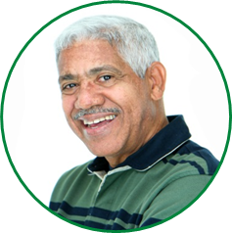
Comments
“I am much more deliberate about recruiting volunteers for specific task or programs. I also feel that I have improved my volunteer coaching skills.” - Wisconsin
I’m more intentional in selecting volunteers for roles and rather than just write a position description for recruitment, we use it as a guiding piece to their work.” - Minnesota

Slide 15
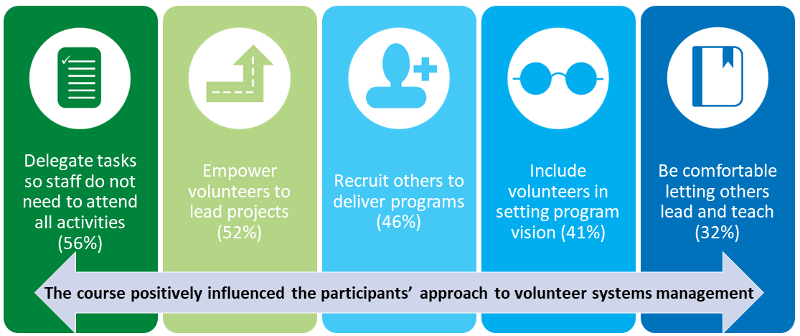
Application of Knowledge

Slide 16
Application of Knowledge – Programs
Volunteers were:
Engaged in dialogue and decisions about the leadership of the program
Given responsibility to teach programs
Empowered to lead major programs

Slide 17
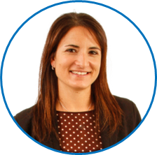
Comments
“It also has help me to deal with volunteer conflict in a more objective way and to get the facts from the parties involved, to reach a better resolution.” - Indiana
“Now, I give myself permission to step back to allow others to lead. I used to feel guilty because I thought it was my job alone to lead.” - North Dakota

Slide 18
Impact of Online Professional Development

Slide 19
Resources
Achieving the Extension Mission Course
https://fyi.extension.wisc.edu/ncrvd/achieving-the-extension-mission-through-volunteers-course/
You Can Access:
2021 Course Promotion and Registration Link
2021 Course Handbook
Achieving the Extension Mission Through Volunteers Impact Study Summary Report 2020

Slide 20
2021 Course Details
Dates: January 25 - March 14, 2021
Cost: $250
Register by: December 15, 2020
https://learning.umn.edu/search/publicCourseSearchDetails.do?method=load&courseId=1585632

Slide 22
Course Development and Financial Support is Provided by the NCR States:
Notes:
Needs to be updated

