Slide 1
G-WOW Changing Climate, Changing Culture Professional Development's Influence on Classroom Teachers
Patricia Carpenter
Masters of Environmental Education
Thesis Research
July 18, 2016

Slide 2

Overview
Personal Background
Methods
Research Questions
Results
Limitations
Summary
Significance

Slide 3
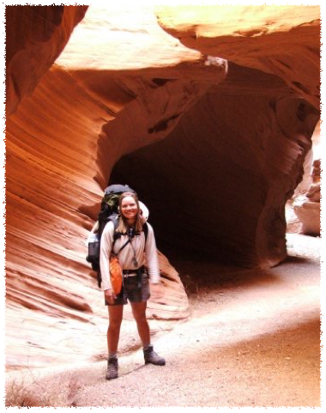
Personal Background: Education
Masters of Environmental Education
B.S. Business Administration-Management
Major Environmental Studies
Wild Rockies Field Institute-Canyonlands
Notes:
WRFI- 60+days of backpacking, canoeing, and an immersion with Hopi and Navajo cultures
place-based course

Slide 4

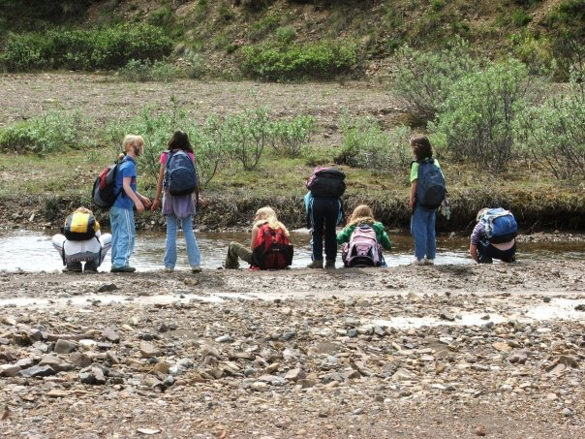
Personal Background:
Work Experience
      Wilderness Therapy
      Science & Nature Centers
  WI Focus on Energy
  UMD
Notes:
environmental educator
lead guide for various audiences

Slide 5
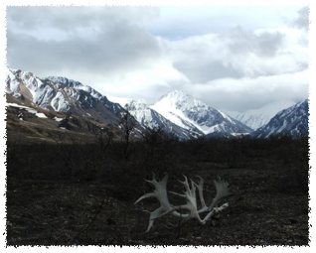
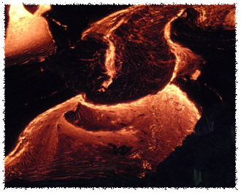

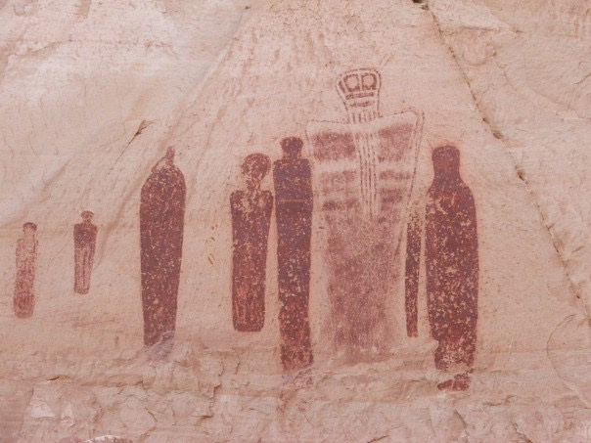
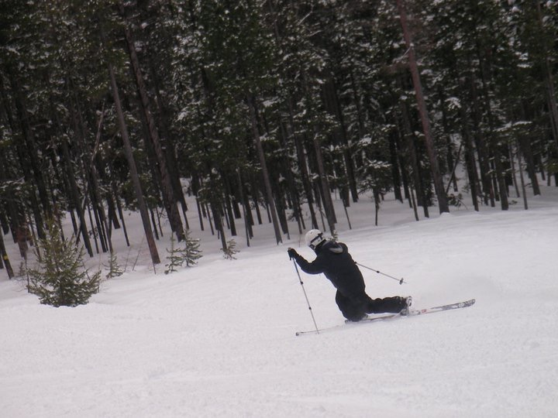
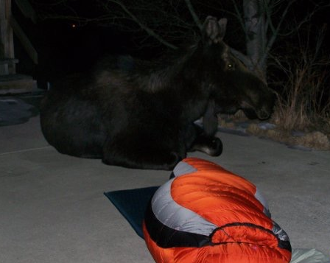
Notes:
travelled while obtaining my education and working

Slide 6
Methods
  Design:
    Retrospective pretest-posttest
  Population:
    2015 G-WOW Classroom Teachers (9/20)
    45% Response Rate
  Instrument:
    Online Questionnaire
    Semi-structured phone interview

Slide 7
Research Questions
    Did participation increase or influence classroom teachers’:
      Perceived level of climate literacy,
      Pedagogical skills for teaching climate change science content knowledge,
      Confidence regarding implementing the G-WOW model,
      Teaching practices regarding climate change education and implementation of the G-WOW model,
      Intentions toward implementing climate education and/or teaching the G-WOW model in the future?

Slide 8
Research Questions
    Did teacher participants implement the service learning component of the G-WOW curriculum? What did teachers perceive as factors influencing or inhibiting their implementation of the service learning projects?
    Did teacher participants perceive the G-WOW model as transferable to the student populations they teach? If so, did they implement the G-WOW model in its original form or do they modify it?

Slide 9
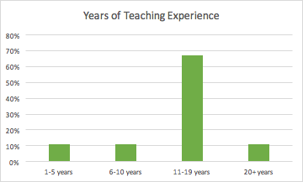
      Results: Demographics
Years of Teaching Experience
1-5 years | 11%
6-10 years | 11%
11-19 years | 67%
20+ years | 11%
Notes:
experienced teachers

Slide 10
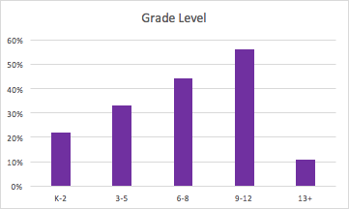
      Demographics
Grade Level
K-2 | 22%
3-5 | 33%
6-8 | 44%
9-12 | 56%
13+ | 11%
Total | 166%
Notes:
majority middle-high school educators
note: some teach across categories

Slide 11
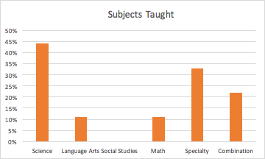
      Demographics
Subjects Taught
Science | 44%
Language Arts | 11%
Social Studies | 0%
Math | 11%
Specialty | 33%
Combination | 22%
Total | 121%
Notes:
mostly science, specialty, and combination

Slide 12
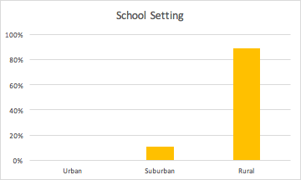
      Demographics
School Setting
Urban | 0%
Suburban | 11%
Rural | 89%
Notes:
mostly rural

Slide 13
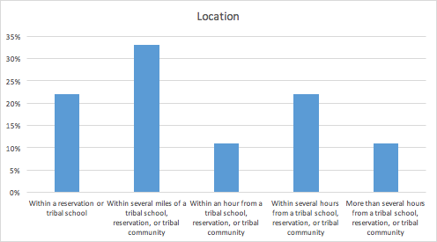
      Demographics
Proximity
Within a reservation or tribal school | 22%
Within several miles of a tribal school, reservation, or tribal community | 33%
Within an hour from a tribal school, reservation, or tribal community | 11%
Within several hours from a tribal school, reservation, or tribal community | 22%
More than several hours from a tribal school, reservation, or tribal community | 11%
Notes:
most within an hour of a tribal school, reservation, or tribal community
half within several miles or within tribal school, reservation, or tribal community

Slide 14
      1a: Perceived Level of Climate Literacy
Understanding the essential principles of Earth’s climate system.
Knowing how to assess scientifically credible information about climate.
Communicating about climate and climate change in a meaningful way.
Making informed and responsible decisions with regard to actions that may affect climate.
Understanding the climate's influence on me and society and my influence on the climate.
 | Mean
Mean | 4.12
SD | 1.22
Strongly Disagree | Somewhat Disagree | Neither Disagree nor Agree | Somewhat Agree | Strongly Agree
1 | 2 | 3 | 4 | 5
Notes:
Rating perceived personal level of climate literacy
From NOAA Climate Literacy

Slide 15
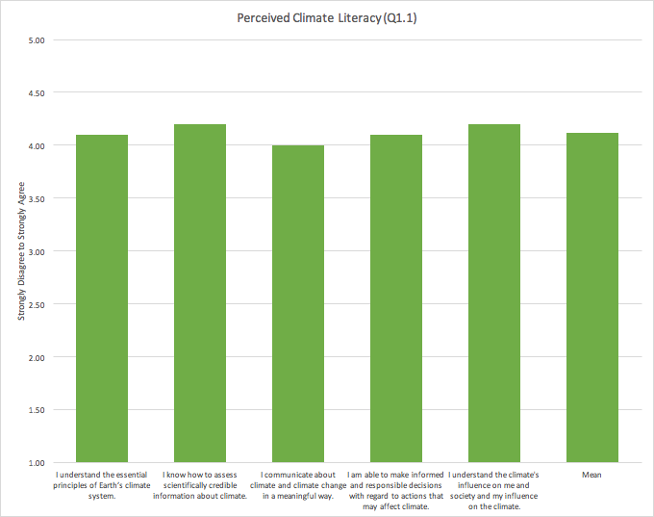
    1a: Perceived Level of Climate Literacy
Strongly Disagree | Somewhat Disagree | Neither Disagree nor Agree | Somewhat Agree | Strongly Agree
1 | 2 | 3 | 4 | 5
Notes:
Scale 1-5 from 1- Strongly disagree to 5 Strongly agree
Mean 4.12 between Somewhat Agree & Strongly Agree—4-5
strongest assessing scientifically credible information about climate & understanding climate’s influence on themselves and their influence on the climate—which, in research literature, are both considered areas of misconceptions

Slide 16
      1b: Pedagogical Skills for Teaching Climate Change Science Content Knowledge
Prior Mean | 2.48
After Mean | 4.10
Right Now Mean | 4.17
Prior SD | 1.10
After SD | 0.72
Right Now SD | 0.88
Low |  |  |  | High
1 | 2 | 3 | 4 | 5
Notes:
RIGHT NOW: at time of questionnaire=end of the school year
means
rating self pretty low prior—significant increase after attendance and another increase from last summer to right now
Low High
1 2 3 4 5

Slide 17
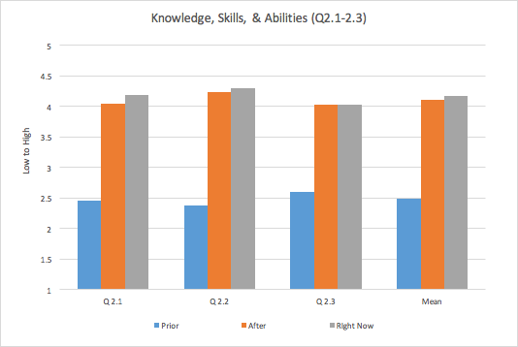
1b: Pedagogical Skills for Teaching Climate Change Science Content Knowledge
1 = Low | 5 = High
Notes:
Pedagogical Skills continued…
Summary of all the sets of items in this section
set 2.1: recommendations from psychology of climate change communication
set 2.2: most items focused on place-based and service learning in this set; most growth of the three sets
set 2.3: pedagogical skills based on Teed & Franco Pedagogical content knowledge principles
Teed & Franco, 2014
Low High
1 2 3 4 5

Slide 18
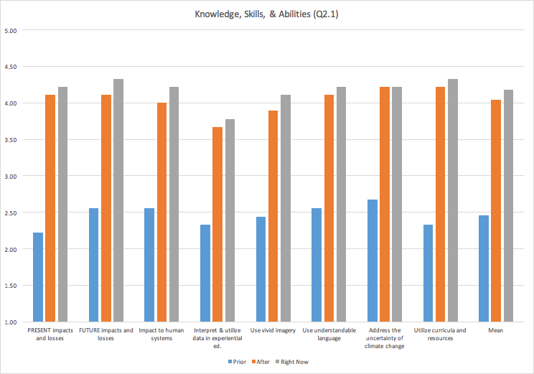
1b: Pedagogical Skills for Teaching Climate Change Science Content Knowledge
1 = Low | 5 = High
Notes:
Center for Research on Environmental Decisions, 2009—psychology of cc communication
Most growth in knowledge, skills, and ability to communicate: PRESENT impacts and losses, utilize curricula & resources, and FUTURE impacts and losses

Slide 19
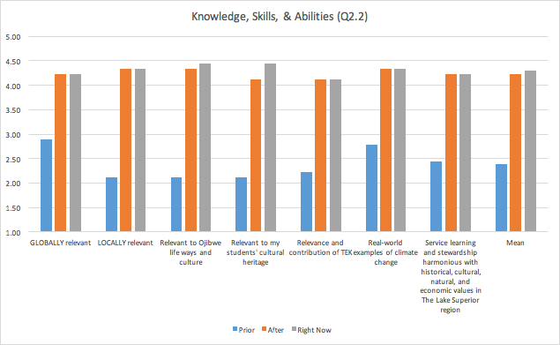
1b: Pedagogical Skills for Teaching Climate Change Science Content Knowledge
1 = Low | 5 = High
Notes:
Pedagogical Skills continued…
most items focused on place-based and service learning in this set
most growth of the three sets
most growth in communicating about: LOCAL relevance, Ojibwe life ways & culture, & relevance to my students’ cultural heritage
Rivers 2 Lakes - Ernst
Low High
1 2 3 4 5

Slide 20
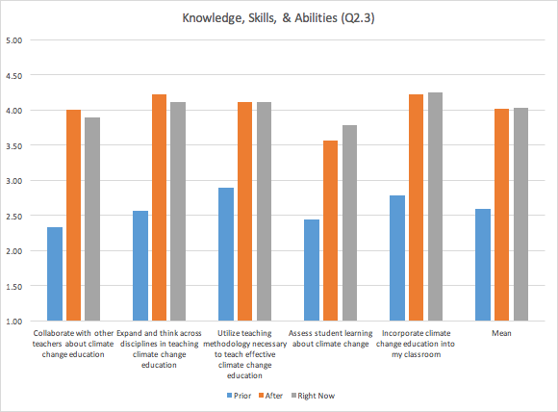
1b: Pedagogical Skills for Teaching Climate Change Science Content Knowledge
1 = Low | 5 = High
Notes:
Pedagogical Skills continued…
based on general pedagogical skills
largest amounts of growth in collaborating with other teachers, expanding and thinking across disciplines, and incorporating climate change education into their classroom
Low High
1 2 3 4 5

Slide 21
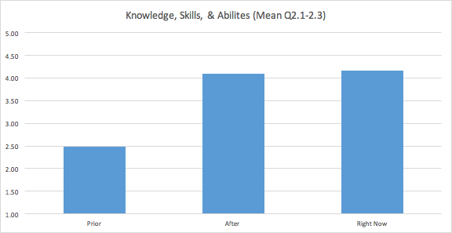
1b: Pedagogical Skills for Teaching Climate Change Science Content Knowledge
1 = Low | 5 = High
Notes:
Overall mean
significant increase in self-report rating knowledge, skills, and abilities

Slide 22
      1c: Confidence Regarding Implementing the G-WOW Model
1 = Low | 5 = High
Notes:
confidence: belief in capability to perform.
Looking at PCK as an indicator of confidence for Confidence regarding implementing the G-WOW Model:
2.1 - series on framing CC and understanding communication based from psychology of CC
2.2 - place-based and service learning
2.3- general pedagogical skills (Teed)
MEAN of all three series of questions
Can look at the same data set again because this is their perceived knowledge, skills, & abilities—shows significant increase in after attending the institute and even higher ratings after implementing the curriculum into their classrooms

Slide 23
      1c: Confidence Regarding Implementing the G-WOW Model
 | Mean | SD
Prior | 3.33 | 1.12
Right Now | 4.44 | 0.73
The institute has changed my confidence | 4.44 | 0.73
Strongly Disagree | Disagree | Neither Disagree nor Agree | Agree | Strongly Agree
1 | 2 | 3 | 4 | 5
Notes:
Mean shows agreement that there was a degree of confidence in teaching about climate change prior to the institute but there was also an increase in confidence from teaching climate change prior to the institute to confidence in teaching about climate change right now

Slide 24
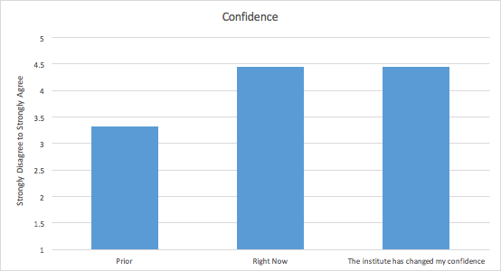
      1c: Confidence Regarding Implementing the G-WOW Model
Strongly Disagree | Disagree | Neither Disagree nor Agree | Agree | Strongly Agree
1 | 2 | 3 | 4 | 5
Notes:
1 strongly disagree; 2 disagree; 3 neither agree nor disagree; 4 agree; 5 strongly agree
I was confident in implementing Climate Change Education Prior…
I am confident regarding implementation right now…
The G-WOW institute changed my confidence…

Slide 25
      1d: Teaching Practices Regarding Climate Change Education & Implementation of the G-WOW Model
1 = Low | 5 = High
Notes:
general pedagogical skills (Teed)
rating knowledge skills and abilities on teaching practices— 1 low 5 high
largest amounts of growth in collaborating with other teachers, expanding and thinking across disciplines, and incorporating climate change education into their classroom

Slide 26
      1d: Teaching Practices Regarding Climate Change Education & Implementation of the G-WOW Model
Ability to align to standards Developed a 12 week interdisciplinary curriculum including institute content: “place based fieldwork, climate camp, and community service based assessment”
“I am using a greater focus on looking at local impacts of climate change that are more relevant to the students.”
Improved criteria for students to create documentaries including both scientific evidence and TEK in their presentations “which helped them send a more powerful message about climate impacts on traditions that are important to them”
Notes:
descriptions of what changes they made regarding instructional practices or curriculum:
local impacts, relation to science standards, developing a unit of study on the institute

Slide 27
      1d: Teaching Practices Regarding Climate Change Education & Implementation of the G-WOW Model
 | Place-based evidence of climate change | Project-based approaches to climate change education | Collaboration with other teachers about climate change education | Impacts of climatic variables on habitats and the sustainability of key species of Ojibwe culture | Impacts of climatic variables on cultural practices OTHER THAN Ojibwe that are relevant to the student learner | Mean
Prior Mean | 1.50 | 1.38 | 1.50 | 1.25 | 1.13 | 1.35
After Mean | 2.00 | 2.00 | 1.89 | 1.89 | 2.00 | 1.96
Prior SD | 0.53 | 0.52 | 0.53 | 0.46 | 0.35 | 0.48
After SD | 0.00 | 0.00 | 0.33 | 0.33 | 0.00 | 0.13
1 = No | 2 = Yes
Notes:
Prior Mean lower—closer to No
After mean almost all Yes
Very low SD After institute
even though starting at different levels of use, low level of variation in what instructional approaches are being incorporated into the classrooms

Slide 28
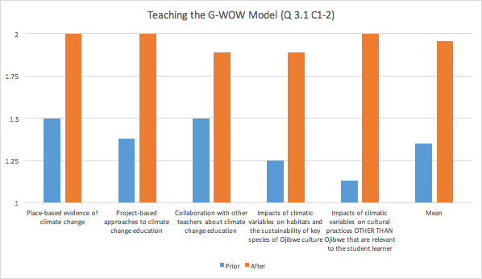
      1d: Teaching Practices Regarding Climate Change Education & Implementation of the G-WOW Model
1 = No | 2 = Yes
Notes:
can see the less variation after institute—1.96 mean
most growth in: impacts of climatic variables on cultural practices OTHER than Ojibwe relevant to student learner & impacts of climatic variables on habitats and the sustainability of key species of Ojibwe culture

Slide 29
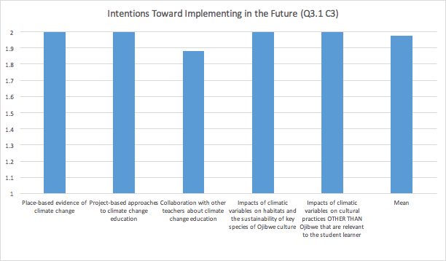
      1e: Intentions Toward Implementing Climate Education and/or Teaching the G-WOW Model in the Future
1 = No | 2 = Yes
Notes:
INTENTIONS toward:
overall mean 1.96—strongly suggests these methods including place-based, project based, collaboration, and variables relevant to Ojibwe culture and other cultures are intended to be used in the future

Slide 30
    2: Did teacher participants implement the service learning component of the G-WOW curriculum?
Changes to Instructional Practices:
“…We are in charge of planting a flower garden each year in front of our school. It is to show students how we can take part in helping to address climate change.”
“Documentaries…included[ing] both scientific evidence and TEK in their presentations which helped them send a more powerful message about climate impacts on traditions that are important to them.”
Notes:
from question 3.2

Slide 31
    2: Did teacher participants implement the service learning component of the G-WOW curriculum?
Added to their American marten project
Climate change documentaries
Citizen science using Bud Burst
Beach sweep, butterfly garden
Adopt a Beach program and National Marine Sanctuary project & presentations
"I can" posters showcased about climate change
Planting a flower garden each year
Notes:
from question 3.2

Slide 32
    2b: What did teachers perceive as factors influencing or inhibiting their implementation of the service learning projects?
G-WOW Changing Climate, Changing Culture Institute | 5.89
Other training or professional development opportunities (NOT G-WOW) | 5.11
My personal environmental content knowledge | 5.44
Procedural/pedagogical knowledge of how to carry out service learning projects | 5.22
Comfort level with teaching in general | 5.56
The grade level I teach | 5.56
The subject I teach | 5.67
Emphasis on state standards | 4.89
Emphasis on state testing | 4.11
Funding | 4.44
Administrative support | 5.56
Planning time | 4.00
Transportation | 4.78
Access to natural area | 5.22
Community interest/community partners | 5.33
Support from students' parents | 5.00
School climate | 5.56
Safety, liability, and classroom management when outside the classroom | 4.75
Completely Prevented | Strong Obstacle | Somewhat of an Obstacle | Was not an Obstacle | Somewhat Assisted | Strongly Assisted | Completely Assisted
1 | 2 | 3 | 4 | 5 | 6 | 7
Notes:
FACTORS INHIBITING OR ASSISTING IMPLEMENTATION:
Report of Means:
Significant-
Yellow-strongest assisters to implementation; green—next strongest— ALL MEANS ABOVE 4—“not an obstacle”

Slide 33
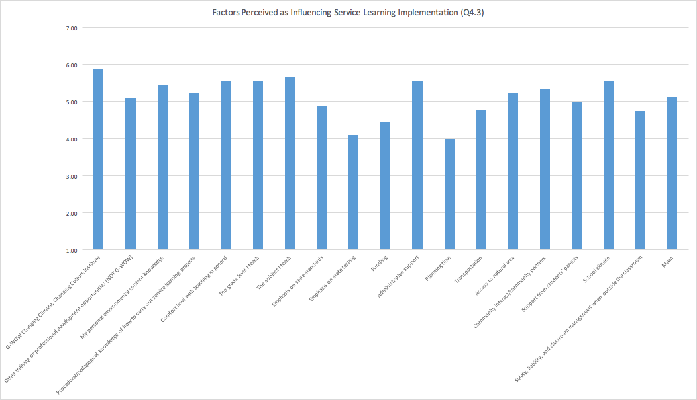
    2b: What did teachers perceive as factors influencing or inhibiting their implementation of the service learning projects?
Completely Prevented | Strong Obstacle | Somewhat of an Obstacle | Was not an Obstacle | Somewhat Assisted | Strongly Assisted | Completely Assisted
1 | 2 | 3 | 4 | 5 | 6 | 7
Notes:
Looking at the means again—4 is considered neutral/not an obstacle and no mean falls below this mark

Slide 34
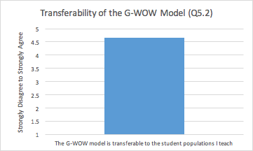
    3: Did Teacher Participants Perceive the G-WOW Model as Transferrable to the Student Populations They Teach?
 | The G-WOW model is transferable to the student populations I teach
Mean | 4.67
Standard Deviation | 0.71
Strongly Disagree | Disagree | Neither Disagree nor Agree | Agree | Strongly Agree
1 | 2 | 3 | 4 | 5
Notes:
TRANSFERABILITY
4=agree 5=strongly agree
Regardless of proximity to tribal school or community, the mean of the respondents was 4.67 between agree and strongly agree—that the curriculum is transferable to their student populations

Slide 35
    3b: If so, Did They Implement the G-WOW Model in its Original Form or Did They Modify It?
“…We use it as a resource to enhances lesson plans in our specific content areas.”
“It is addressed each season by showing how Ojibwe seasonal activities are being affected by climate change.”
“…Usage of many lessons or parts of them as well as incorporating cultural impact caused by climate change”
“…Making maps of MN instead of WI”
Using ”…parts as-is, but in addition used it to create templates for students to follow to link climate to their traditions/hobbies/culture.”

Slide 36
    3b: If so, Did They Implement the G-WOW Model in its Original Form or Did They Modify It?
In original form utilizing Ojibwe cultural practices | In a modified form utilizing cultural practices important to my culture | In a modified form utilizing species important to the culture(s) of my students | I do not use the G-WOW Model
50% | 70% | 60% | 0%
Notes:
Looking at this individually most responses look like they are using the model relevant to their culture compared to where they teach—
what this shows is even outside of Ojibwe country the model is being seen as being adaptable to work within their schools—
Can learn more from interviews:
Transferability and modifications of the model
Other relevant formal/informal training vs Institute influence
Barriers/Facilitators of service learning

Slide 37
Limitations
Predisposition to EE/climate change ed. & service learning
Self-report of perceptions
2015 summer institute
Classroom Teachers delimitation; no student measures
Experienced teachers: Funding not provided to incentivize service-learning
Assumption: Reported service learning projects are contributing to student outcomes and mitigating/adapting to climate change
Notes:
future study—Get a longitudinal measure of teacher outcomes but also student outcomes and the overall impact of service learning on student outcomes and whether they are considered responsible action toward climate change

Slide 38
Summary
Agreement of perceived climate literacy
Increases in:
  PCK & skills for teaching CC
  Confidence
Lack of significant barriers to implementing service learning—Institute contributed to action
Model as transferable to student populations despite location
All respondents use the G-WOW model in some form
Notes:
Did participation increase or influence classroom teachers’:
Pedagogical skills for teaching climate change science content knowledge, Some, after the institute, brought students up and some of them could have been further impacted by this experience
will be able to learn more from interviews

Slide 39
Significance
Transferable across cultures
Consider G-WOW methods
Professional Development
G-WOW Positive influence
Notes:
Transferable across cultures: Participants cultivated connections to the content despite their cultural identity
Consider the methods: Experiential and place-based teaching of the G-WOW Institute as important in considering methods for forming and implementing successful climate change education.
Service-learning project: literature suggests encourages students to engage in their communities, think critically, and act responsibly. For the sustainability of this and future generations, it is imperative youth understand their actions make a difference and apply their knowledge toward community-based action.
Professional development: important to look at the success of G-WOW as an example of extending beyond conventional environmental educational focusing on simply increasing awareness
G-WOW: Positive influence on respondents to incorporate relevant climate change education and service-learning projects with their student audiences

Slide 40

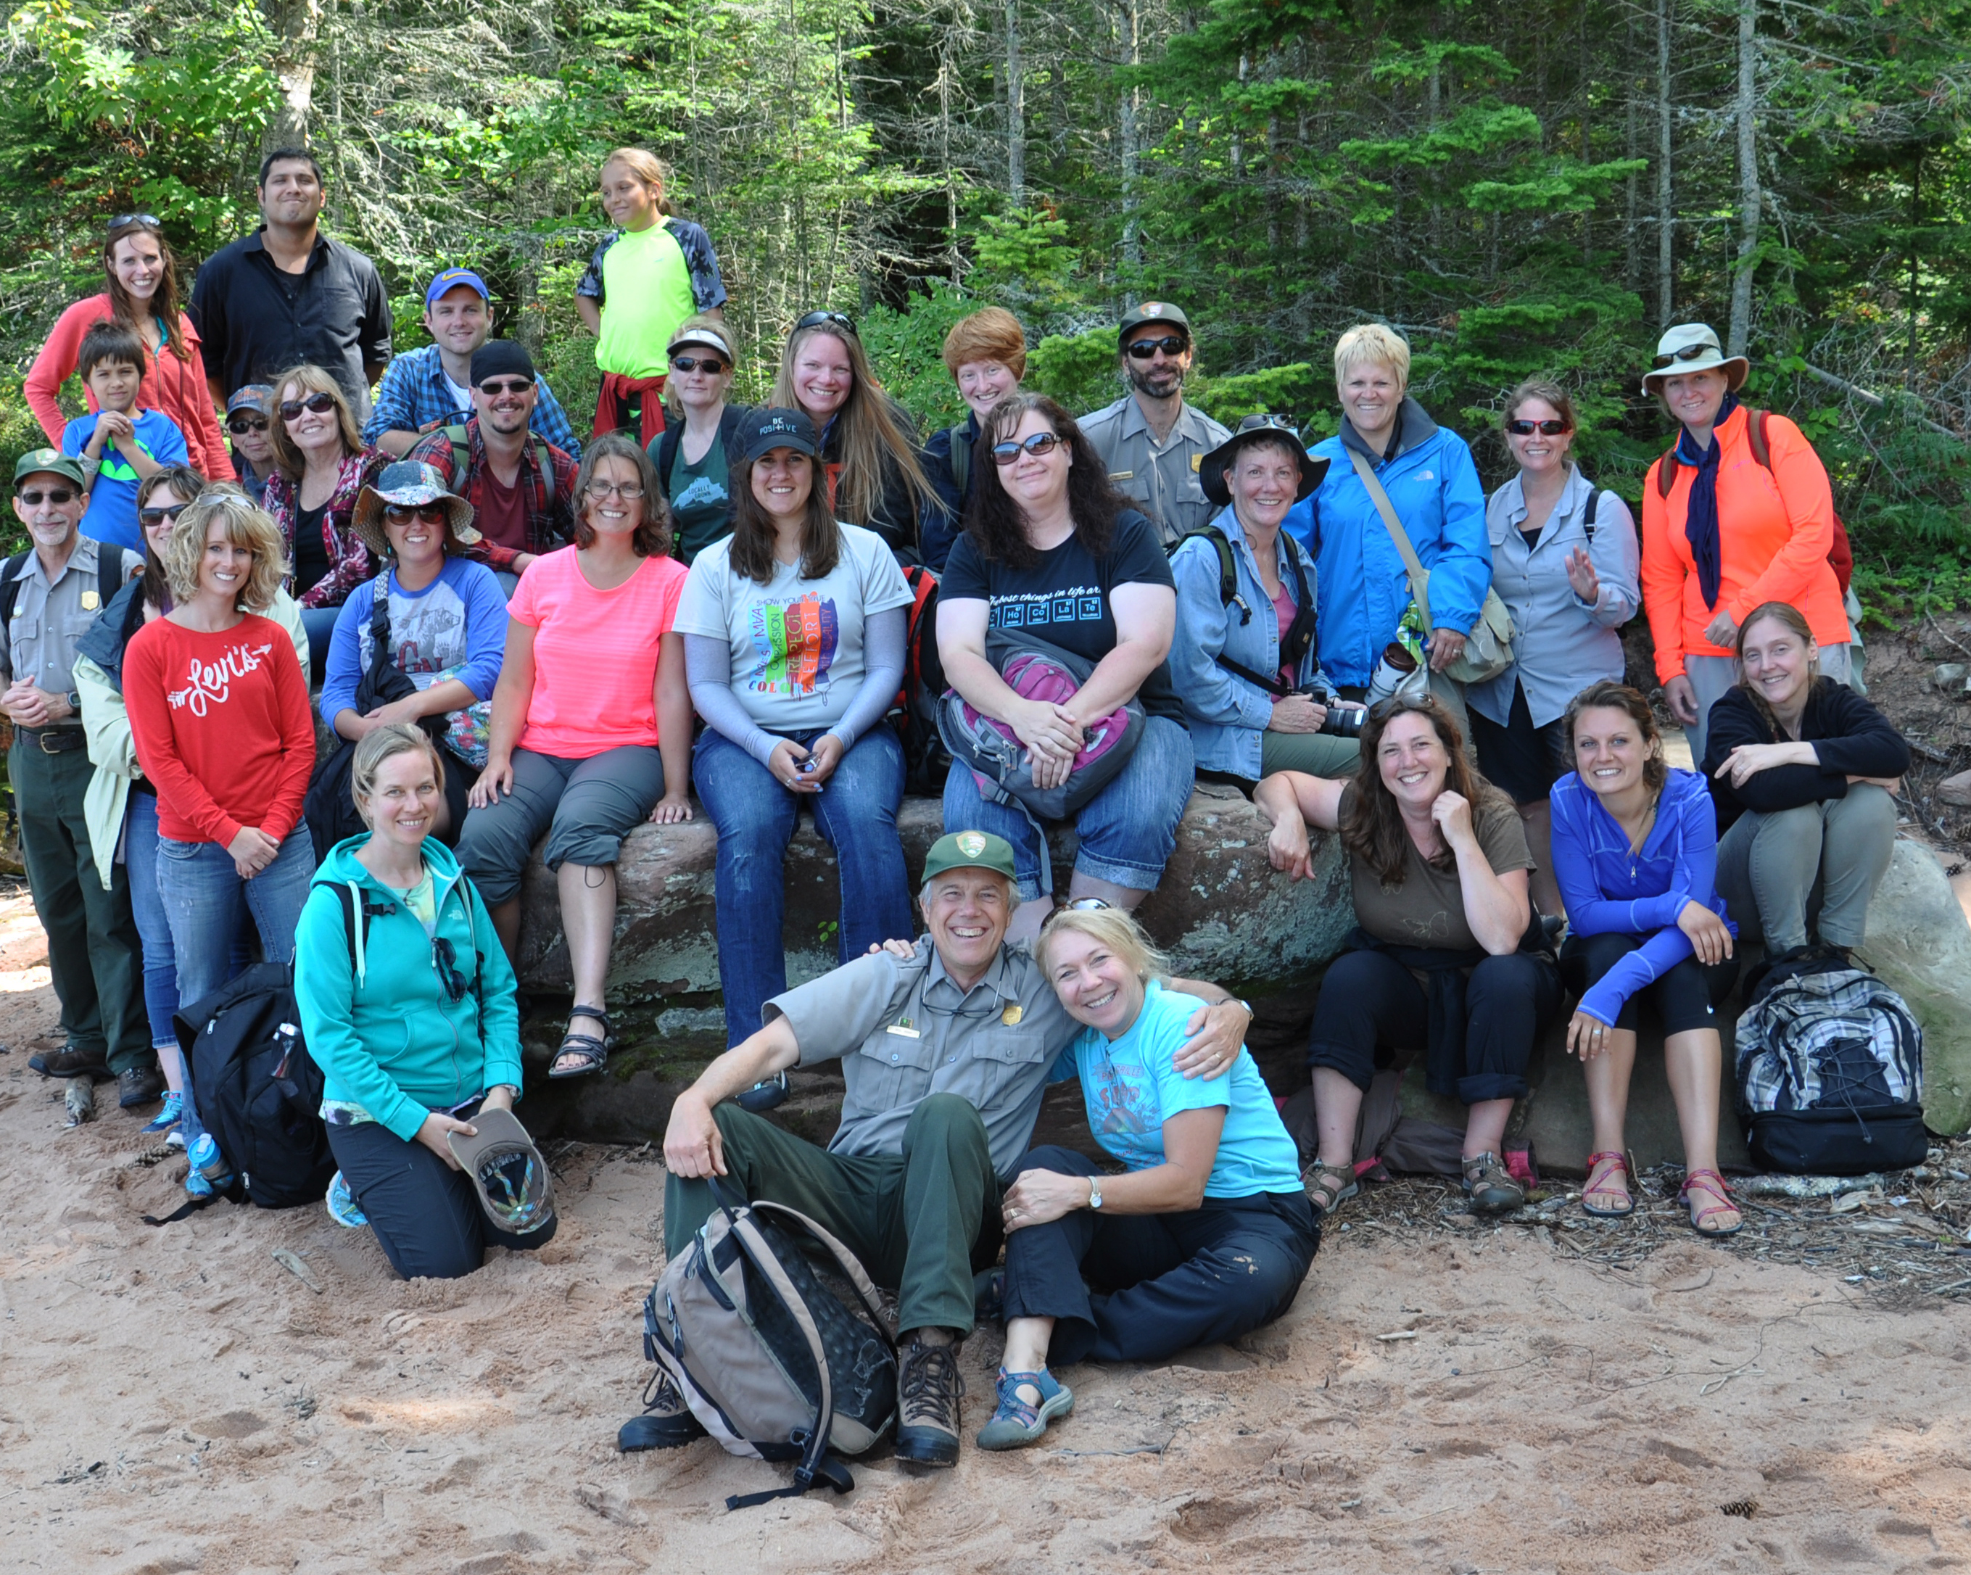
Questions?
Contact: pjcrusch@gmail.com
Notes:
Thank you
Cathy, Roxanne, Julie Ernst

