Slide 1
Needs Assessments Kadi Row & Jenna Klink Evaluation and Program Development Specialists Division of Extension
November 4, 2019

Slide 2
Overview of today’s content
The what and why of needs assessments
3 main steps to conducting a needs assessment
Further tips and resources

Slide 3
5 key points
They are not a one and done
They are collaborative efforts
It’s important to have multiple sources
Assets are as important as needs
There is help!

Slide 4
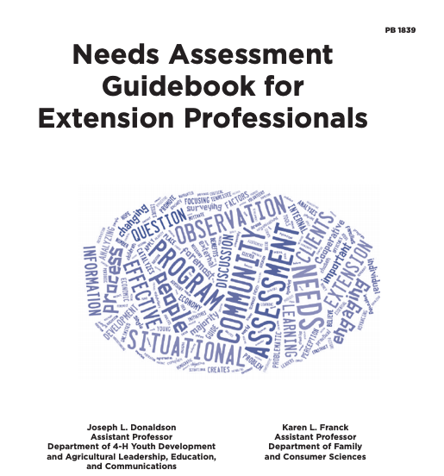
Rad Resource

Slide 5
Why/when have you done a needs assessment?

Slide 6
What is a needs assessment?
Process to identify what people/communities need and what assets exist
Used to focus a response
Not just a one and done
Credit: Needs Assessment Guidebook for Extension Professionals 2016. Donaldson & Franck. Univ. of Tennessee Extension PB 1938

Slide 7
Why needs assessment?
Gain deeper understanding of the community
Understand the context in a more objective way
Identify both needs and assets
Effectively plan your programming, focus your response

Slide 8
Understand the context
Seek to understand the issue, opportunity, or situation from multiple perspectives.
What is the issue, opportunity, or situation? Who is defining this? Who should be?
What things are assumed to be true about the context?
What is the context surrounding the issue, state of affairs, opportunity, and situation?

Slide 9
Who’s needs?
A particular audience (Farmers? Families?)
A particular geography (County? Community?)
Interface with other key players/stakeholders

Slide 10
3 Steps to a Needs Assessment
Step 1: Exploration of existing data
Keep your exploration focused on the purpose of your needs assessment
What do you (or others) already know?
Do you need additional information?
Who else needs to be involved? Consider a Needs Assessment Committee
Credit: Needs Assessment Guidebook for Extension Professionals 2016. Donaldson & Franck. Univ. of Tennessee Extension PB 1938

Slide 11
Using an Need Assessment Committee for needs assessment
Who should be involved?
What is their role?

Slide 12
3 Steps to a Needs Assessment
Step 2: Assessment
What new data do you need?
Who do you commonly get data on needs from?
Who aren’t you currently reaching and how might your learn from them?
What methods will help you get it?
Credit: Needs Assessment Guidebook for Extension Professionals 2016. Donaldson & Franck. Univ. of Tennessee Extension PB 1938

Slide 13
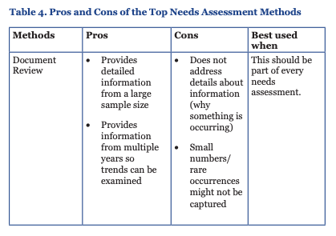
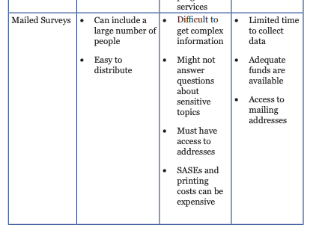
All methods have strengths and limitations
Credit: Needs Assessment Guidebook for Extension Professionals 2016. Donaldson & Franck. Univ. of Tennessee Extension PB 1938

Slide 14
3 Steps to a Needs Assessment
Step 2, con’t.: Assessment
Don’t collect information that you don’t intend to use
Use multiple methods to triangulate
Pilot your methods
Document what you are learning
Credit: Needs Assessment Guidebook for Extension Professionals 2016. Donaldson & Franck. Univ. of Tennessee Extension PB 1938

Slide 15
3 Steps to a Needs Assessment
Step 3: Utilization
This is the concrete tie to program planning
Use what you learn to set program priorities
Develop educational response
Credit: Needs Assessment Guidebook for Extension Professionals 2016. Donaldson & Franck. Univ. of Tennessee Extension PB 1938

Slide 16
Cautions and caveats in utilization
Disregarding issues
Allowing undue influence
Focus was too narrow or too broad
Relying on only one data source
Credit: Needs Assessment Guidebook for Extension Professionals 2016. Donaldson & Franck. Univ. of Tennessee Extension PB 1938

Slide 17
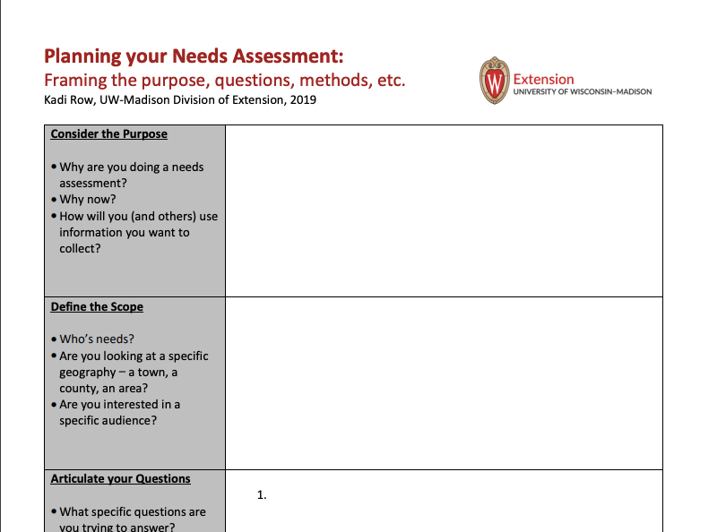
Resources to help you – Planning Worksheet

Slide 18
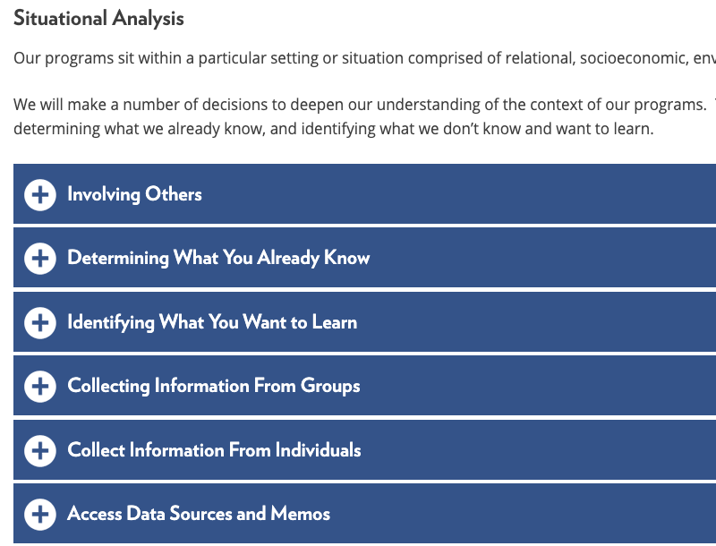
Resources to help you
PDE website – UW-Madison, Division of Extension
Needs Assessment Guidebook – UTenn Extension
Program Development
& Evaluation Specialists
Josset Gauley (CD and PYD)
Jenna Klink (HDR)
Kadi Row (AG and NR)
Shannon Sparks (HWB)
Colleagues in Extension Office of Access, Inclusion, and Compliance
Your Program Manager

Slide 19
Role of Program Manager
It’s a 2-way street
Program Manager:
Can help develop methods/tools for needs assessments
Provides guidance for programmatic response
Local Educators:
Have local insights to inform Program/Institute plans
Understand your audience/community

Slide 20
5 key points about Needs Assessments
They are not a one and done
They are collaborative efforts
It’s important to have multiple sources
Assets are as important as needs
There is help!

Slide 21
Assessment poll

