Slide 1
How Much Will It Cost?
And Can I Afford It?

Slide 2
Participants will:
Identify total cost of individual rental units.
Compare units based on total costs.
Practice balancing personal income and expenses.

Slide 3
What Do the Ads Tell You?
What is the address of the unit?
What is included in the rent?
What are the utilities the tenant pays?
Is there a hook-up charge? Is there a refundable deposit for utilities?
How much have these costs been in the past?
What other costs would the tenant be expected to pay? (i.e., pet deposit, parking, garage, damage deposit etc.)

Slide 4
Rental Cost Comparison
Unit | #1 | #2 | #3
Expense (initial cost)
Security deposit
Application deposit*
Other (for example, 1st & last month rent)
Total | $ | $ | $
Monthly Cost
Rent
Utilities
Water & sewer
Trash pick-up
Parking
Garage/storage
Cable
Internet
Maintenance (for example, lawn, snow)
Laundry
Transportation
Other
Total Money needed 1st month | $ | $ | $
When looking for a place to live, check out all the costs.

Slide 5
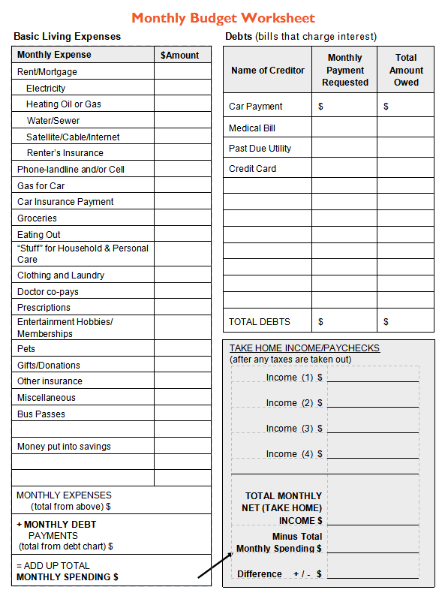
Monthly Budget Worksheet
Activity 3: handout 3

Slide 6
Paying the Rent
On Time, Every Month
Sunday | Monday | Tuesday | Wednesday | Thursday | Friday | Saturday
1 Rent due $450 | 2 | 3 | 4 | 5 | 6 Payday $240 $112.50 for rent | 7
8 | 9 | 10 Cable due $45 | 11 | 12 | 13 Payday $240 $112.50 for rent | 14
15 | 16 | 17 Heat and electric due $65 | 18 | 19 | 20 Payday $240 $112.50 for rent | 21
22 | 23 | 24 Phone due $40 | 25 | 26 | 27 Payday $240 $112.50 for rent | 28
29 | 30 | 31 | 1 Rent due $450

Slide 7
Track Spending
Notebook
Receipts
Calendar
Checkbook
Envelope
Electronically
Financial institution

Slide 8
Learning Assessment
List 2 reasons why it is important to compare rental properties before making a selection?
What are 2 monthly costs to keep in mind when determining the total monthly costs of a rental unit?
What are your 2 main sources of income?
What are your 2 largest expenses?
What are 2 ways to track spending?
What are 2 ways you could decrease expenses?

