Slide 1
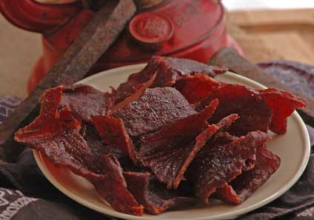

Preserving Safe, High Quality Meat
Lunch & Learn
12 noon to 1 pm
October 6, 2014

Slide 2



Audio Setup
Computer (VoIP) Audio
Phone Audio
1
Click on the Audio Setup Wizard button in the Audio & Video Panel.
1
Click on the blue telephone icon in the Audio & Video Panel.
2
2
Click to talk.
Dial the telephone number and PIN provided.
3
A icon by your name means your mic is on.

Slide 3

Need Help with Today’s Program?
Help Desk: 800-442-4614
Phone in to today’s program
  Toll: 630-424-2356
  Toll Free: 855-947-8255
  Passcode: 6774570#
Program will be archived:
http://fyi.uwex.edu/safepreserving/webinars/

Slide 4
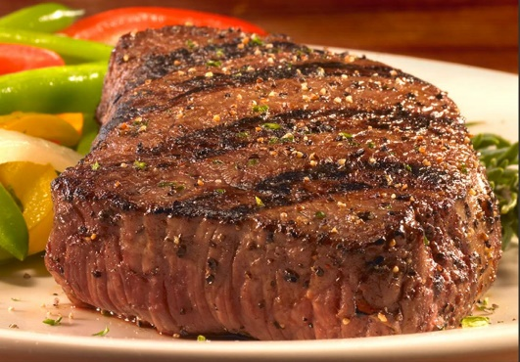
Resources
How Do I... www.uga.edu/nchfp
  Can Poultry, Red Meats and Seafoods
  Dry Jerky
  Freeze Fish, Meat, Poultry
UWEX Food Safety: A-Z index J=Jerky www.foodsafety.wisc.edu
  Instructions for Making Safe Jerky at Home
  Making Safe Jerky in a Home Dehydrator
  Preparing Safer Jerky
UWEX: Canning Meat, Wild Game, Poultry and Fish Safely (B3345) http://fyi.uwex.edu/safepreserving/recipes/

Slide 5
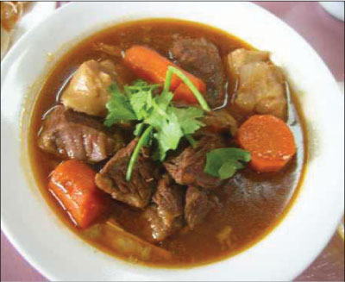
Start with Quality Meats
Preserve only those meats that have been handled under sanitary conditions, including wild game
  So You Got a Deer
  www.uwex.edu/ces/ag/issues/fmd/So_you_got_a_deer-G1598.pdf
  Safe Deer Processing (videos)
  http://www.cwd-info.org/index.php/fuseaction/about.video
  Handling Venison Safely (A-Z index H=Hunting)
Best quality will be achieved with lean meat, poultry, and fish
Handle meat, poultry and fish to avoid contamination with pathogens….and avoid contaminating other foods with meat juices!

Slide 6
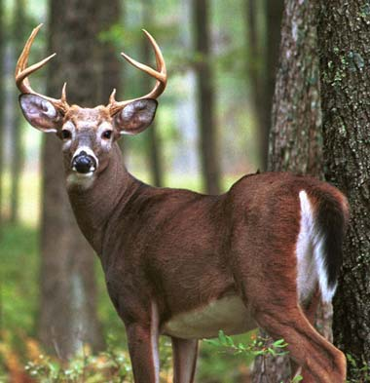
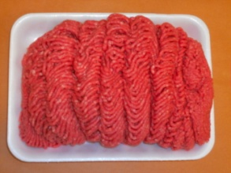
Preserving Beef and Venison
Handle venison safely to prevent contamination
  Consult DNR resources for current information on Chronic Wasting Disease (CWD)
  dnr.wi.gov/topic/wildlifehabitat/regulations.html
Choose lean meat that is fresh and has been kept cold
Meat may be frozen, canned, or dried
  Avoid freezing meat in grocery store tray-pack
  Repackage using packaging suitable for the freezer: freezer paper, aluminum foil, freezer bags, or a combination
  Debone meat for easier freezing and thawing
  Freeze lean meats for up to 12 months, cured meats or fatty cuts of meat for up to 3 months

Slide 7

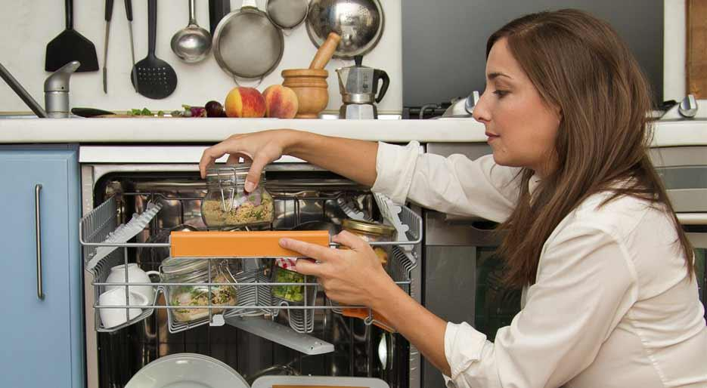
Canning Meat
Cells and spores of C. botulinum
Meat and other low-acid foods must be canned in a pressure canner to avoid botulism poisoning
Spores of Clostridium botulinum can germinate, grow, and produce toxin when the conditions are right
  Botulism toxin is one of the deadliest toxins known
  Meat and other low-acid foods may contain the toxin without looking spoiled
A pressure canner uses high temperature to destroy botulinum spores.
  Oven canning, boiling water canning, and
  dishwasher canning of meat is very unsafe!
Notes:
Some bacteria produce spores. Spores are a normal part of the life cycle of these bacteria. The bacteria occur as vegetative cells or as spores.
Spores are a dormant stage of life and can survive many harsh conditions (heat, cold, exposure to chemicals). Some bacterial spores can survive in boiling water 212 F for more than 16 hours. The same organism in the vegetative state would not survive in boiling water at all.
Spores have been compared to plant seeds in that they will germinate and grow when the conditions are right.

Slide 8
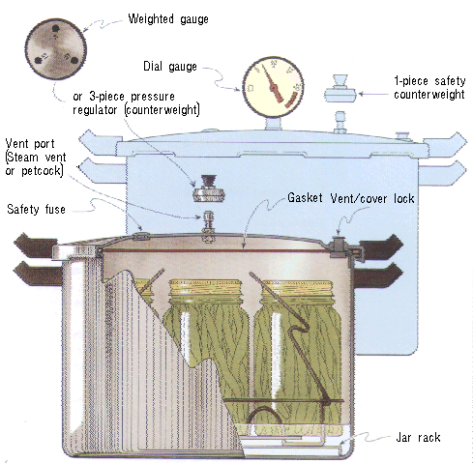
Pressure Canning
Process at high temperatures
(240°F and above)
Dial gauge measures incremental changes in pressure
Weighted gauge measures pressure at 5,10, or 15 pounds (psi)
Weighted Gauge
Dial Gauge
The pressure in these canners raises the temperature above the boiling point of water and allows safe processing of low-acid foods.

Slide 9
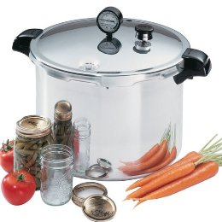
Steps for Pressure Canning
Place filled jars on a rack in a pressure canner filled with ~2 quarts of water
Seal canner by tightening lid, turn heat on high, and once a full column of steam is produced, vent for 10 minutes
After venting, close vent port and bring canner to pressure
  11 psi dial gauge
  10 or 15 psi weighted gauge
Process for the required time
Turn heat off and allow to canner to cool naturally
  NEVER force cool a canner

Slide 10
Canning Meat
Safe canning times for meat:
  Allow heat to penetrate to the cold spot in the jar and throughout the food
  Reach temperatures needed to destroy harmful bacteria and spores
Trim meat of fat, bruises and heavy gristle
Use only the jar size and packing style listed
  Consider canning venison in tomato-juice
Process for the time listed; adjust for elevation
The darker areas of the state indicate elevations above 1,000 feet. Increase processing pressure from 10 psi to 15 psi for a weighted gauge canner. Process in a dial gauge canner at 11 psi.

Slide 11
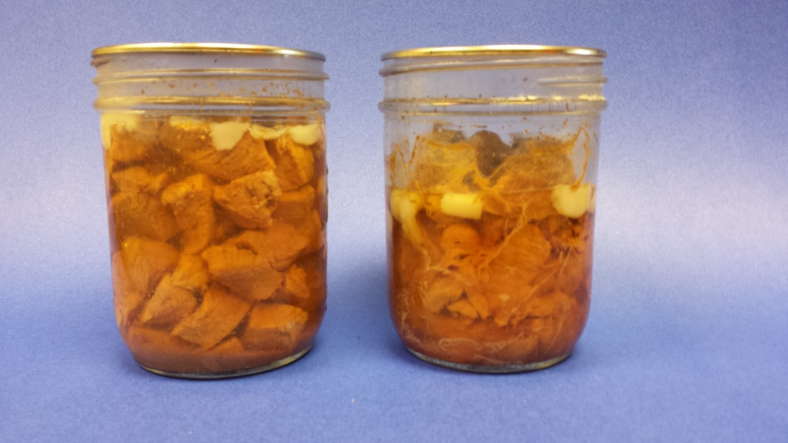
Hot Pack or Raw Pack? (same processing time)
Hot Pack
Meat roasted or browned prior to packing into jars
Allows:
  More meat in jars
  Good color
  Added flavor
Raw Pack
Raw meat loosely packed in jars – no added liquid
Quick & easy to do
NOTE: the long processing times for meat ALLOW you to add a bit of onion, garlic or seasoning and still have a safe recipe
Left:
Beef hot packed
Right:
Beef raw packed
Image courtesy of Chris Kniep, Winnebago County

Slide 12
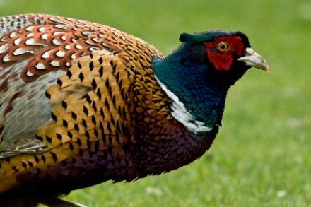
Poultry, Rabbit & Small Game
Carefully skin and dress wild game and game birds.
Remove fat, especially excess fat, on poultry and game – it quickly becomes rancid on freezing and interferes with canning.
Do not stuff poultry or game birds prior to freezing.
For best flavor, soak small game in brine prior to canning.
Can poultry and small game with or without bones.

Slide 13
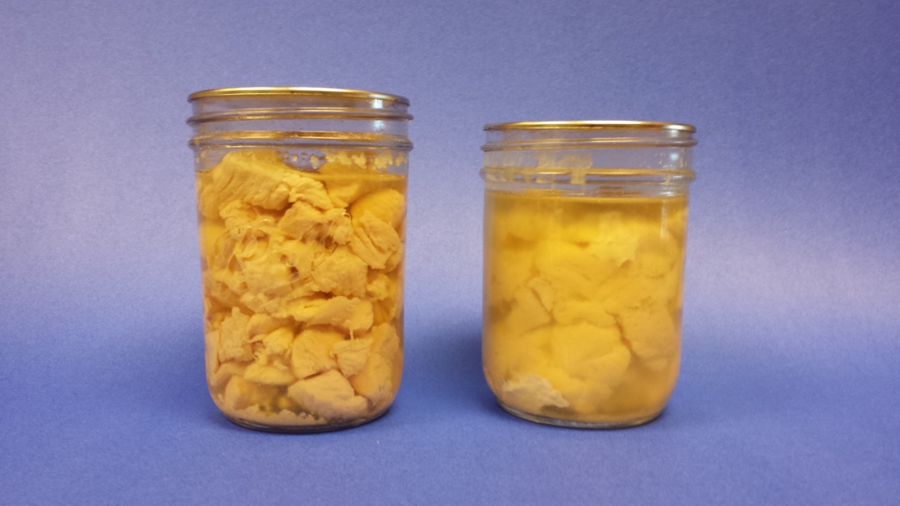
Hot Pack or Raw Pack?
(same processing time for pack method; longer processing time for bone-in poultry)
Hot Pack
Bake until 2/3 done
Added flavor from browning
and broth
Raw Pack
Pack raw chicken loosely in jars
Quick & easy to do
Left:
Chicken hot packed
Right:
Chicken raw packed
Image courtesy of Chris Kniep, Winnebago County

Slide 14
Canning Meat Mixtures
Because of the long processing times for meat and poultry, many meat mixtures may be safely canned, using the processing times for meats.
Follow a hot-pack procedure
Mix meat with vegetables which require similar processing times
Do not thicken or add pasta, rice, or fat. An unsafe product may result!

Slide 15
Freezing Fish
Fish is highly perishable; store no more than 2 days.
Fish caught should be kept on ice or in cold water. Clean and gut fish within 24 hours.
Pre-treat prior to freezing to improve quality-
    Dip fatty fish for 20 sec in ascorbic acid solution
    Dip lean fish in salt brine
Packaging
  Lemon-gelatin glaze: dip cold fish in lemon juice/ water/gelatin dip
  Ice glaze: dip frozen fish in near-freezing ice water
  Water: create a fish ‘popsicle’

Slide 16

Freezing Fish
Freeze and store fish at 0°F or colder.
Up to 3 months for fatty fish.
  Salmon, smelt, lake trout. The fat in these fish can oxidize and they can loose flavor if stored too long.
Up to 6 months for lean fish.
  Perch, walleye, pan fish. Lean fish are better preserved frozen than canned.

Slide 17
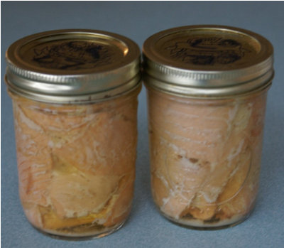
Canning Fish
Species of fish suitable for canning include catfish, Northern pike, salmon, smelt and trout.
Fish is usually canned in pint jars; extra care must be taken when canning in quart jars (smoked fish can only be canned in pints).
Process ½-pints for the time listed for pints.
Fish is a low-acid food and must be canned in a pressure canner.
Fish are raw-packed prior to canning.
The types of C. botulinum spores in water are hard to destroy. Fish is processed for 100 min (pints) or more!

Slide 18
Making Safe Jerky
Jerky can be made from beef, venison, pork or poultry.
Pork or wild game for jerky should be treated to kill the trichinella parasite prior to jerky making:
  Freeze at 0°F (or colder) for at least 30 days
Partially freeze meat for easier slicing
  Slice no more than ¼” thick
  Trim and discard all fat
  Marinade as desired
Ground meat can be used to make jerky.
  Use only lean/very lean meat of 10% fat or less.
  Prepare strips no more than ¼” thick.
  Add dry spices to meat for flavor.

Slide 19
Drying Jerky
Blot marinated strips dry, and arrange on dehydrator racks or trays.
Dry in a dehydrator, or oven, preheated to 145°F or higher.
  Begin checking at 3 hours. Dried meat is firm but flexible. Meat should reach an internal temperature of 160°F or higher.
  Blot off any beads of oil with a clean paper towel.
  Cool and package. Store 2 weeks at room temperature, up to 3 months in the freezer.
  A safety-assured product is made by adding a post-drying oven heating step: 10 min in a preheated 275°F oven

Slide 20
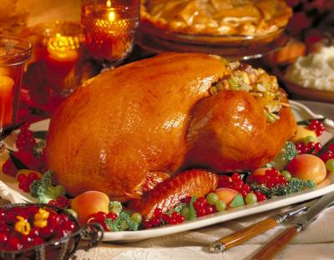
Lunchtime Learning
November 3 – A Food-Safe Thanksgiving & Crock Pot Food Safety
Tips for preparing a safe holiday meal, and ideas for using your crock pot safely.
All slides and audio files are archived:
http://fyi.uwex.edu/safepreserving/webinars/

