Slide 1
Homeowners in Distress: Preventing Foreclosures Strategies to Help Homeowners
J. Michael Collins & Deb Neubauer
University of Wisconsin Cooperative Extension
October 20, 2010

Slide 2
Overview
Current issues
Data on foreclosure
WHPE educational materials
Strategies
Dane County Case Study

Slide 3
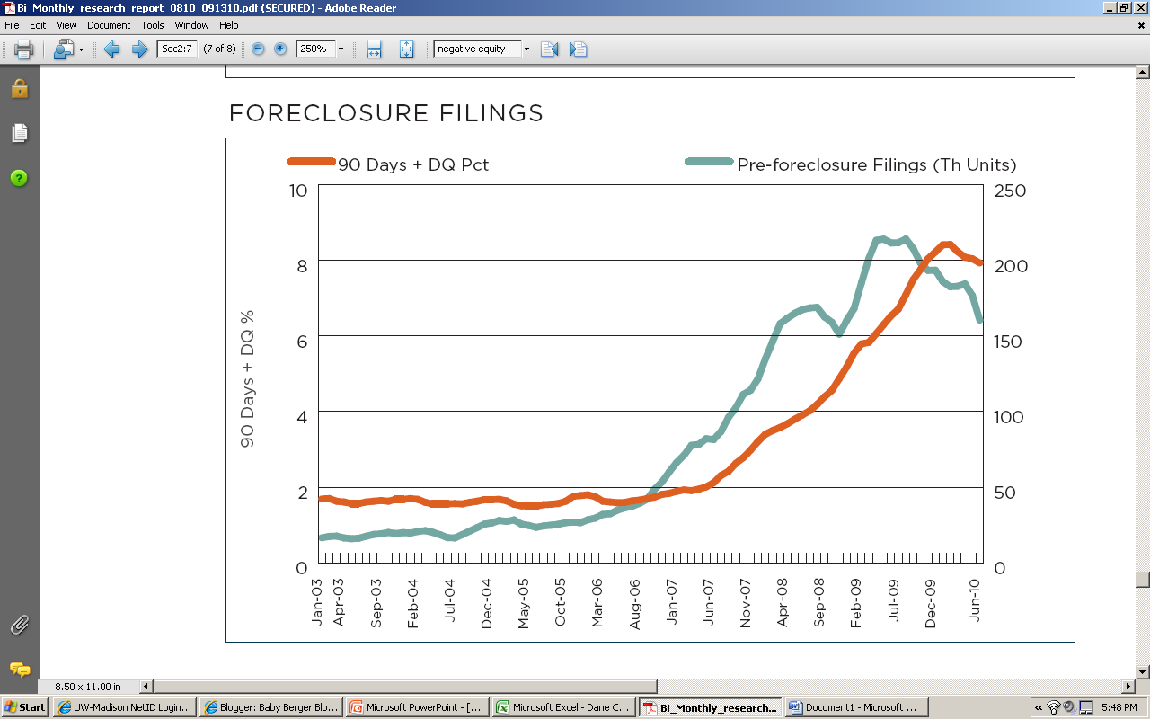
Nationally Expecting Wave of Foreclosures Soon…
CoreLogic, formerly First American Corporation, www.corelogic.com

Slide 4
Distressed Sales Rising
National Home Sales by Segment
CoreLogic, formerly First American Corporation, www.corelogic.com

Slide 5
Who is Affected?

Slide 6
High Area Unemployment Correlated with REOs

Slide 7
Data for Wisconsin
http://www.uwex.edu/ces/cced/economies/communityindicators/Indicators_Links.cfm#q2_2010

Slide 8
Foreclosure Filings | 2010 (thru June) | 2009
Adams | 90 | 171
Ashland | 33 | 57
Barron | 107 | 227
Bayfield | 35 | 67
Brown | 597 | 1097
Buffalo | 10 | 44
Burnett | 83 | 139
Calumet | 82 | 160
Chippewa | 145 | 272
Clark | 69 | 126
Columbia | 172 | 349
Crawford | 43 | 58
Dane | 801 | 1550
Dodge | 232 | 446
Door | 72 | 143
Douglas | 115 | 224
Dunn | 99 | 197
Eau Claire | 172 | 335
Florence | 11 | 16
Fon du Lac | 188 | 449
Forest | 18 | 37
Grant | 50 | 101
Green | 82 | 164
Green Lake | 43 | 101
Iowa | 69 | 101
Iron | 16 | 33
Jackson | 36 | 72
Jefferson | 209 | 399
Juneau | 84 | 193
Kenosha | 628 | 1238
Kewaunee | 46 | 95
La Crosse | 156 | 339
Lafayette | 33 | 78
Langlade | 60 | 105
Lincoln | 57 | 142
Filings by County | 2010 (thru June) | 2009
Manitowoc | 179 | 301
Marathon | 283 | 505
Marinette | 114 | 260
Marquette | 51 | 113
Menominee | 0 | 6
Milwaukee | 3071 | 6323
Monroe | 88 | 188
Oconto | 125 | 261
Oneida | 115 | 232
Outagamie | 417 | 770
Ozaukee | 124 | 266
Pepin | 18 | 37
Pierce | 121 | 254
Polk | 180 | 408
Portage |  | 0
Price | 33 | 64
Racine | 630 | 1221
Richland | 45 | 64
Rock | 532 | 1165
Rusk | 37 | 62
Sauk | 176 | 381
Sawyer | 59 | 122
Shawano | 114 | 213
Sheboygan | 278 | 547
St. Croix | 353 | 753
Taylor | 38 | 78
Trempealeau | 32 | 100
Vernon | 47 | 81
Vilas | 85 | 159
Walworth | 404 | 726
Washburn | 57 | 118
Washington | 270 | 552
Waukesha | 783 | 1335
Waupaca | 160 | 338
Waushara | 79 | 158
Winnebago | 382 | 787
Wood | 118 | 259
Wisconsin (sans Portage) | 14341 | 27967

Slide 9
Common Themes of Interviews with People in Foreclosure Process
School aged kids – minimize disruption
Relationship issues
Pride management with family & peers
Lack of trust in institutions
Some exceptions for ‘helpful’ counselors / agencies
Communication / Education is challenge
Lack internet, limited phone, time constrained
Interest in budgeting (reformed spendthrifts)

Slide 10
Financially Strapped
“I am on unemployment and I am about ready to declare bankruptcy. I can’t do consumer credit counseling b/c I am not employed. All my unemployment checks go toward paying my two mortgages. I am $19k in debt. I would like to save but I need to work in order to save.”
- married woman in 40s
By late delinquency (180+ days)
Tapped out family
Cashed in / borrowed from 401k
Austerity budgeting

Slide 11
Emotional Toll
“I had a job where I could work overtime when I wanted. So I bought a lot of toys (motorcycle, trucks, etc.). Then they got repossessed. I found it devastating. It was so embarrassing. Now I have one vehicle – the one that is most practical – and it is hard. I did not realize my unemployment would be so long. I did not think it would happen to me.” – male in 50s
Unwilling to reveal extent of needs
Not seeking advice in community

Slide 12
Hard to Reach / Not Accessing Information
“I have access to the internet through the library. I simply cannot afford it at home. There is a lot of waiting and stuff so it makes it difficult. I do have an internet account at work but limited so I can’t really do a search at work.”
Single mother in 30s
Reaching people – phone, mail, web – all limited

Slide 13
When during the month are people looking for help?
Source: MortgageKeeper.org, September 2010 Referrals by Counselors

Slide 14
Most Common: Food, Job, Utilities
Source: MortgageKeeper.org, 2009-2010 Referrals by Counselors

Slide 15
Typology of Consumers in Distress (Negative Trigger Events)
Income disruption, but potential to work
Job loss/cutback (relocation options)
Divorce (child support issues)
Widow/er (may have limited work options)
Disability
Chronic (DI application process)
Health crisis
Acute or ongoing expenses (medical debt management)
Investor (not all are speculators)
tenant eviction issues
subsidized units
Small business failure (non-real estate)
Sale / bankruptcy (special issues if farm)
Strategic defaulters

Slide 16
Providing Services
Prevention
People not in default, but worried
Early Intervention
Missed 1-2 payments
Late Intervention
Missed 3+ payments
Transitional Support
Short sale or foreclosure auction

Slide 17
Early Intervention is the Ideal
Source: Collins & Schmeiser, 2010

Slide 18
http://fyi.uwex.edu/whpe/

Slide 19
WHPE Themes
Financial Issues of Owning a Home
Physical Issues of Owning a Home
When Things Go Wrong

Slide 20
1. Budgeting Basics
The goals of this chapter are:
Understanding your situation.
The benefits of and process for creating a spending plan.
To discuss financial priorities and goals and the steps needed to achieve them.

Slide 21
2. Making Ends Meet
The goals of this chapter are:
Show resources that may be available.
Understanding benefits and assistance programs, as well as tax credits.
Address embarrassment of help seeking.
Programs can have complicated details. Be patient and take time to learn your options.

Slide 22
3. Credit Management & Counseling
The goals of this chapter are:
To overview the benefits and drawbacks of debt.
How review a credit report.
Understand credit scores
Options for managing debt.
Take-away messages:
Always keep an eye on your credit—it affects more than you think.
Manage an economic hardship with the least damage to your credit record.
Check your credit score.
Bankruptcy and repayment are options but will not make your financial problems go away.

Slide 23
4. Understanding Default & Foreclosure
The goals of this chapter are:
Background into how and why default and foreclosure occur.
Alternatives to foreclosure
The legal process of foreclosure.
Take-away messages:
Losing your home to foreclosure is in no one’s best interest; understand your options.
Decide if you want to stay and are committed to repaying the loan; if not look into a sale.
Talk to your lender.
Take time to learn details of programs and follow up on every detail; Don’t be derailed by paperwork.
Ask for help but be careful of anyone offering a quick fix.

Slide 24
5. Keeping Organized
The goals of this chapter are:
To help you embrace the benefits of being organized.
To provide you with the tools to make smart decisions when purchasing Insurance.
To encourage and guide you in creating your own household organizational system.
To provide advice on which records should be kept and where.
Take-away messages:
Paperwork matters!
Know what to store and where to store it.
Plan for the unexpected.

Slide 25
6. Maintaining Your Home
The goals of this chapter are:
Understand the responsibilities of owning a home.
Provide tools to help budget for repairs.
Understand the costs and benefits of financing repairs and remodels.
Take-away messages:
A lot goes into owning a home beyond simply choosing what color to paint the walls.
Staying on top of home maintenance is important to save money in the long run.
Energy efficiency and proper insurance can also save you money over time.

Slide 26
7. Refinancing
The goals of this chapter are:
To illustrate the hidden costs that interest adds to a mortgage payment.
To explain how refinancing can save homeowners money.
To explain some of the fees associated with refinancing.
Take-away messages:
Over the course of a loan, you will pay much more than you originally borrowed.
Refinancing a loan can save you a lot of money on interest that you will not have to pay.

Slide 27
Dane County Example
Identifying Problems
Community Coalition
Strategies
Role of Cooperative Extension

Slide 28
Websites
Home Ownership Preservation Foundation www.995hope.org
Wisconsin Housing and Economic Development Authority www.wisconsinforeclosureresource.com

Slide 29
Deb Neubauer
Dane County Financial Education Center
Lower Level, Suite 005
2300 S Park Street
Madison, WI 53713
(608) 261-5077
Fax: (608) 261-9727
deb.neubauer@ces.uwex.edu
For More Information: http://fec.uwex.edu
J. Michael Collins
Faculty Director, Center for Financial Security
University of Wisconsin-Madison
7401 Social Science, 1180 Observatory Drive
Madison, WI 53706
608-616-0369
jmcollins@wisc.edu
For More Information: cfs.wisc.edu

