Slide 1
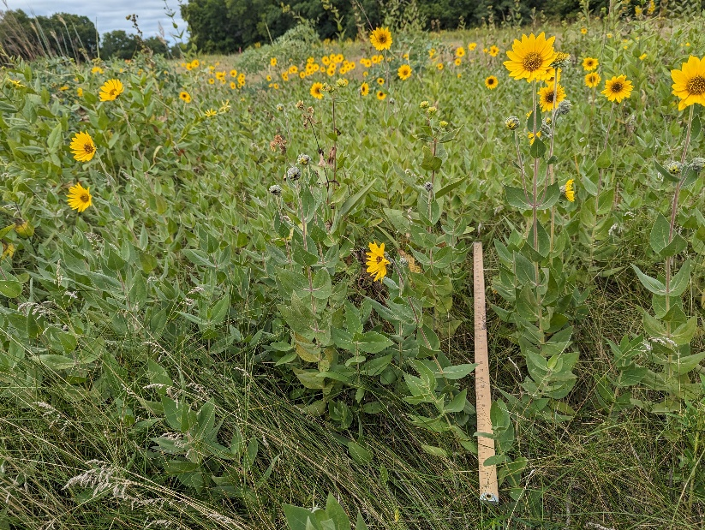
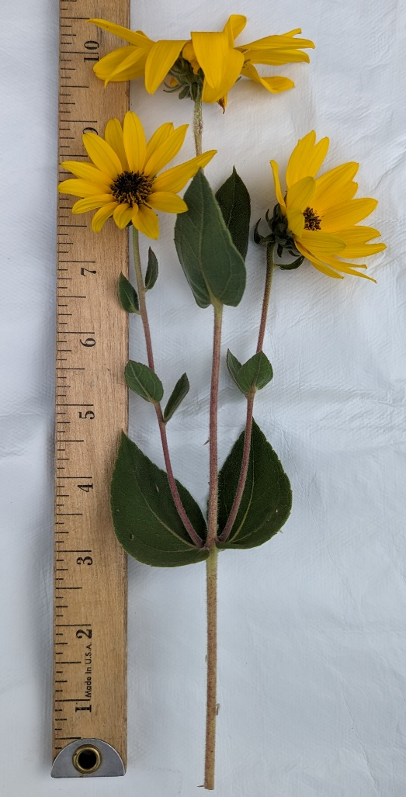
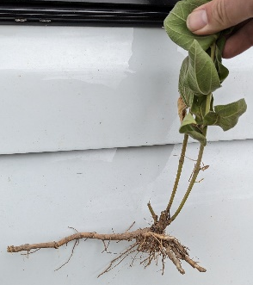
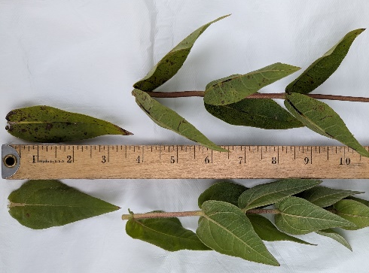

Wisconsin Weed Identification ashy sunflower – Helianthus mollis Lam.
Life History: Ashy sunflower is a warm-season, perennial forb in the Asteraceae (sunflower) family. It is typically found growing in well-drained soils and full sun. Can be aggressive in prairies.
Leaves: Leaves are opposite, stiff, ascending, lacking a petiole, truncate to lobed with clasping hairy grayish-green surface. Up 4.75 inches long and 3.25 inches wide but highly varied. Leaf margins are smooth (entire) to shallowly toothed with a pointed tip.
Ashy sunflower in a native prairie.
Flower/Fruit: Flowers consists of single flower heads (1-1.25 inches wide) on terminating stems. Blooms late, starting in September. Fruits are achenes, wedge shaped, dark-brown or black, tipped by two scales with pointed tips enclosing a small single seed.
Stem/Root: Stems are erect, solitary to clustered, densely hairy, gray brown, growing to a height of 4 feet. Grows from rhizomes in spreading patches.
Rhizomes robust, perennial.
Similar Plants: Rosinweed and other sunflowers have similar flowers, but leaves are rough (sandpaper) unlike ashy sunflower’s softer leaves. The dusty grey appearance of ashy sunflower leaves sets it apart from other Asteraceae.
Ashy sunflower stems, leaves, and flowers.
Rosinweed (top) has rougher, more lance shaped leaves.
More information?
Visit renzweedscience.cals.wisc.edu
Photos/layout by Matthew Wallrath
Revised 9/2023

